Slide 1
Year 8
Remote Learning Term 5
Week 3

Slide 2
Lesson 3 Developing Brechtian Techniques
ALL: To explore the Brechtian technique.
MOST: To develop and apply the Brechtian techniques to a performance.
SOME: To lead and direct a piece of drama including the A Effect techniques.
Notes:
Lesson 3

Slide 3

What careers are there to do with devising/creating Drama?
Discuss with you group and feedback to the whole class

Slide 4
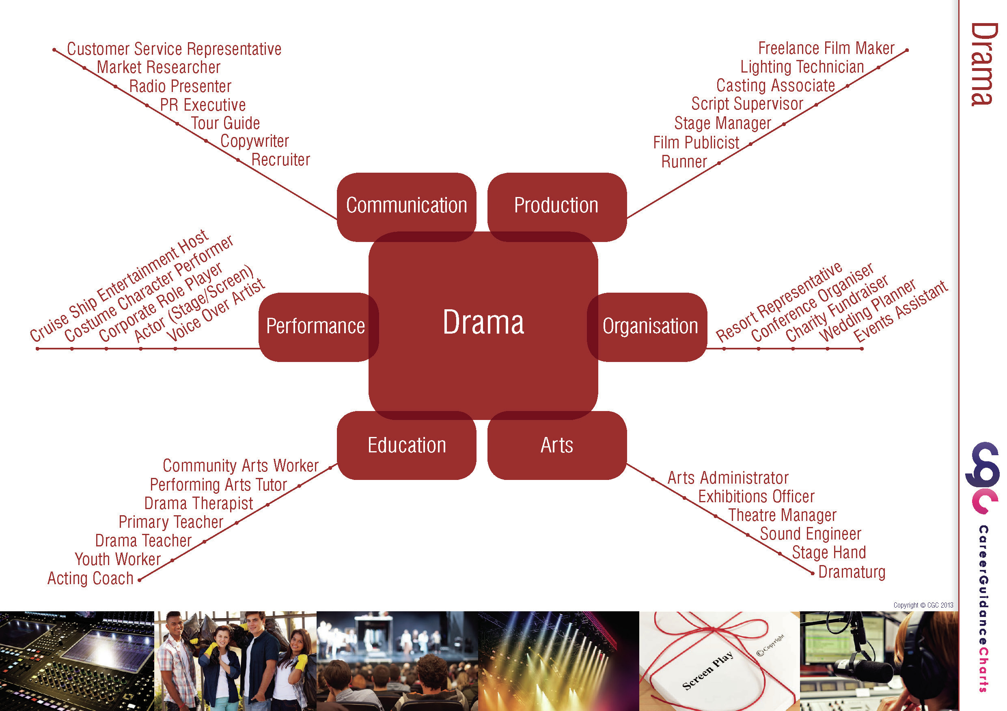
Notes:
Careers in the Theatre

Slide 5
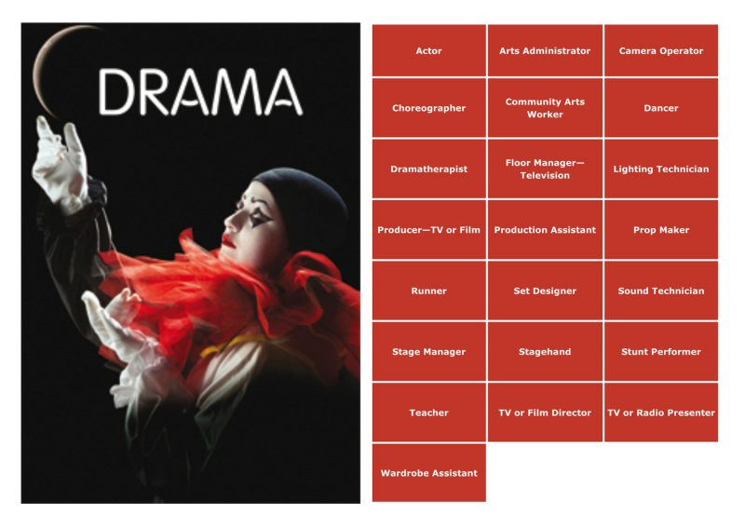
Theatre Careers

Slide 6
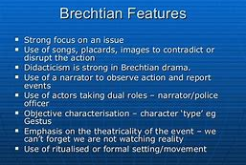
What Brecht techniques can you remember?

Slide 7

Devise and write an scene based on the picture
These are some of the drama techniques used to make sure audiences would not get too attached to the story: (Brecht Techniques to use)
Narration
Third Person Narration
Speaking Stage Directions
Direct Address
Using Placards
Multi-Role
Split Role
Notes:
Rehearse and Perform 1 -2 minute performance.

Slide 8

Email your completed work to your Drama Teacher
Mrs Lake
Mrs Hawkins
Miss Jefferies

