Slide 1
Year 8
Remote learning Term 5
Week 4

Slide 2
Lesson 4 Devising and Brecht
Outcome: To devise an Epic theatre performance using Brechtian techniques
ALL: Show an understanding of Brechtian Techniques, Perform, perhaps a little shy and apply newly learnt skills like placarding with expression.
MOST: Show a good understanding of Brechtian Techniques, Perform confidently and apply newly learnt skills like placarding with expression in the performance
SOME: Show a very good understanding of the alienation technique, perform confidently, work carefully in your group to and remain focused on applying new skills.
Notes:
Lesson 4

Slide 3
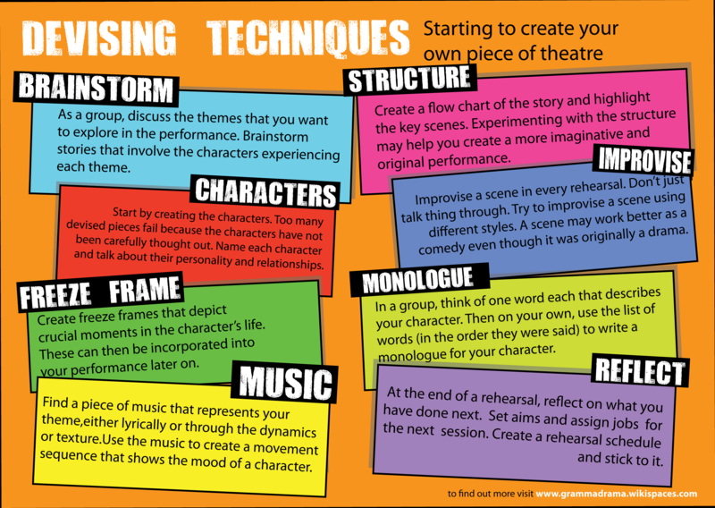
Assessment Performance Piece

Slide 4
Exploring stimulus material
In drama, we sometimes use our imaginations to create a performance piece with a meaningful message or idea behind it that we want to communicate to our audience. Drama can be inspired by many different things, and one such thing is an image.
In groups, look at the collage of images. Discuss:
What the images appear to show
How they are similar/ different
What the images make you think of and feel
Any questions that they raise for you
Key or interesting details within the images
Notes:
Decide which picture to use for your group – differentiated picture collages

Slide 5
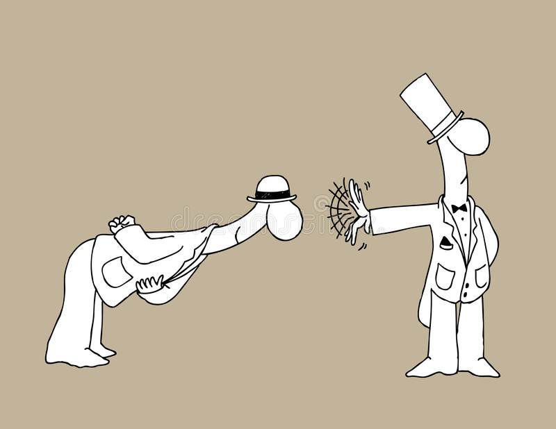
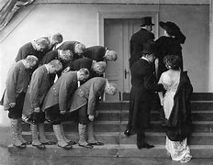
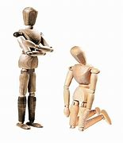
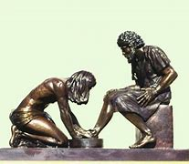
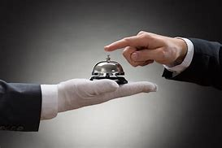
Notes:
Stimulus 1 –Easy

Slide 6

Ideas
Now that you have looked at the images, start to think about what sort of performance piece you could create, based upon one, or several of these ideas.
Your task now is to provide a brief outline of 3 different concepts for a performance. You should think carefully about:
Characters
Events (plot)
Messages for the audience

Slide 7

You need to produce three ideas in your group.
 | Idea 1 | Idea 2 | Idea 3
Characters
Events (plot)
Messages
Other (props, settings, etc)

Slide 8

Email your completed work to your Drama Teacher
Mrs Lake
Mrs Hawkins
Miss Jefferies

