Slide 1
Year 8
Remote Learning Term 5
Week 5

Slide 2

You need to produce three ideas in your group.
 | Idea 1 | Idea 2 | Idea 3
Characters
Events (plot)
Messages
Other (props, settings, etc)

Slide 3
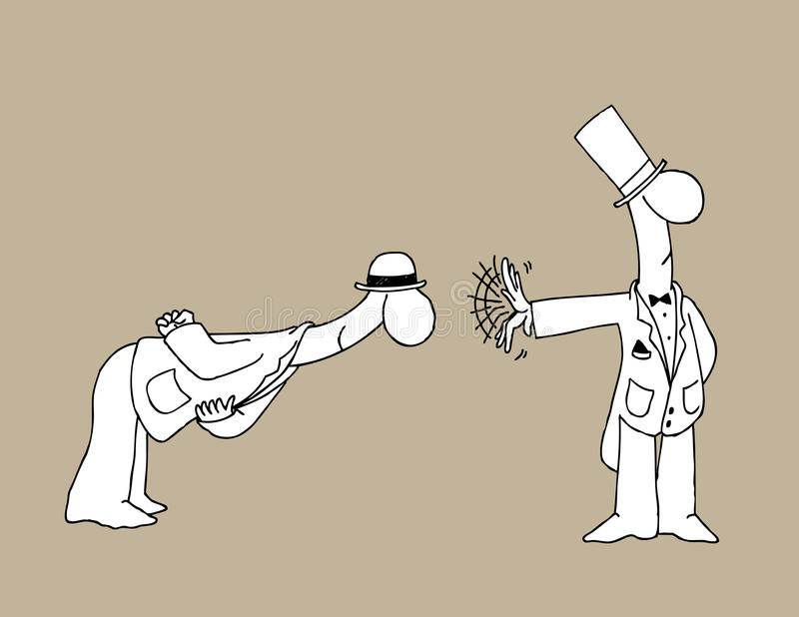
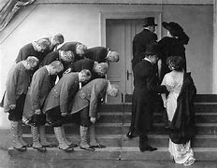
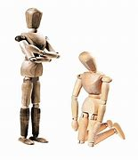
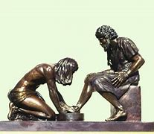
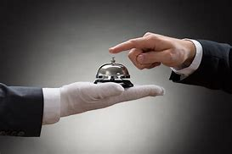
Notes:
Stimulus 1 –Easy

Slide 4
Developing your ideas
The next process is for you to decide which of your ideas has the most dramatic and artistic potential.
Present your ideas to the members of your group and discuss which is your favorite. It might be the case that you use a mixture of different concepts to create the perfect idea.
Now that you have decided upon your idea, you must start to further develop it. There are a series of tasks for you to complete over the following pages. They include:
A storyboard of your plot
Character profiles for 3 key characters
· A scripted opening (HWK TASK)

Slide 5
Storyboard your idea (Non-linear structure)
Episode 1 | Episode 2 | Episode 3 | Episode 4
Episode 5 | Episode 6 | Episode 7 | Episode 8

Slide 6

Email your completed work to your Drama Teacher
Mrs Lake
Mrs Hawkins
Miss Jefferies

