Slide 1
Year 8
Remote Learning Term 5
Week 6

Slide 2
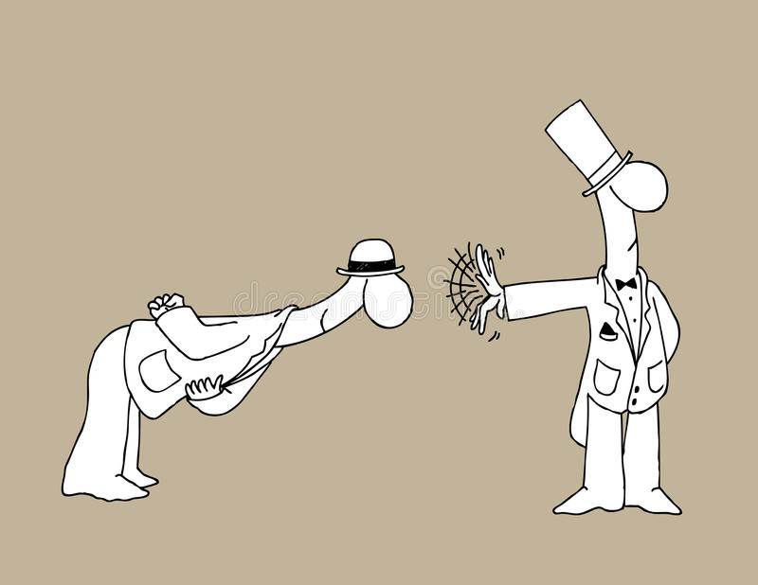
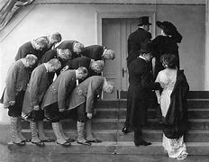

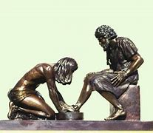

Notes:
Stimulus 1 –Easy

Slide 3

You need to produce three ideas in your group.
 | Idea 1 | Idea 2 | Idea 3
Characters
Events (plot)
Messages
Other (props, settings, etc)

Slide 4
Storyboard your idea (Non-linear structure)
Episode 1 | Episode 2 | Episode 3 | Episode 4
Episode 5 | Episode 6 | Episode 7 | Episode 8

Slide 5
Task
Scripted opening
Below are some basic conventions of script writing to prepare you for writing your own scripted opening
1. Setting the scene at the start of a play is known as a SLUGLINE (this is italicised)
e.g. A busy park, night time, dim lighting and rubbish scattered on the floor
2. NARRATION is where you set up the scene or give part of the backstory to the actors. Again this usually goes at the start and is in italics
E.g. BARRY is a 17 year old who has had a difficult life. He is often sullen and angry. At this point in the play he is enraged by the behaviour of his twin sister and wants answers
3. The name of the character speaking must always be stated in CAPITALS, followed by a colon e.g
BARRY: How did you find out about that abandoned warehouse?
GEORGE: Oh, it just came out of nowhere!
4. All stage directions need to go in italics, and brackets if it occurs whilst someone is talking
GEORGE: (looking away) Oh it just came out of nowhere!
George then lifts himself slowly from the bench and walks away
Notes:
Homework Task/ put on class charts

Slide 6

Task: Write the opening episode script for your devised drama

Slide 7

Email your completed work to your Drama Teacher
Mrs Lake
Mrs Hawkins
Miss Jefferies

