Slide 1
Year 9
Remote Learning Term 5
Week 1

Slide 2
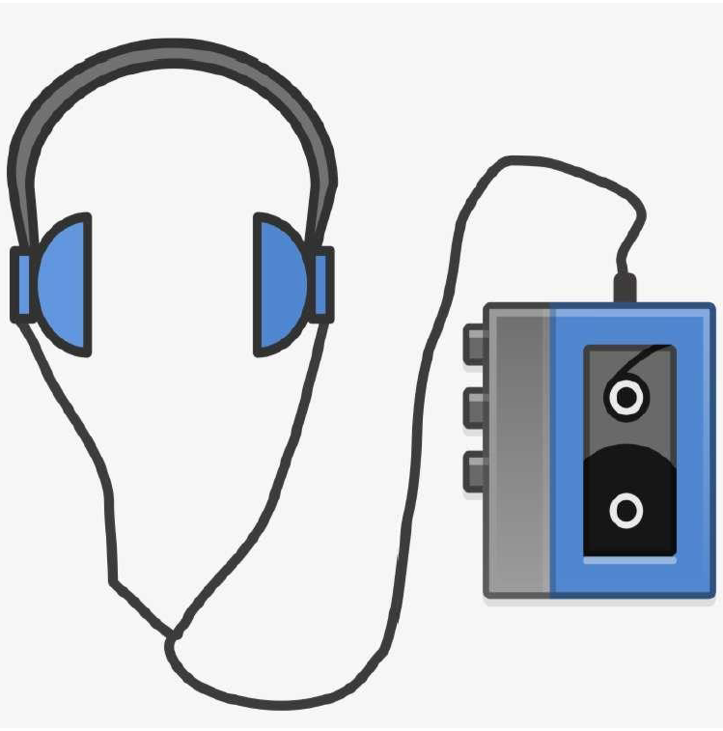
Verbatim Theatre
Learning Outcomes:
You will be able to:
Understand what Verbatim Theatre is and why we would create a performance in this style.
Apply your understanding to the development of an idea for a piece of Verbatim theatre.
Develop skills in devising theatre, script writing and presentation.

Slide 3
Introducing Verbatim Theatre
Lesson 1
Introducing the topic of Verbatim Theatre.
To understand what is meant by the term ‘Verbatim Theatre’.
Key vocabulary – Verbatim, characterisation, gesture, posture, vocal skills.

Slide 4
Mind map Verbatim Theatre
Verbatim Theatre
To understand what is meant by the term ‘Verbatim Theatre’.
To develop skills in performing as a character in a verbatim style

Slide 5
Verbatim Theatre
Verbatim theatre is a form of documentary theatre in which plays are constructed from the precise words spoken by people interviewed about a particular event or topic.
To understand what is meant by the term ‘Verbatim Theatre’.
To develop skills in performing as a character in a verbatim style

Slide 6
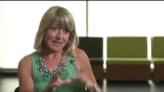
Introduction to Verbatim Theatre
Notes:
Watch the National Theatre clip ‘An Introduction to Verbatim Theatre’ - http://www.youtube.com/watch?v=ui3k1wT2yeM.

Slide 7
Task
After watching the video, complete the three questions on the ‘Verbatim Theatre’
What is meant by the term ‘Verbatim Theatre’?
What are some of the benefits of using Verbatim Theatre?
What are some of the challenges of using Verbatim Theatre?
To understand what is meant by the term ‘Verbatim Theatre’.
To develop skills in performing as a character in a verbatim style

Slide 8
Plenary
Now complete the final question on the ‘Verbatim Theatre’
Why do you think a theatre company may choose to create a piece of Verbatim Theatre?’
Did we achieve our learning objectives?
To understand what is meant by the term ‘Verbatim Theatre’.

Slide 9

Email your completed work to your Drama Teacher
Mrs Lake
Mrs Hawkins

