Slide 1
Year 9
Remote Learning Term 5
Week 2

Slide 2


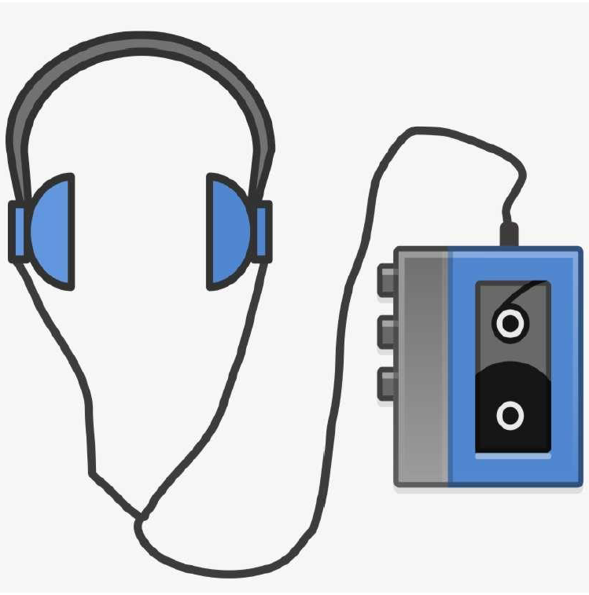
Initial Ideas
Lesson 2
Develop initial ideas for their own productions.
To select and justify initial ideas for subject content for your Verbatim theatre production.
To create clear and relevant dramatic intentions for your production.
Key vocabulary – Research, stimulus, intention, theme, initial ideas.
Homework – research task

Slide 3

Recap on Verbatim Theatre
Verbatim theatre – what is it?
What are the advantages and disadvantages of using Verbatim theatre?
Why might a theatre company use Verbatim theatre?

Slide 4

Assessment Task
You will be working on creating your own proposal for a piece of Verbatim theatre, concluding in a presentation pitch to the class.

Slide 5
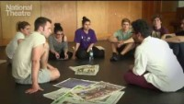
Guide to Creating Verbatim Theatre
What do you learn from this clip and how you might take this understanding and apply it to your own ideas for performance?

Slide 6
Task One
Ideas for Performance
You begin by completing a mind map, listing as many different ideas for topics / issues / events that could be used as a starting point for a Verbatim theatre production.
Try to explore the subcategories of these topics – for example, if selecting bullying, then subcategories could include the impact of social media and cyberbullying on teenagers or exploring the perspective of the bully character, etc.

Slide 7
Task Two
Create
Create a mind map of ideas for your performance – you should think of a range of ideas.
Consider
Consider what topic, issue or event you may wish to focus on –
Write down
Write down any of your initial ideas as a group and then highlight which you have chosen to use as your starting point.

Slide 8
Task Three
You now need to choose one of the topics which will become the starting point for your performance. Answer the initial ideas for the performance and complete the following questions
Your Performance
What topic, issue or event will you be basing your performance on?
Why have you chosen to base your performance on this topic, issue or event? What will make it an interesting stimulus?
Where is it going to be set?
What type of characters will you have?

Slide 9
Dramatic Intentions
What is meant by dramatic intentions?
The purpose or message of the play – what you want your audience to gain or learn from watching the performance.
Discuss and Answer the question
What is the intention of your performance? (What do you want the audience to learn from your performance?)

Slide 10
Plenary
Title and Tagline
Create a title and tagline for your production. Remember that it has to summarise the production and should provide a sense of your intention.
Research
Chose an areas of your given topic / issue / event to research.
It must include a selection of quotes for use in the script.

Slide 11

Email your completed work to your Drama Teacher
Mrs Lake
Mrs Hawkins

