Slide 1
Year 9
Remote Learning Term 5
Week 3

Slide 2
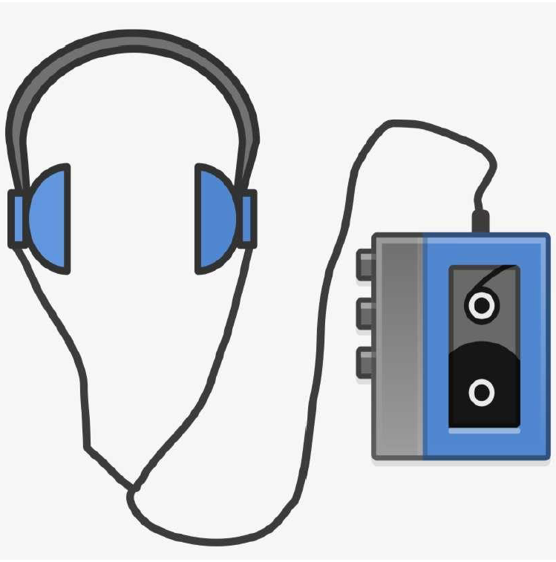
Developing the Script
Lesson 3
Creating a sample of the script for the Verbatim production.
To understand how to create a Verbatim script from research findings and interview material.
To apply your understanding to the development of your own Verbatim theatre.
Key vocabulary – Stage directions, setting, dialogue, script.

Slide 3
Key Questions
How can we take research findings and interview material to develop our Verbatim script?
How can we make a Verbatim performance interesting to an audience?

Slide 4
Recap
Verbatim theatre is a form of documentary theatre in which plays are constructed from the precise words spoken by people interviewed about a particular event or topic.

Slide 5
Task One
Read the article titled ‘Task One – James’ Story’ in ClassCharts.
First - Read the article to get an idea of the content and the character in the interview.
Consider – what do you think the message of the article is?
Then - Imagine you are playing the character of James.
Note down or highlight between 10-15 lines from the article that you
would use as dialogue for a Verbatim performance using this character.
Extension Activity – Create a script from the lines of dialogue.
Consider where you would set the scene and what would make it interesting.
Include use of stage directions to describe the setting and to explain any moments of action in your scene.
LO: To understand how to create a Verbatim script from research findings and interview material.

Slide 6
James’ Story – Taken from the Childline Website
I felt guilty because the bullies had chosen me "When I was 10 my mum and dad had moved house so I went to a new primary school. Up until then, I’d always liked school. Nothing I did was right and the name-calling, punching and kicking began. They didn’t like my glasses. They didn’t like what I looked like. They didn’t like me being the new kid.
I would wake up every day with a feeling of dread and felt physically sick at the thought of going to school. I used to try and think of every possible excuse to get out of it.
I couldn't take the bullying anymore. I'd had enough. I just didn't want to be a burden anymore.
The bullying didn’t stop after school. They were all local kids that lived near me. I couldn’t go to the shops, the park or even the town centre. Wherever the bullies saw me, they kept it up. Even when they weren’t there, it was like they were following me.
Secondary school was even worse. Those kids who didn’t know me were clued up by those who did. It got really nasty and I had doors slammed in my face, and my head bashed against a brick wall. I felt sick, scared and exhausted.
I’d seen posters or Childline around the school and decided to call them. The first couple of times I called I couldn’t speak and I hung up. I just couldn’t say the words I needed to say. So I wrote a letter and I let it all out.
They listened and believed everything I said. They gave me advice on how to cope with the bullying such as joining lessons earlier or later and avoiding areas where they congregated. Because I was believed, they also gave me the confidence to tell my mum and dad.
I started calling twice a week, about the same time, and usually spoke to a counsellor called Craig. He really listened, didn’t tell me what to do, and gave me the time to explain how I was feeling. That was so important to me.
On the phone, I could be me and they let me speak about my emotions and channel the negative feelings. Childline helped me realise that I had the strength to overcome the bullying within me. It was always there, I just needed someone to help me find it

Slide 7

The Paper Birds
We will be watching a clip of a theatre company called ‘The Paper Birds’.
Below is the description that they give of their theatre company.
‘The Paper Birds is a devising theatre company, with a social and political agenda.
We are recognised as UK leaders in verbatim theatre. We’re artists, investigators, entrepreneurs, educators. We pride ourselves on taking complex subjects and making them accessible.
Our vision is to provoke change, one encounter at a time. Our mission is to be quiet rebels,
amplifying the voices of everyday people. We inspire change through the theatre we create.
We are story collectors. We spend time in communities, listening to personal experiences.
The words of the people we meet form the backbone of our shows, giving voice to the voiceless, painting powerful and very human alternative social commentaries.
Our desire to listen, to understand and then ‘give voice’ means not only making space for the under-represented and the misunderstood, but also that our shows explore voices from all walks of life.
We aim to do this in breath-taking theatrical fashion.

Slide 8
The Paper Birds
The video shows a part of the process that The Paper Birds
go through to create their own Verbatim productions.
As you watch the video take notes.
Consider the following areas when making your notes:
The topics that The Paper Birds choose to focus on.
The process they go through when researching the topic.
How they use the research they have found.
https://www.youtube.com/watch?v=1omtiQxXbls
LO: To understand how to create a Verbatim script from research findings and interview material.

Slide 9
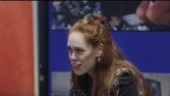
Notes:
https://www.youtube.com/watch?v=1omtiQxXbls

Slide 10

Task Two
Research Findings
Create a ‘Research Findings’ page with the most important information from the research and highlight key information.

Slide 11
What Do We Need to Consider When
Creating a Verbatim Script?
The character we are representing should be clear and we must be sensitive to the real person used as the inspiration.
The dialogue we use must not be taken out of context.
The message of the piece should be clear from the dialogue and action in the scene.
The dialogue should be interesting and insightful – giving us the unique perspective of the person we are representing.
The overall concept of the performance must be considered – where are you setting the performance? How does this impact the material / characters / dialogue needed to make the piece work?
LO: To understand how to create a Verbatim script from research findings and interview material.

Slide 12
Presenting Verbatim Theatre
Watch the clip from The Paper Birds production called ‘Broke’.
This play is all about what it means to be living on the
front line of poverty and debt in the UK.
Look for how they present the different characters of those they interviewed despite only having three actors.
You may need to turn up the volume as the clip is quite quiet!
https://www.youtube.com/watch?v=uoV0dsGT0N4
LO: To understand how to create a Verbatim script from research findings and interview material.

Slide 13
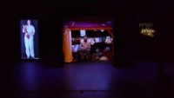

Slide 14
Task three
Developing Your Script
You are to use your research to write at least one scene of your performance – this could be the opening scene or may be a scene later on in the performance if this is more fitting to the research.
You should consider the elements of the performance that you have developed in your initial ideas from the previous week
What staging are your using?
Does this impact the stage directions?
What is their intention and how are they showing this in the script?
What characters have they chosen to include and how are they making these clear whilst staying sensitive to the real people?

Slide 16
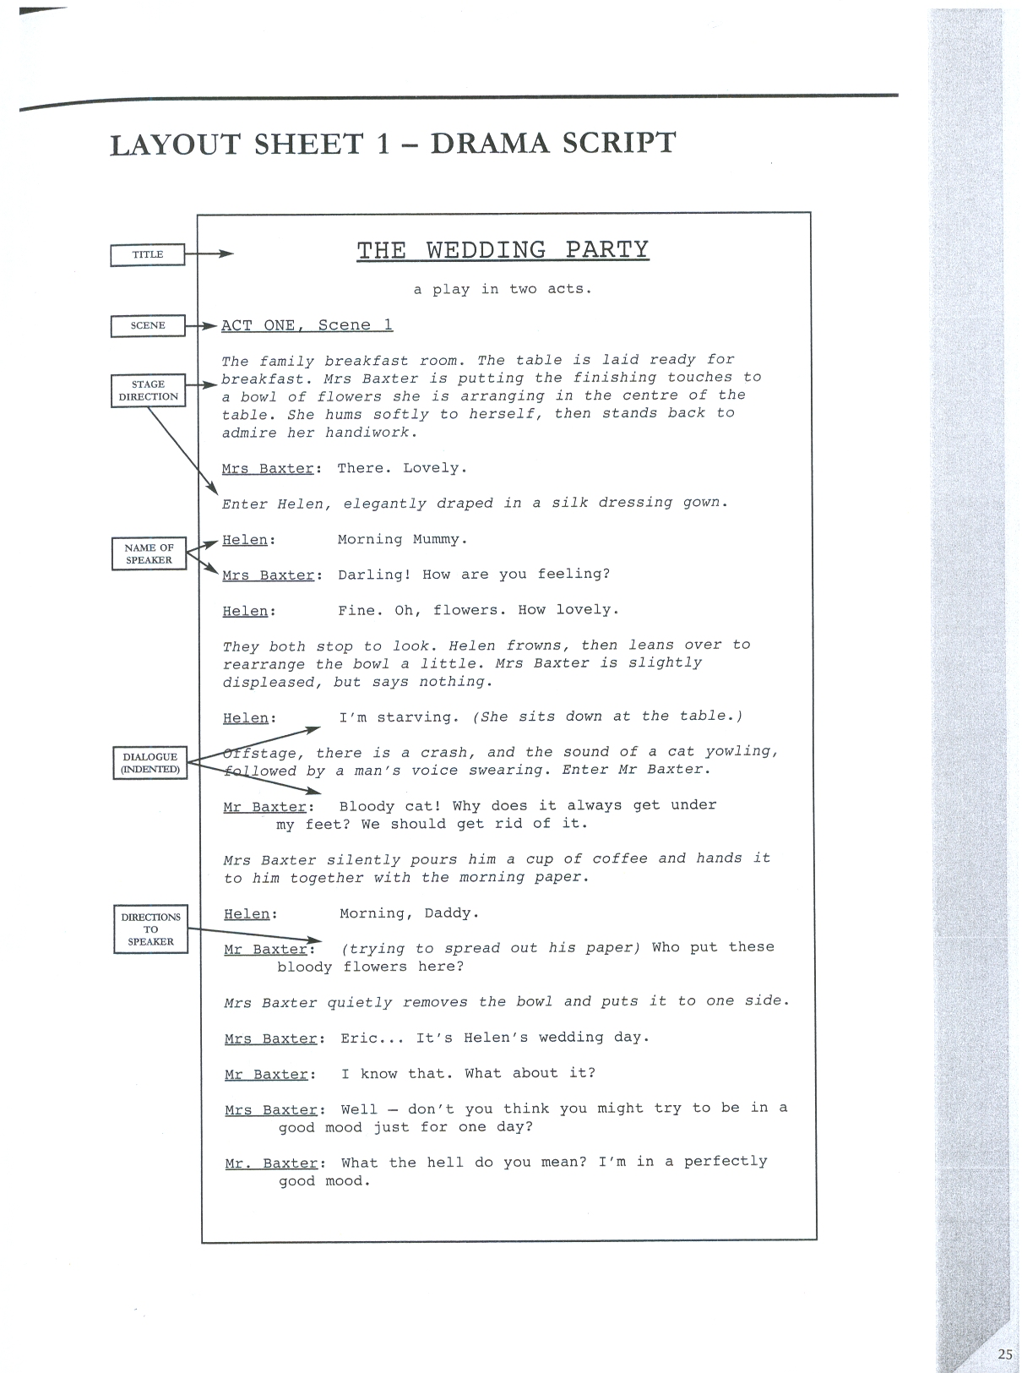
Example

Slide 17
Topics
Bullying
Loneliness / Isolation
Football Hooliganism
Racism
Gender Roles
Social Media
Consider the topic that you have chosen for your own concept for a Verbatim production You may wish to discuss these questions with other members of your group – it is ok for you to have similar answers for some of these.
1. What do you want the message of your performance to be?
2. What characters will you need to be able to communicate this message to the audience?
3. Find three relevant facts about the topic that could be useful to your performance. Explain how these may help you when devising your performance.
4. Find at least five quotes from people relevant to the topic that you could use in your performance – you may already have some from your homework research task.
5. Why do you think your idea would make an interesting performance?
6. Explain the theatrical techniques you would use to make your performance more engaging for an audience and explain how they would enhance the performance.
Extension Activity –
Write the opening stage directions to your performance. These should set the scene for your entire performance. Include what the stage layout will be and what will happen before the dialogue starts.

Slide 18
Plenary
Choose one line from your script that you think will have the most impact on your audience.
Consider the intention of your production – it must fit within this.

Slide 19

Email your completed work to your Drama Teacher
Mrs Lake
Mrs Hawkins

