Slide 1
Year 9
Remote Learning Term 5
Week 4

Slide 2
Set Design and Costume
Lesson 4
To create the set and costume designs for the production.
To understand how set and costume design can support in communicating the themes and intentions of a production.
To develop your own set and costume designs to highlight the themes and intentions of your proposed production.
Key vocabulary – Set design, costume design, dramatic intentions, themes,

Slide 3
Starter
Set and Costume Design
Mind map as many different elements that you can think of that you may need to consider when creating a set or costume design for a production – e.g. colour, condition, location, staging, etc.

Slide 4
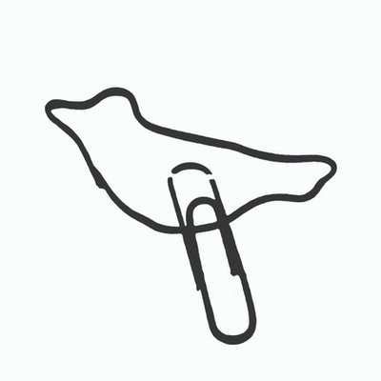
Paper Birds ‘Mobile’ Set Design
Watch the video clip demonstrating the creation of the set design for the Paper Birds production of ‘Mobile’ which is set in a mobile caravan
Write notes on the video
Questions to answer:-
What do you think were the dramatic intentions of the production ‘Mobile’?
How do you think the set design supported with those intentions?

Slide 5
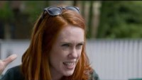
What do you think were the dramatic intentions of the production ‘Mobile’?
How do you think the set design supported with those intentions?

Slide 6
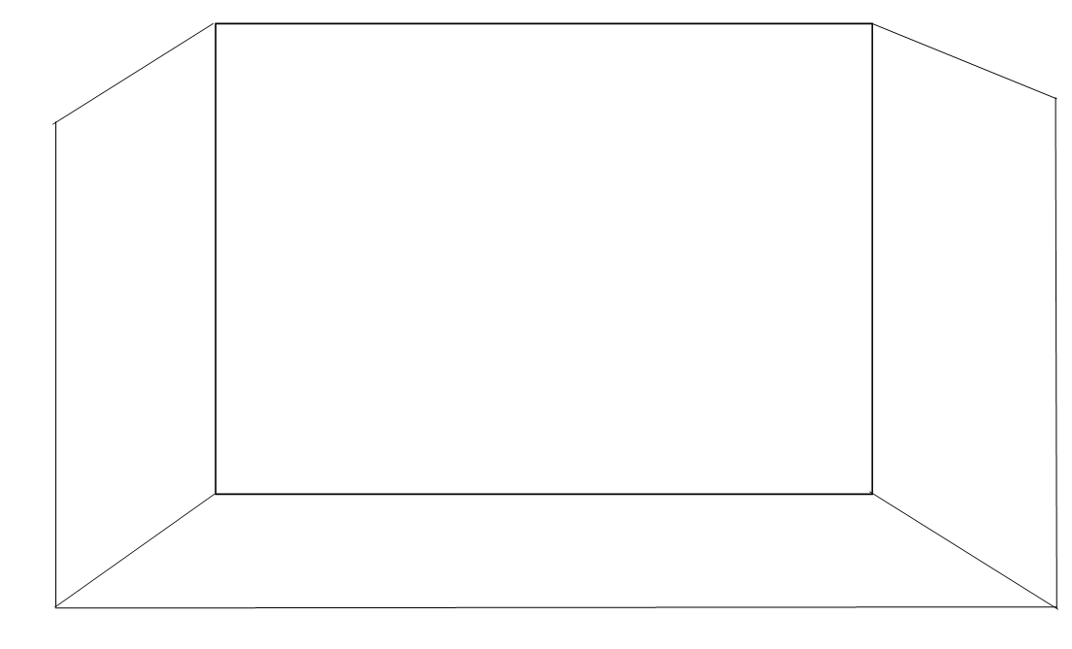
Task One
Set Design
Create your own ideas for the main set design of the production – this may be the opening design or for a pinnacle scene later on in the performance.
You need to annotate around the design, explaining your choices and linking these to your dramatic intentions of the production.

Slide 7
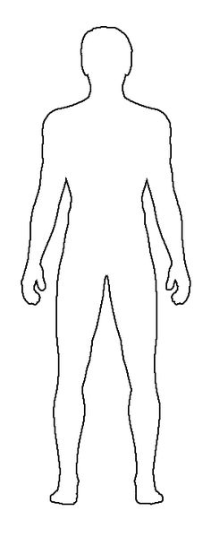
Task Two
Costume Design
Create your own ideas for three characters from the production.
You must annotate around the designs, explaining your choices and linking these to your dramatic intentions of the production.

Slide 8
Plenary
Which are the most appropriate for the production?
Do they all work together?
How do they link to the intentions of the production?

Slide 9

Email your completed work to your Drama Teacher
Mrs Lake
Mrs Hawkins

