Slide 1
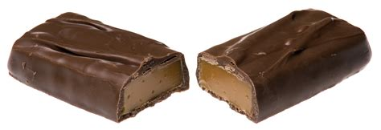
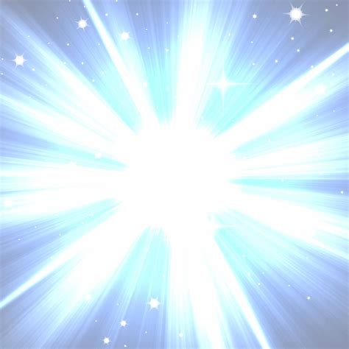

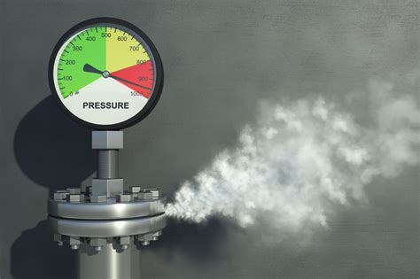
Complete the retrieval quiz to see what you can remember.
Last Lesson
Last Topic
What is the name of our galaxy?
What is made when magnesium reacts with oxygen?
Before half term
September
What colour will universal indicator turn in a strong acid?
If some gas is put into a smaller container, what happens to the pressure?

Slide 2
Last Lesson
Last Topic
What is the name of our galaxy?
The Milky Way
What is made when magnesium reacts with oxygen? Magnesium oxide
Before half term
September
If some gas is put into a smaller container, what happens to the pressure? The pressure will increase, as there will be less space, therefore more collisions with the walls.
What colour will universal indicator turn in a strong acid? Red

Slide 3
Our Solar System
To describe the model of our solar system
To recall the order of the planets in our solar system
To explain why we see objects in our solar system, and why they appear to move as they do

Slide 4
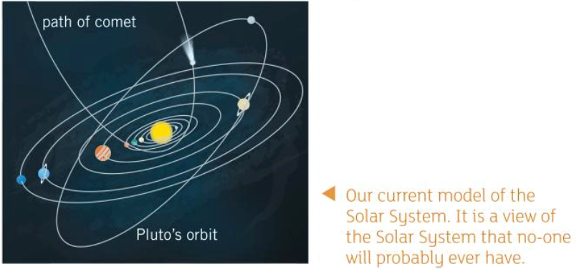
Our Solar System
Hopefully you are already familiar with the planets in our solar system and that they orbit the sun.
You need to know the order of the planets: Mercury, Venus, Earth, Mars, Jupiter, Saturn, Uranus, Neptune
Before Pluto was downgraded to a dwarf planet, people used to remember the order by the mnemonic “my very easy method just speeds up naming planets”. Can you come up with your own mnemonic to remember the order?

Slide 5
Exploring Our Solar System
If you are unable to access the website for some reason, you should be able to find the answers elsewhere on the internet!
Visit the website https://www.solarsystemscope.com/
On here, you can explore the solar system in a pretty cool way. Use this tool to answer these questions:
What similarities does Mars have with Earth (click on Mars and explore to find this out)?
How many moons does Neptune have and what are their names? Why is one of it’s moons quite dark?
What is Ceres and where can it be found in our solar system?
Press the play button at the bottom to make the planets spin around the sun. Play around with how fast this happens and look from different angles. What do you notice about the orbit of Ceres compared to the planets?
Which planet spins around the sun the fastest (has the shortest year)?
Use the ‘structure’ button to have a look inside Mercury. Compare the structure of Mercury to that of Earth.
Explore the ‘messier objects’ using the magnifying glass. Have a look at the Wild Duck Cluster. Roughly how many stars are in this cluster? Where did it get it’s name?

Slide 6
Exploring Our Solar System
If you are unable to access the website for some reason, you should be able to find the answers elsewhere on the internet!
Visit the website https://www.solarsystemscope.com/
On here, you can explore the solar system in a pretty cool way. Use this tool to answer these questions:
What similarities does Mars have with Earth (click on Mars and explore to find this out)? Mars has a similar day length and seasons, like Earth. It also has a rocky surface and polar ice caps.
How many moons does Neptune have and what are their names? Why is one of it’s moons quite dark? 2 – Triton and Proteus. Proteus is Neptune’s dark moon, it only reflects 6% of sunlight due to it’s irregular shape.
What is Ceres and where can it be found in our solar system? Ceres is a dwarf planet found in the asteroid belt between Mars and Jupiter.
Press the play button at the bottom to make the planets spin around the sun. Play around with how fast this happens and look from different angles. What do you notice about the orbit of Ceres compared to the planets? The orbit of all of the planets is in roughly the same plane, Ceres is not.
Which planet spins around the sun the fastest (has the shortest year)? Mercury has the shortest year (88 days).
Use the ‘structure’ button to have a look inside Mercury. Compare the structure of Mercury to that of Earth. Mercury and Earth both have a crust, mantle and core. Earth has an inner and outer core. Iron is in the core of both planets.
Explore the ‘messier objects’ using the magnifying glass. Have a look at the Wild Duck Cluster. Roughly how many stars are in this cluster? Where did it get it’s name? There are roughly 2900 stars in this cluster. It got it’s name from stars forming a triangle that looks like a flying flock of ducks.

Slide 7
What did you think?
Did you enjoy exploring our solar system using the website? What did you find useful about it and what could have been improved? Give it a www. And ebi. ☺

