Slide 1
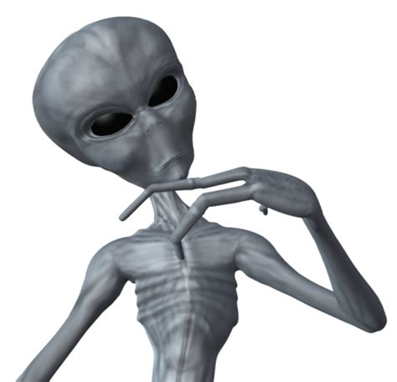
Pre-topic quiz!
We are starting a new topic today, so we are going to start with a quiz to see what you already know.
Don’t worry if you don’t do very well – we haven’t covered this topic yet, after all! Completing pre-topic quizzes like this have been proven to improve learning.
Work your way through the next few slides, and check your answers as you go along ☺

Slide 2
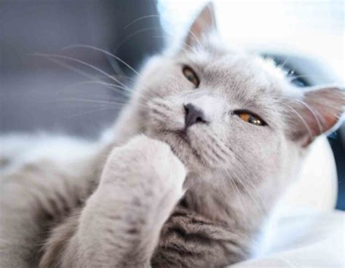
Q1. What is the Earth’s only natural satellite?
The sun
The international space station
The moon
The stars

Slide 3
Q1. What is the Earth’s only natural satellite?
The sun
The international space station
The moon
The stars
The Earth’s only natural satellite is the moon.

Slide 4
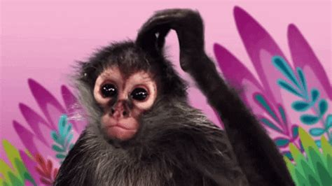
Q2. What is the name of our galaxy?
The universe
Exoplanet
Saggitarius
The Milky Way

Slide 5
Q2. What is the name of our galaxy?
The universe
Exoplanet
Sagittarius
The Milky Way
Our galaxy is called the Milky Way.

Slide 6
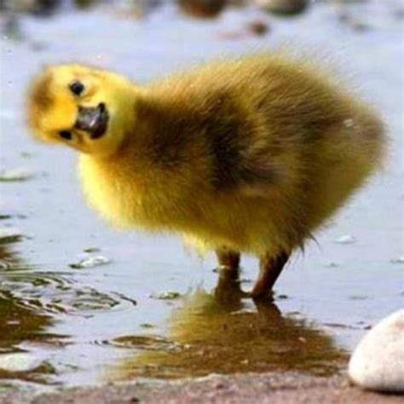
Q3. What is the name of the outermost planet in our solar system?
Neptune
Uranus
Saturn
Mercury

Slide 7
Q3. What is the name of the outermost planet in our solar system?
Neptune
Uranus
Saturn
Mercury
The outermost planet in our solar system is Neptune (Pluto is not a planet).

Slide 8
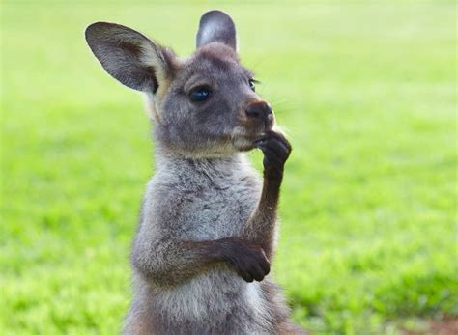
Q4. How many times does the Earth rotate on it’s axis once it has orbited around the sun once?
24.0000
365.2422
365.0000
364.0000

Slide 9
Q4. How many times does the Earth rotate on it’s axis once it has orbited around the sun once?
24.0000
365.2422
365.0000
364.0000
365.2422 times. That is why we have a leap year every 4 years.

Slide 10
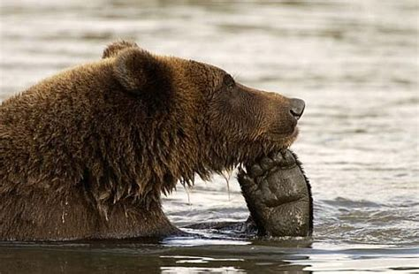
Q5. Which phase of the moon comes after a full moon?
Waning gibbous
Waxing gibbous
Waning crescent
Waxing crescent

Slide 11
Q5. Which phase of the moon comes after a full moon?
Waning gibbous
Waxing gibbous
Waning crescent
Waxing crescent
Waning gibbous comes after a full moon.

Slide 12
The Night Sky
To describe the objects that you can see in the night sky
To describe the structure of the universe
To create your own constellation

Slide 13
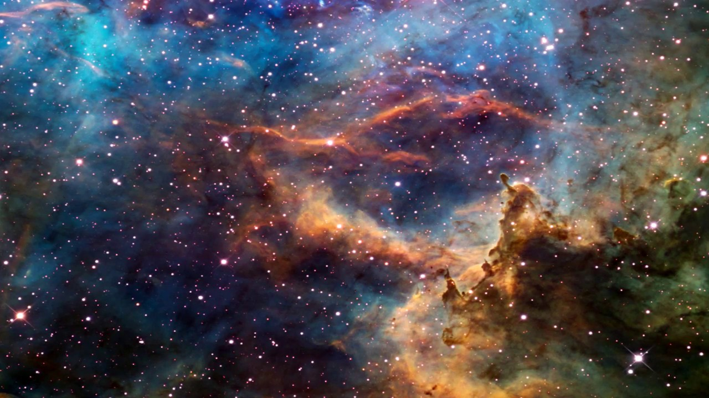
The scale of the universe
Visit this website to investigate the scale of the universe: http://htwins.net/scale2/
Hopefully this will give you a feeling of awe – the universe is MASSIVE!

Slide 14
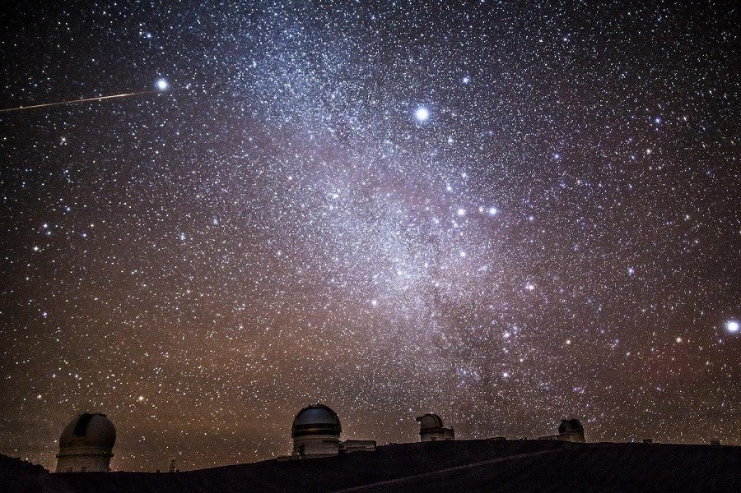
What can we see in the night sky?
A satellite is something that orbits a planet. It can be natural or man-made.
Have a go at matching up the thing you can see in the night sky and the explanation of what it is.
Thing you can see in the night sky
International space station
The moon
Mercury, Venus, Mars, Jupiter and Saturn
Stars in the Milky Way (our galaxy)
Andromeda
What is it?
A natural satellite. It reflects light from the sun.
Distant balls of burning gas (just like our sun). They give off their own light and can have their own solar system.
A man-made satellite. It reflects light from the sun.
The closest large galaxy to us. It is made from stars, just like our galaxy, that give off their own light.
Some planets in our solar system. They reflect light from the sun.

Slide 15
What can we see in the night sky?
A satellite is something that orbits a planet. It can be natural or man-made.
Have a go at matching up the thing you can see in the night sky and the explanation of what it is.
Thing you can see in the night sky
International space station
The moon
Mercury, Venus, Mars, Jupiter and Saturn
Stars in the Milky Way (our galaxy)
Andromeda
What is it?
A natural satellite. It reflects light from the sun.
Distant balls of burning gas (just like our sun). They give off their own light and can have their own solar system.
A man-made satellite. It reflects light from the sun.
The closest large galaxy to us. It is made from stars, just like our galaxy, that give off their own light.
Some planets in our solar system. They reflect light from the sun.

Slide 16
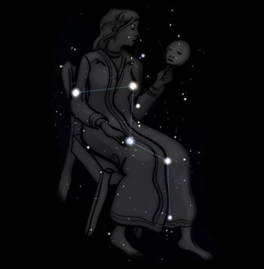
Constellations
Groups of stars in the sky have been grouped together and given myths to accompany them throughout history.
The constellations that you can see are different in summer and winter due to the seasons (more on that later).
See if you can spot the constellation Cassiopia on a clear night – it’s a good one to look out for as it is always there.
If you are unable to see anything in the night sky, use this website to have a virtual stargaze: https://www.timeanddate.com/astronomy/night/
Once you’ve had a good look, pick a group of stars and make your own constellation (like Cassiopia). Draw your picture to go with your stars and send it to me using the paperclip icon. There will be a P3 for the best ones!

