Slide 1
Structure of the Earth
Aims
To name the layers of the earth
To design a simple model of the earth
To read about the properties of the different layers of the Earth’s structure

Slide 2


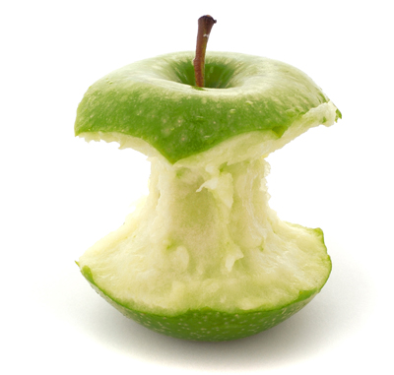
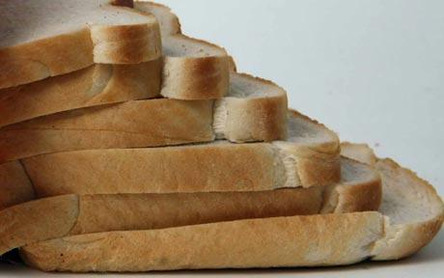


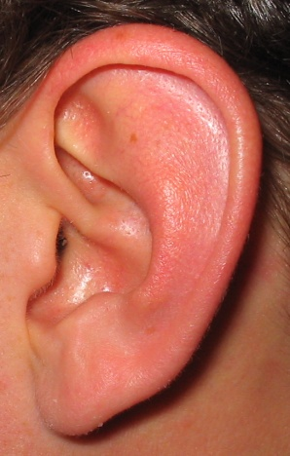

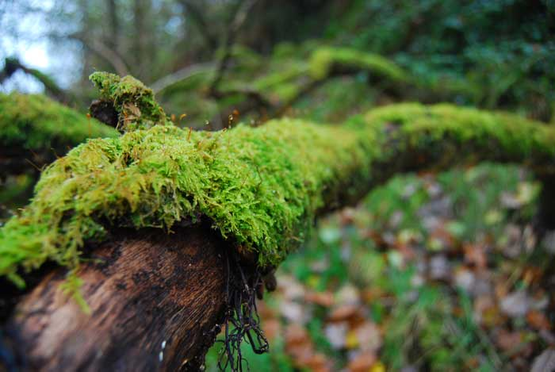
Starter Activity – Key words
Use the pictures to work out the key words for today’s lesson
1
2
3
CRUST
CORE
MANTLE
CHALLENGE
PH
ATMOSPHERE

Slide 3
Watch the first 4 mins and 30 s of this clip.
How the Earth formed and the layers of the earth
https://www.youtube.com/watch?v=JGXi_9A__Vc

Slide 4
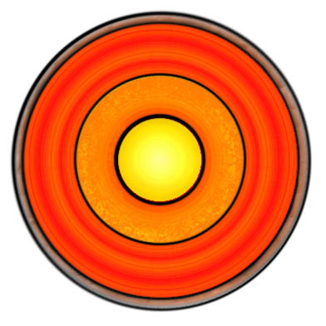
To be able to recall and describe the structure of the earth (D Grade)
To be able to describe the relative sizes of each layer of the Earth’s structure (C Grade)
Structure of the Earth Race
Atmosphere
Atmosphere | Crust | Mantle | Core
80% of the air lies within 10km of the surface Most of the rest is within 100km but it is hard to judge where our atmosphere ends and space begins | Average thickness 50km- varies from 5-70km thick under the ocean thinner but the continental part is thicker. Contains minerals and other resources | Starts underneath crust Continues 3000km below earth’s surface Behaves like a solid but flows slowly | Radius of about 3500km Made of nickel and iron (magnetic metals) Outer core is liquid Inner core is solid and has a radius of 1200km Temp. of 6000℃
Crust
Mantle
Outer core
Inner core

Slide 5
The next slide shows you similar information about the parts which make the Earth
You need to complete the columns check your answers on the slide which follows it.

Slide 6
Our scale is 1:100,000,000, which means that each 100,000,000 cm in actual measurements iis represented in our model by 1 cm IGNORE go to next slide
Layer of Earth​ | Actual size (km)​ | Actual size (cm) Multiply by 100,000 | Size in model (cm) (Divide by 100,000,000)
Inner core​ | Diameter of 1216​ | First one done for you 121,600,000 | Diameter of 1.2​2
Outer core​ | Thickness of 2240​
Mantle​ | Thickness of 2880​
Crust​ | Thickness of 24​
1 km = 100,000cm​
So we might as well just divide by 1000

Slide 7
Fill inf
Layer of Earth​ | Actual size (km)​ | Size in model divide the km by 1000 to get it in cm
Inner core​ | Diameter of 1216​ | 1.2
Outer core​ | Thickness of 2240​
Mantle​ | Thickness of 2880​
Crust​ | Thickness of 24​
1 km = 100,000cm​

Slide 8
Using the last slide….
Draw a scale model of the layers of the Earth in your exercise book using the dimensions in the table e.g. 1.2cm
If you were not able to pick up your book then please do your school work on paper for when we get back to school.

Slide 9
What am I?
To be able to recall and describe the structure of the earth (D Grade)
To be able to describe the relative sizes of each layer of the Earth’s structure (C Grade)
I am dense, very hot, made mostly of solid iron and nickel.
I’m iron and nickel too, but I’m liquid.
I’m really very thin and am mostly silicon, oxygen and aluminium.
I contain minerals and other resources
I’m a viscous semi-solid with convection currents circulating in me.
I just hang around on the outside.
Inner core
Outer core
Crust
Mantle
Atmosphere

Slide 10
Plenary – Fill in the gaps
The structure of the earth consists of three layers the in the centre, then the and the outer layer of , with the above the surface. The outer layer of the Earth is very compared to the Earth’s diameter. The layer below this is but can flow in parts very .
core
crust
mantle
atmosphere
thin
solid
slowly
Core Crust Mantle Slowly Solid Thin Atmosphere

