Slide 1
Rocks
Aims
To know that rocks are grouped depending on the way their particles are arranged which depends upon how they formed.
What the main features/ properties of sedimentary rocks are
How sedimentary rocks form-
And learn what weathering and erosion are.

Slide 2
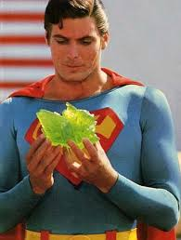
ROCKS
STARTER is it a rock?
It would have to contain what?
What must have happened to these?
Minerals
They must have been cemented together (not just be separate like sand grains)

Slide 3
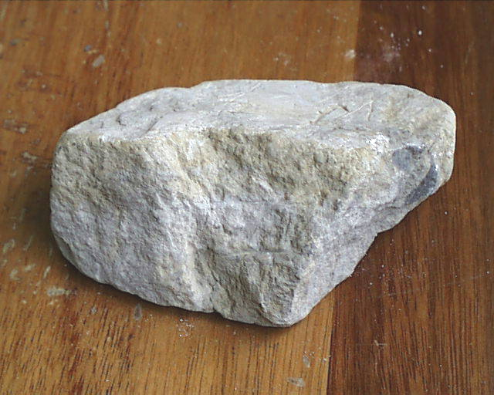
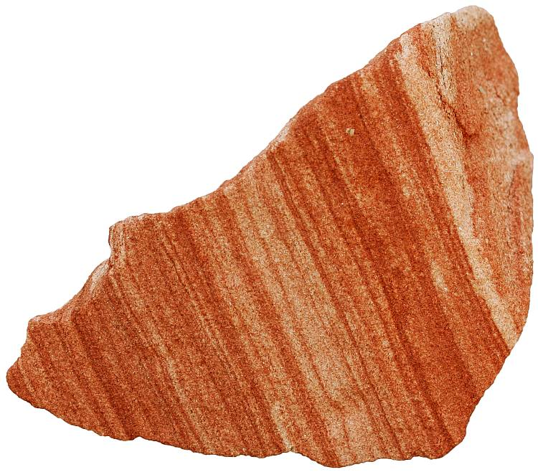
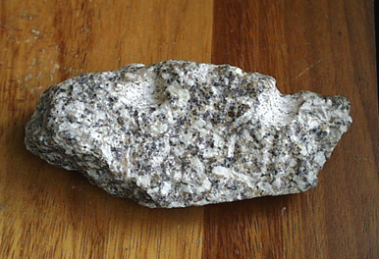
Which of these is the odd one out and why?

Slide 4
Which of these is the odd one out and why?
This one contains interlocking crystals not rounded particles

Slide 5
Rock Texture
This is not like fabric texture – it doesn’t describe how the rock feels
Rock texture describes the combination of sizes and shapes of the grains in the rock, and how these fit together

Slide 6
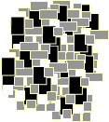
Interlocking grains
The grains fit together neatly, with no spaces in between

Slide 7
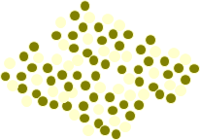
Rounded grains
The grains are rounded particles with tiny spaces in between

Slide 8
Where do the particles come from?
From the surface of ready made rocks being loosened. This is called WEATHERING
How are they loosened? – think about this and look at the next slide

Slide 9
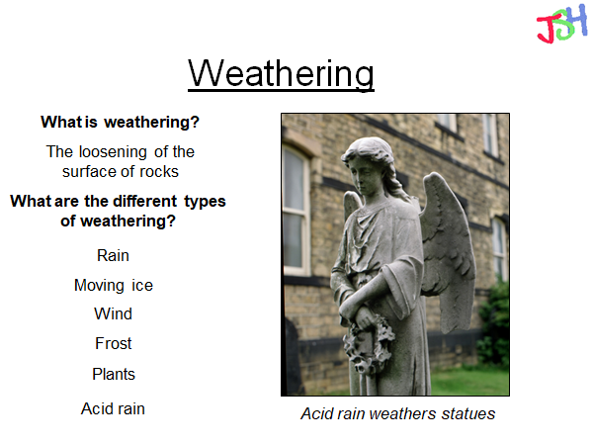
Rounded grains
The grains are rounded particles with tiny spaces in between

Slide 10
But weathering does not form new rock
The loosened pieces must be transported to the sea and then what?
Try this……..
weathering(Loosening) and movement (transport) are called EROSION

Slide 11
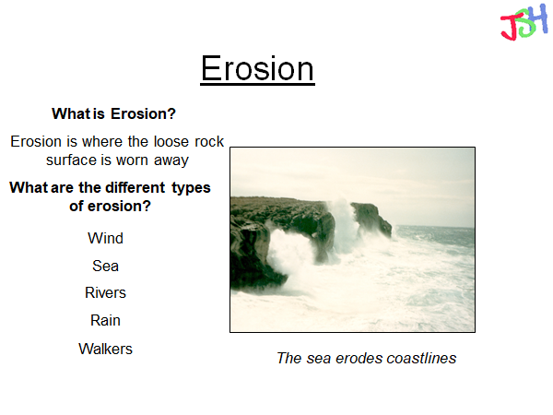
The fragments of rock (all different sizes) are transported (moved) but then are laid down - called DEPOSITION (they are deposited /set down)
What happens next ?

Slide 12
Put some garden soil or sand into a plastic container (lemonade bottle) add a small amount of water and shake or stir it. Watch what happens.

Slide 13
Did your particles settle out?
This settling of particles is called DEPOSITION
Sediments/broken bits of rock are eroded then they are moved by water and eventually ( when water slows down or stops moving or it gets to the sea) they settle to the bottom – just like when you stirred your mud with water.
Did some layers form?
When layers build up like this and press down on the layers below they are COMPACTED. Lastly, other substances in the water stick these squashed particle together (called CEMENTATION because it’s like cement)

Slide 14
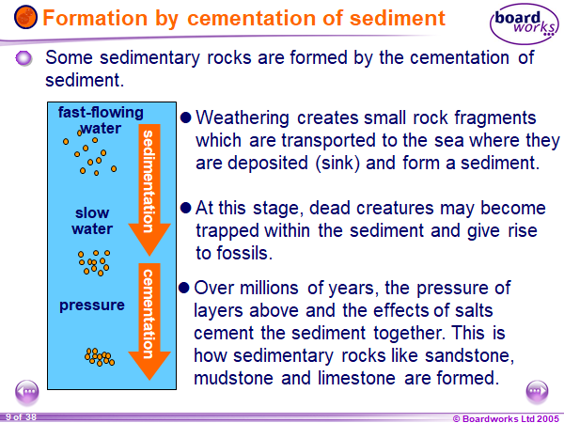
How sedimentary rocks form summary
sedimentation
cementation

Slide 15
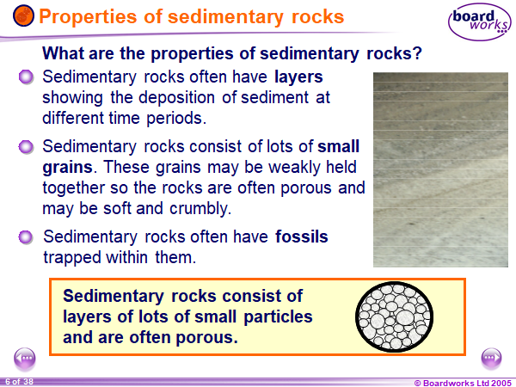

Slide 16
Plenary - extension
Write down the title
key properties of sedimentary rocks and make your own notes about them.
Do you think they would scratch easily? Do you think water could move through them easily?
How are their particles arranged

