Slide 1
Igneous and metamorphic rocks
Aims -
To know why rocks have particular properties depending on how they formed
To learn how metamorphic and igneous rocks are formed.
To state one difference between igneous and metamorphic rocks.

Slide 2
Igneous and metamorphic rocks
Starter
Get a blob of blue tack or chewing gum or plasticine - something squidgy
Flatten it out and put round pencil marks in it –evenly spaced
Then carefully push the edges together with two parallel rulers (flat things).
What do you notice about the shape of the circles now -and how they appear?

Slide 3
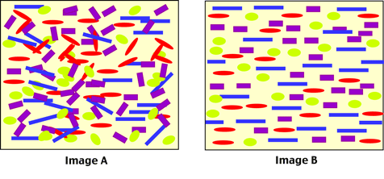
This is what happens - they line up.
Because the minerals are in lines you can cut along the lines and split the rock into layers
E.g. slate. Metamorphic rocks often (but not always) look stripy
Before metamorphism
After metamorphism
Pressure can rearrange the particles in this way but so can heat under the earth (e.g. by magma - molten rock). This may happen over millions of years.

Slide 4
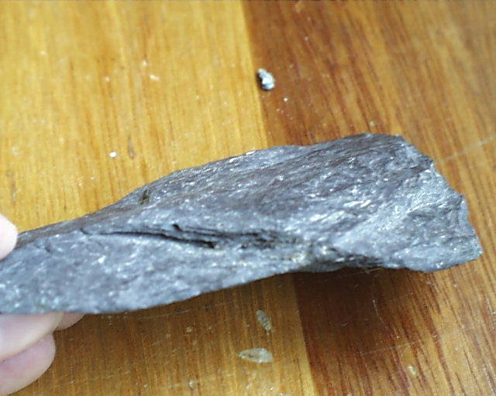
an example of metamorphic rock
Slate is …
Slate is …
Metamorphic rocks are made up of crystals they are not porous- porous means that water can go through it. They are strong because of the crystals and can be split into layers because of how they are lined up.
Notes:
4

Slide 5

Properties of metamorphic rocks
How are the properties of metamorphic rocks different from sedimentary rocks?
Metamorphic rocks often have layer structures of crystals caused by the effect of heat and pressure.
Metamorphic rocks are usually denser and harder than sedimentary rocks.
Metamorphic rocks sometimes show distortions caused by the movements that led to their formation. This may give rise to wavy or zig-zag patterns within the rock.
Metamorphic rocks contain regular layers of crystals that sometimes have a wavy or zig-zag arrangement.
Notes:
5

Slide 6
Igneous rock
Underground liquid rock is called MAGMA
As magma cools and freezes its particles arrange themselves into crystals.
Each crystal is made up of particles of one mineral. There are no gaps between the crystals, so igneous rocks are hard and difficult to damage
The size of the crystals depends on how quickly the magma cools - think back to making copper sulfate crystals (blue ones).
They are large if they cool slowly and small if they cool quickly.

Slide 7
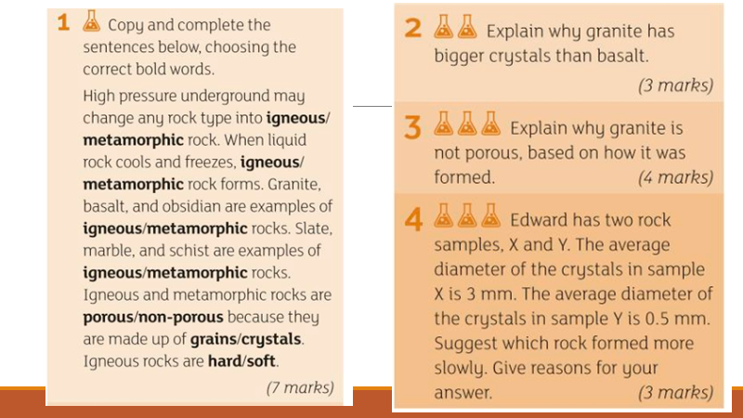
Now have a go at these questions

Slide 8
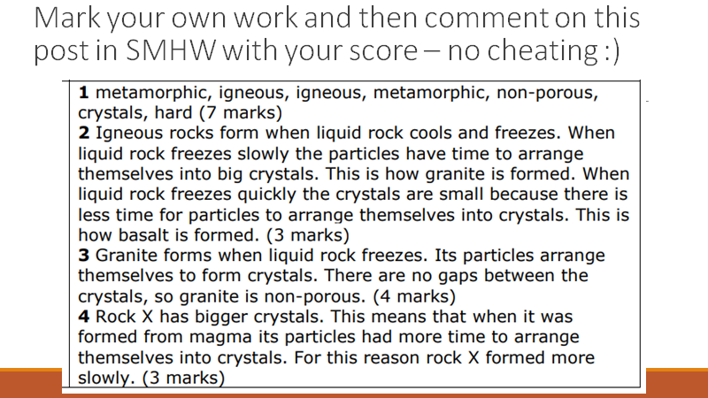

Slide 9
Plenary
Can you write one sentence about the properties (qualities/properties)
Of sedimentary rocks
Metamorphic rocks
Igneous rocks
Challenge: Can you add a diagram?
Extra challenge: Can you find names and pictures of a sedimentary, igneous, and metamorphic rock.
If you are a little stuck, this link might help: https://www.bbc.co.uk/bitesize/guides/zgb9kqt/revision/2

