Slide 1
Imagine...
Breaking up a crunchie bar into tiny bits is like breaking any type of rock up -
If you put it into layers on top of more and more crunchie it’s like making sedimentary rock.
Squeezing the particles together in your hands (yuck) is like making metamorphic rock.
Boiling them in the microwave is like making liquid rock which could become igneous rock (please do not do this) SAFETY HAZARD with melted superhot choc
You can’t see the rock cycle steps happening on a day-to-day basis.
Rocks change very slowly under normal activity, but sometimes catastrophic events like a volcanic eruption or a flood can speed up the process.

Slide 2
The Rock Cycle
Very simple picture
Learning Objectives
State the Earth is constantly changing (L3) |Describe the rock cycle and how rocks change from one type to another (L5) | Explain how volcanic eruptions can be predicted (L7)
The Earth, and Rocks are always changing… very simply, this is how it works:
Sedimentary rock
Igneous rock
Metamorphic rock

Slide 3
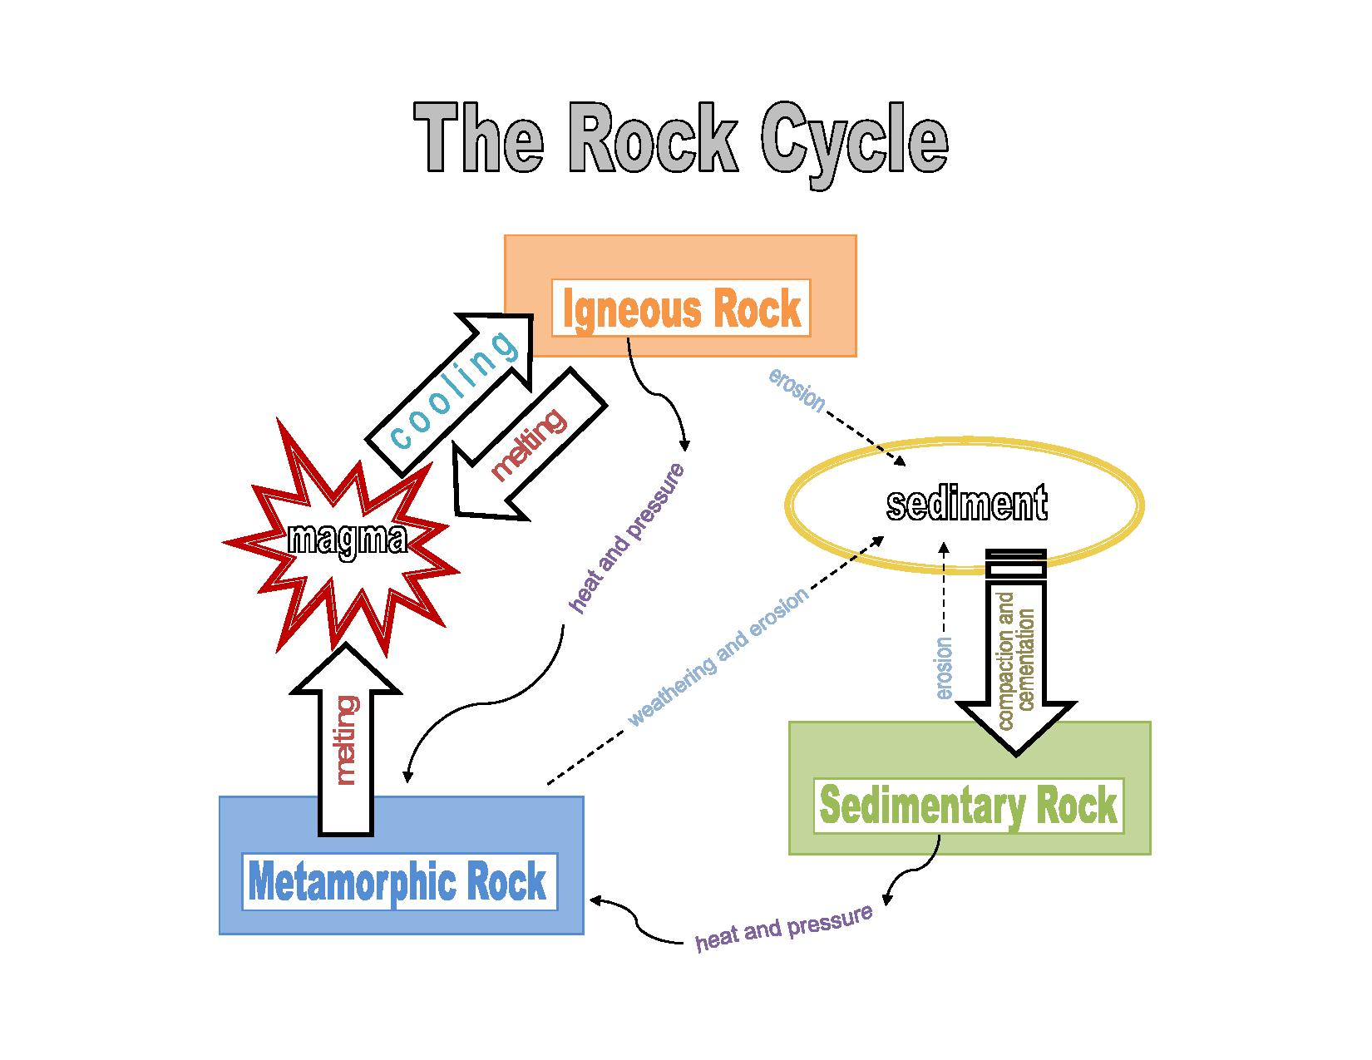
This picture shows how one rock can be converted into another.
A better picture of the rock cycle.
There’s a song on the next slide where it is explained that most rocks can be changed into other rocks.
So this picture is more realistic.

Slide 4
The rock cycle
https://www.youtube.com/watch?v=G7xFfezsJ1s 2min 35s
song about how rocks can turn into other rocks - it’ a good summary but try not to get too distracted by the man!

Slide 5
How can rocks get heated up?
Metamorphism. Over very long periods of time, sedimentary or igneous rocks end up buried deep underground, usually because of the movement of plates which form the Earth’s crust ( tectonic plates). While underground, these rocks are exposed to high heat and pressure, which changes them into metamorphic rock. This tends to happen where tectonic plates come together: the pressure of the plates squish the rock that is heated from hot magma below.
(Tectonic plates are large sections of the earth’s crust that move separately from each other. Their movement often results in earthquakes.)

Slide 6
How can rocks actually melt? (and form igneous rock)
Rock Melting. Can you imagine ‘rock hard’ rocks melting? That’s what they do in the depths of the earth! Metamorphic rocks underground melt to become magma. When a volcano erupts, magma flows out of it. (When magma is on the earth’s surface, it is called lava.) As the lava cools it hardens and becomes igneous rock. As soon as new igneous rock is formed, the processes of weathering and erosion begin, starting the whole cycle over again!

Slide 7
Look at the next slide - even more detailed rock cycle

Slide 8
Rock cycle
Weathering breaks down rocks.
igneous rocks
basalt
volcano
Rocks rise
to the surface by
uplift and erosion.
transportation
and deposition
sea
Magma
rises to
the surface
where it
cools rapidly.
igneous rocks
granite
sedimentary rocks
mudstone
high pressure
and temperature
slow solidification
metamorphic rocks slate and marble
magma
melt
Notes:
8

Slide 9
AFL Check: Rock cycle quiz
TASK- Complete the following quiz on paper by writing full sentences. Check your answers
No
1. Does the rock cycle ever stop?
Sedimentary, Igneous, Metamorphic
2. What are the 3 categories of rock?
Yes
3. Could a rock go from sedimentary rock to metamorphic rock?
Yes
4. Could a metamorphic rock became an igneous rock?
No
5. Could a rock go through the entire cycle in our lifetime?
Slowly
6. Does geology move quickly or slowly compared to our lives?
Geology- the study of rocks.

Slide 10
Homework is
To draw the diagram on slide 3 on paper (or in your book if you have it)
AND to complete the quiz!

