Slide 1
Diseases
QUIZ a disease that can be spread to a person from another person, an animal or object is called...
A A non communicable disease
B an identifiable disease
C a notifiable disease
D a communicable disease
See slide 3 for the answer

Slide 2
Disease-Causing Organisms that are so small they can only be seen through a microscope are.
Any condition that interferes with the proper functioning of the body or mind is a ...
A malapropism
B cirrhosis
C disease
A microbes
B pathogens
C bacteria

Slide 3
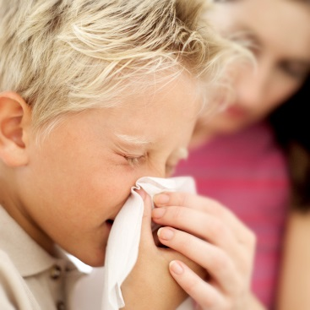
Definitions what is a Communicable disease:
Communicable disease: a disease that can be spread to a person from another person, an animal or object. Ex: common cold, influenza, etc.
Non-communicable disease: a disease that can NOT be spread from person to person. Ex: cancer, heart disease, asthma, etc.

Slide 4
What’s a pathogen?
Make your own notes from the next slide.

Slide 5
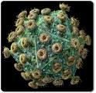
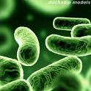
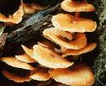

Four Types of pathogens: disease causing microscopic organisms
Virus: smallest simplest life form.
Genetic instructions enclosed in protein case. Not alive. Cause upper respiratory infections and many other type of diseases.
Bacteria: Prokaryotic single-celled organisms. They are everywhere. Not all bacteria are bad.
Fungi: Eukaryotic organisms (as are plants nd animals)more complex than bacteria, but cannot make their own food. Thrive in warm, moist environments.
Protozoa: - the ONE we need to know causes malaria
Protists are eukaryotes, which means their cells have a nucleus and other membrane-bound organelles. Most protists are single-celled. Other than these features, they have very little in common. Animal like ones are called protozoa whilst plant like ones are called algae

Slide 6
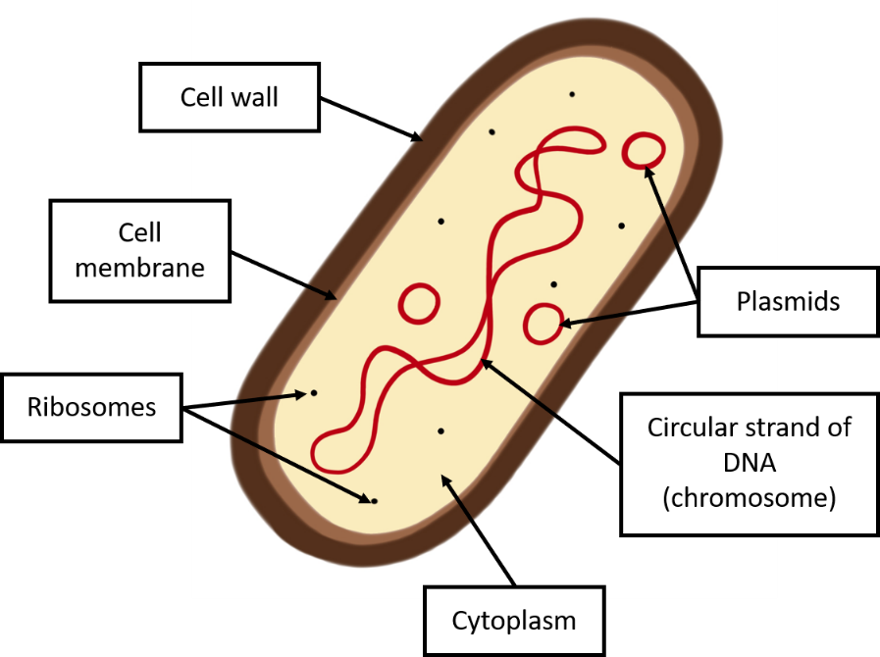
Bacteria are small prokaryotic cells (~100th the size of a body cell). They produce toxins which can make you feel ill by damaging cells and tissues
Bacteria can reproduce rapidly in the body by binary fission. They are alive and carry out the seven life processes

Slide 7
See if you can guess the disease on the next slide – how many clues did you need?

Slide 8
Work in two or three- describe to the person having the disease what their symptoms are- how many guesses before they realize what they have caught?
Some bacteria have infected you
You have fever and stomach cramps
you have vomiting and diarrhoea
You caught this by eating uncooked chicken
Next slide for answer

Slide 9
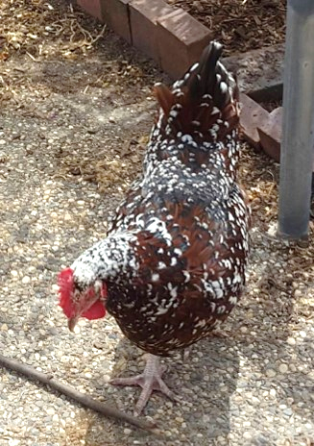
Salmonella
Salmonella infection can cause fever, stomach cramps, vomiting and diarrhoea. In other words: food poisoning. These symptoms are caused by toxins produced by the bacteria.
Salmonella infection almost always results from eating contaminated food. e.g. food which was prepared in unhygienic conditions, or eating a chicken which contracted salmonella while it was alive.
Cooking food thoroughly kills Salmonella.

Slide 10
Salmonella- make your own notes
Salmonella infection-symptoms?
How is it caught?
Cooking thoroughly kills Salmonella.

Slide 11
Answer is on next slide
What disease do you have if?
You have pain when you urinate
It’s caused by a bacterium
You caught this as a result of unprotected sex.
You have a thick yellow or green discharge from your vagina or penis.

Slide 12
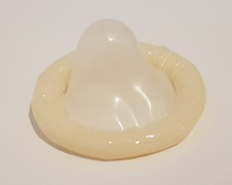
Gonorrhoea- a couple of shocking extra points
Gonorrhoea is a bacterial sexually transmitted disease (STD). It is passed on by having unprotected sex. Barrier methods of contraception, such as condoms, can reduce the spread.
Gonorrhoea infection can cause pain when urinating and a thick yellow or green discharge from the vagina or penis.
In recent times some strains have become resistant to penicillin (‘super gonorrhoea)
Untreated gonorrhoea can cause long term pelvic pain, infertility, and ectopic pregnancies. Babies born to infected mothers may have severe eye infections and even become blind.
All sexual partners of an infected individual must be treated to prevent the spread of this disease. 10% of infected men and 50% if infected women have no symptoms

Slide 13
List the cause, this is spread and the symptoms for gonorrhoea in your book…..

Slide 14


VIRUSES are not cells, nor are they considered to be living organisms. They are about 1/100th the size of a bacterium. Like bacteria, they can replicate rapidly.
Viruses take over cells and use the cell’s own machinery to make copies of themselves. The infected cell will usually burst releasing the new viruses. This cell damage and side-effects of the immune system response are what make you feel ill.

Slide 15
If you had these symptoms what disease might you have? How many clues did it take?
You have a fever
You have a skin rash
It’s serious so you may go blind, get brain damage or die
There is not treatment for this. Someone infected needs to be isolated to stop the spread of the virus
The answer is at the top of the next slide

Slide 16
The answer was measles
Another viral disease…
HIV what do you know about it?
How is HIV is a virus spread?
What are the symptoms?
What can be achieved with medication if HIV is detected and treated?

Slide 17
HIV
HIV is a virus spread by unprotected sex (including oral sex) or by exchanging body fluids such as blood (e.g. by drug needle sharing).
At first the patient has flu-like symptoms which last a couple of weeks. Usually they don’t experience further symptoms for several years. At this stage the virus can be controlled with antiretroviral drugs.
List the cause, way it is spread, the symptoms …..

Slide 18
HIV What can be achieved with medication if HIV is detected and treated? Make notes about this
AIDs cannot yet be cured. The virus attacks immune cells. Left untreated, the immune system becomes so damaged that it cannot defend against other infections. This is known as late-stage HIV infection or AIDS.
The use of anti retroviral drugs, which should be started as soon as possible after the infection for best results, can prevent the development of AIDs for many years
The treatment of AIDs achieves these things…..
Stop the virus from replicating
Reduce the risk of infecting others
Normal life expectancy

Slide 19

THE PLANT VIRAL DISEASE WHICH YOU MUST KNOW ABOUT
Tobacco Mosaic Virus – infects around 150 species of plant
It is transmitted when healthy plants contact diseased ones. Insects can also carry it between plants. There is not treatment and the virus can remain infectious in the soil for 50 years
Tobacco mosaic virus (TMV) is a virus which infects plants including tomatoes and tobacco. It causes a mosaic discolouration and wrinkling on the plant’s leaves. This means that the plant cannot photosynthesise as effectively, so the virus affects growth.
List the cause, how is this spread and what are its symptoms…..
How could you stop it from spreading in your garden?
Don’t contaminate one plant from another, kill pests and
Use TMV resistant strains of plants!

