Slide 1
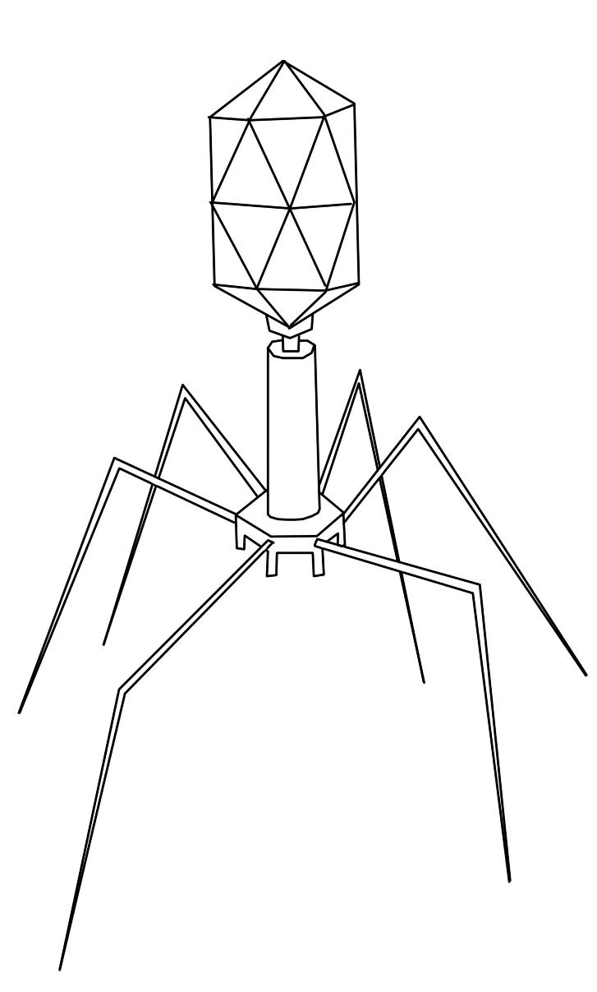
Communicable Disease
Notes:
Ask them to write a short sentence or two about what being physically and mentally well means to them.
For example no diseases, well fed, uninjured, not under too much stress etc.

Slide 2
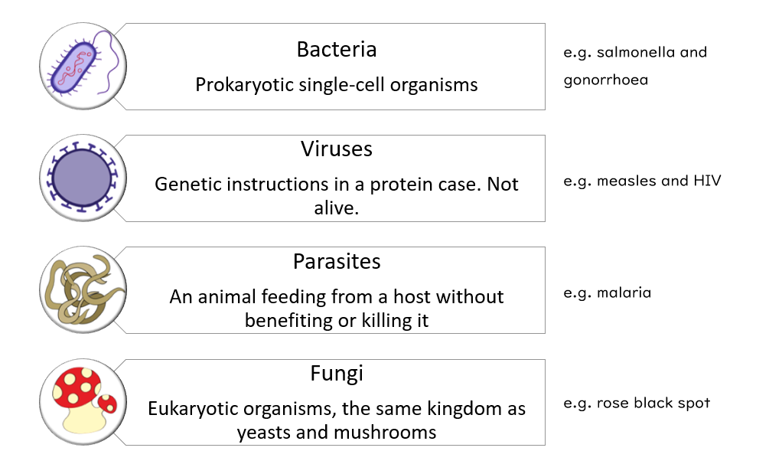
Recap: Types of Pathogen (disease causing organism)

Slide 3
Prior knowledge check:
Quick Quiz
Pathogens can infect:
Animals
Plants
Both
The malarial protist is a type of:
Bacterium
Parasite
Virus
Fungus

Slide 4
Prior knowledge check Answers:
Quick Quiz
Pathogens can infect:
Animals
Plants
Both
The malarial protist is a type of:
Bacterium
Parasite
Virus
Fungus

Slide 5

FUNGI are eukaryotic organisms (their cells have…?)
which can be single-celled or have bodies (like threads in the soil) made up of hyphae (pronounced high-fee). These hyphae can cause disease when they burrow into the surface of plant skin or leaves.
nuclei
Rose Black Spot
Black or purple spots form on leaves which then turn yellow and drop off. Like TMV, rose black spot means that less photosynthesis can happen, interfering with growth.

Slide 6

Hyphae can produce spores which spread disease to other animals and plants. In the case of Rose Black Spot, it spreads from plant to plant in water or by wind.
Gardeners can treat Rose Black Spot by removing diseased leaves and destroying them so that the disease cannot spread to other plants. Affected rose plants can be treated with fungicide sprays.

Slide 7
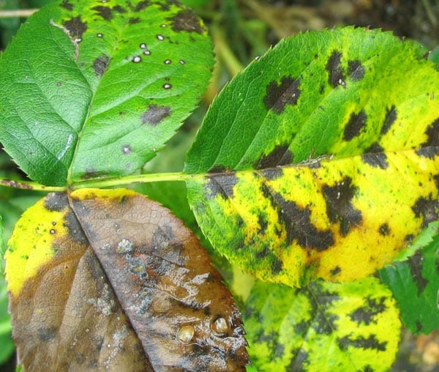
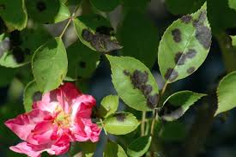
Rose black spot
This is caused by a fungus whose spores are carried by the wind and water.
This is a nuisance because…..
Reduce its impact by…….
Remove parts and burn
Fungicide
Resistant types of rose
https://www.youtube.com/watch?v=ulx5GyaHAZg 3-4 mins

Slide 8
PROTISTS
Protists are eukaryotes too, most of them are single-celled. Some of them are parasites.
Sometimes they are carried to new organisms, which they infect, by a VECTOR organism. (This does not get the disease). An example is malaria. This causes repeated bouts of fever and is often fatal.
Which vector carries malaria?
Leeches
Midges
Mosquitos
Fruit flies

Slide 9
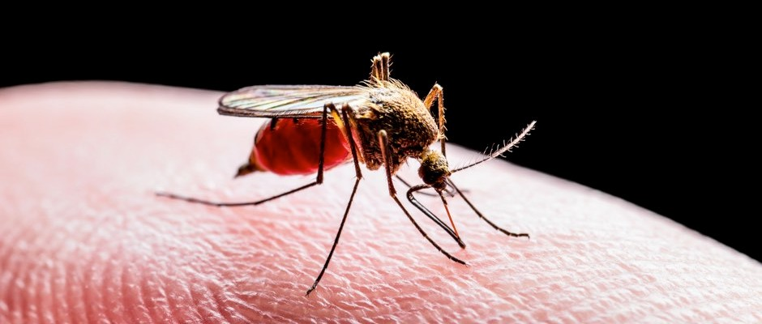
What disease would you have if these were your symptoms?
tiredness
sweating
fever
malaria
Vomiting and headaches
diarrhoea
WATCH
https://www.youtube.com/watch?v=nFcvDVf1XRI
https://www.youtube.com/watch?v=qw6jnFqZ-Hk
How can we prevent it?

Slide 10
What disease would you have if these were your symptoms?
tiredness
sweating
fever
malaria
Vomiting and headaches
diarrhoea
Malaria is caused by 5 different species of a protist called Plasmodium
About half a million people die from this disease every year
The pathogens are transmitted from one person to the next by one particular female kind of mosquito.
https://www.youtube.com/watch?v=nFcvDVf1XRI
https://www.youtube.com/watch?v=qw6jnFqZ-Hk
How can we prevent it

Slide 11
Protists are eukaryotic too, most of which are single-celled and some of which are parasites. Sometimes they are carried to new hosts by a vector organism which does not get the disease itself. Malaria is an example which causes repeated bouts of fever and is often fatal.
Which vector carries malaria?
Leeches
Midges
Mosquitos
Fruit flies

Slide 12
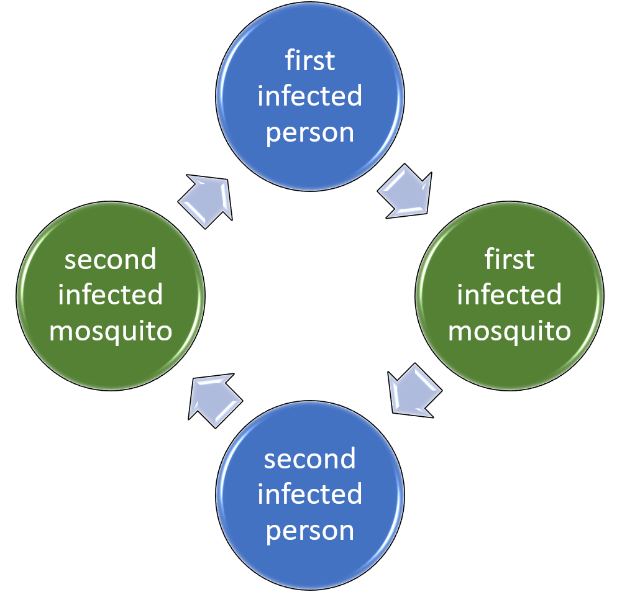
When a mosquito bites an infected person or animal, it picks up the malaria protist. The mosquito becomes the vector for the disease.
It then bites another person or animal, infecting them by inserting the protist into the victim’s blood vessels.
Insecticides and mosquito nets can protect people from being bitten and catching malaria.

Slide 13
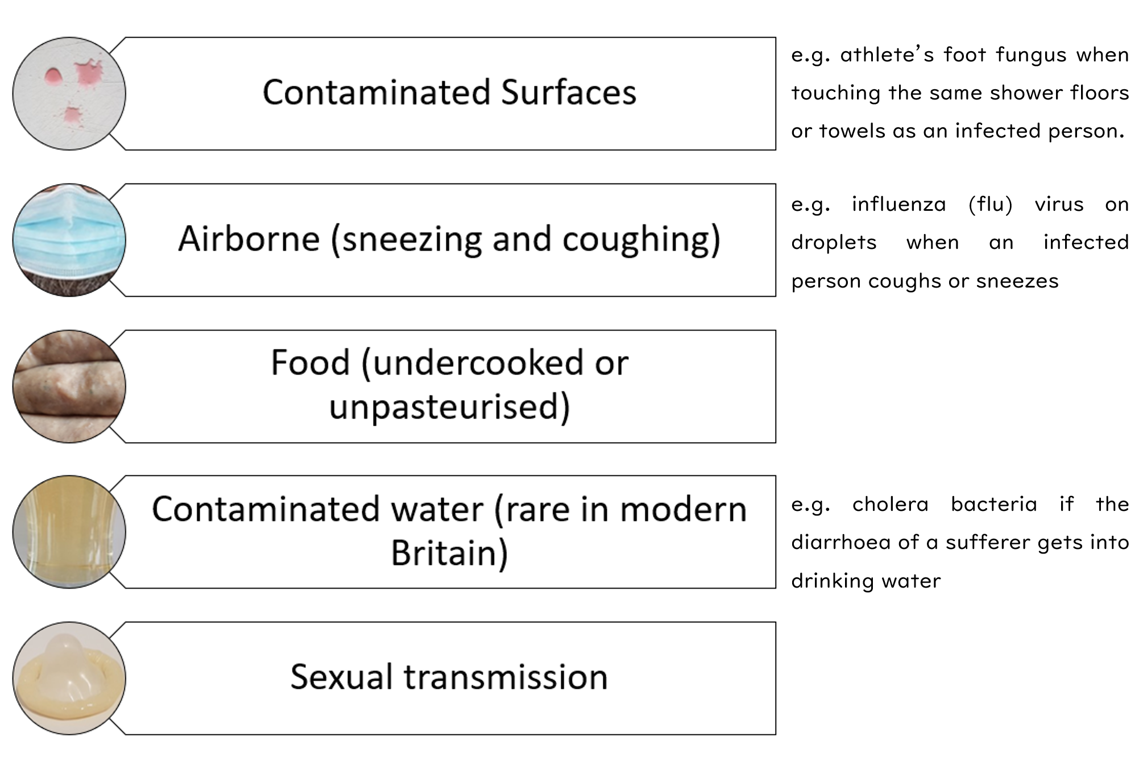
Recap: Methods of Transmission of communicable diseases

Slide 14
How can we prevent the spread of communicable diseases?
Think about this and then make your own notes from the next slide
Prevention
Notes:
Mind map methods of containment with the class. If using an interactive whiteboard draw on directly, otherwise use a flip chart.

Slide 15


