Slide 1

Energy Changes & the Atmosphere
Year 9
TERM 5 WEEK 1
Exothermic and Endothermic Reactions

Slide 2
Learning Objectives
energy cannot be created or destroyed in a chemical reaction
that energy is transferred to or from the surroundings in chemical reactions, and some examples of these exothermic and endothermic reactions
how to distinguish between exothermic and endothermic reactions on the basis of the temperature change
how to carry out an investigation into energy changes in chemical reactions

Slide 3
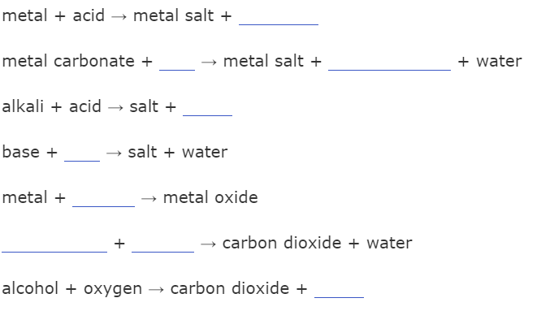
Starter – Retrieval Practice
Fill in the blanks

Slide 4
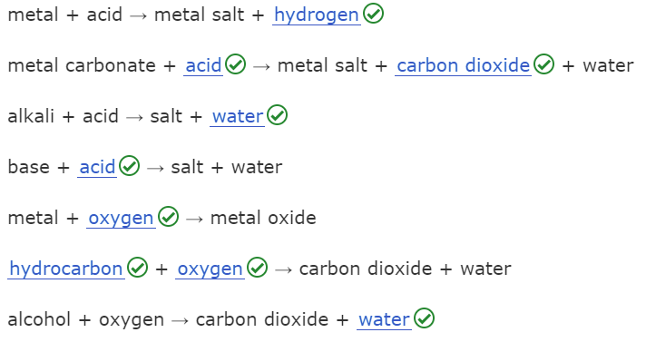
Starter – Retrieval Practice
ANSWERS

Slide 5
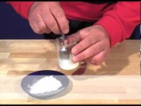
An exothermic reaction

Slide 6
Law of Conservation of Energy
Energy is conserved in chemical reactions. It is neither created nor destroyed.
In an EXOTHERMIC reaction, chemical energy from the reacting chemicals is converted into heat energy.
Heat energy is given out to the surroundings and the temperature of the surroundings INCREASES

Slide 7
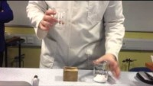
An endothermic reaction

Slide 8
Law of Conservation of Energy
Energy is conserved in chemical reactions. It is neither created nor destroyed.
In an ENDOTHERMIC reaction, heat energy from the surroundings is converted into chemical energy in the products
The temperature of the surroundings DECREASES.

Slide 9
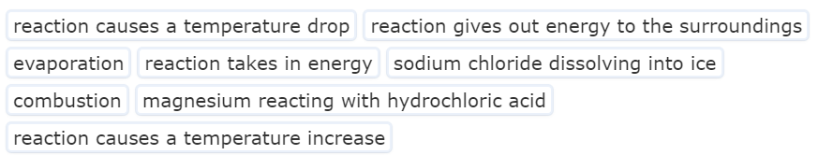
Exothermic or Endothermic?
Sort the statements – which describe fit with exothermic and which with endothermic? You may need to research couple of these.

Slide 10
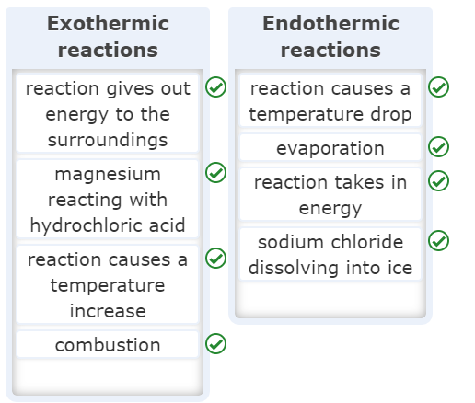
Exothermic or Endothermic? ANSWERS

Slide 11
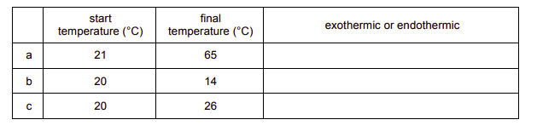
The table shows the temperature change in some reactions. State whether each reaction is exothermic or endothermic.

Slide 12
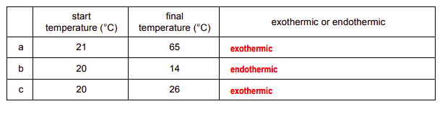
The table shows the temperature change in some reactions. State whether each reaction is exothermic or endothermic.

Slide 13
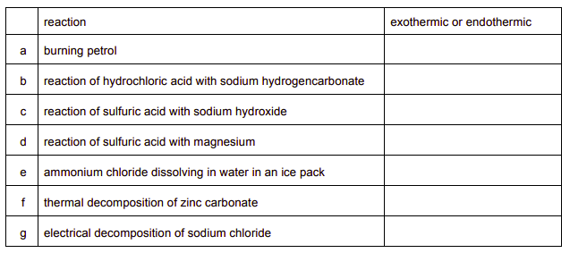
Home learning – find out whether each of the following is exothermic or endothermic

