Slide 1

Energy Changes & the
Atmosphere
Year 9
TERM 5 WEEK 2
Measuring Energy Changes in Chemical Reactions

Slide 2
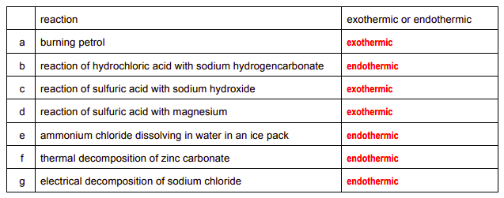
Home learning answers from week 1

Slide 3
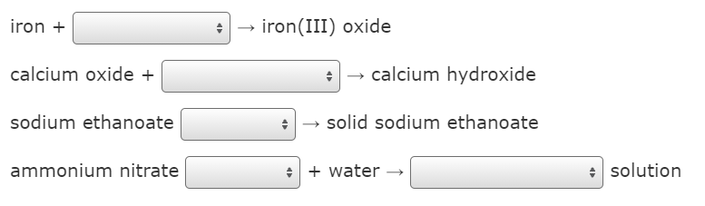
Retrieval Starter – complete the equations
+ water

Slide 4
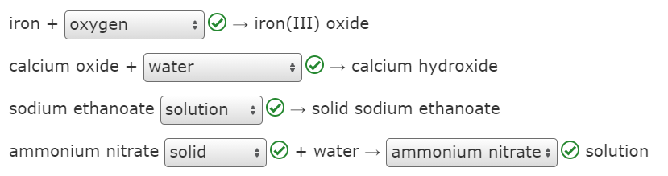
Retrieval Starter – ANSWERS
+ water

Slide 5
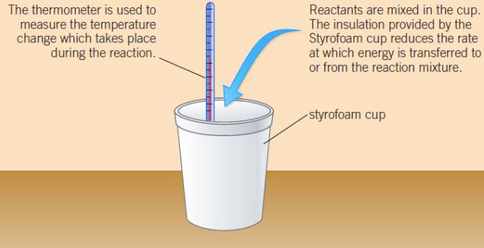
Investigating temperature changes
This is the basic apparatus for the experiment – how could it be improved?

Slide 6
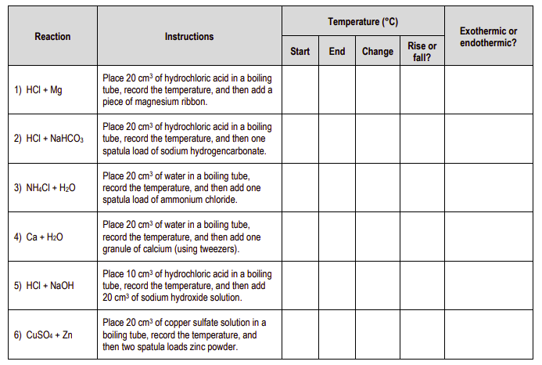
Your teacher will demonstrate – record your answers in the table

Slide 7
Challenge – write symbol equations for each experiment.

Slide 8
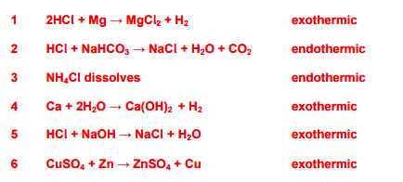
ANSWERS

Slide 9
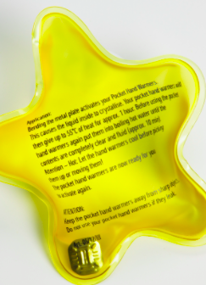
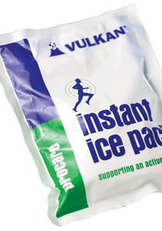
Home learning
Hand warmers and cold packs for sports injuries work using exothermic and endothermic reactions
Find out how each one works and which chemicals they contain
Make a leaflet explaining your findings

