Slide 1

Energy Changes & Atmosphere
Year 9
TERM 5 WEEK 3
Factors affecting energy changes in chemical reactions

Slide 2
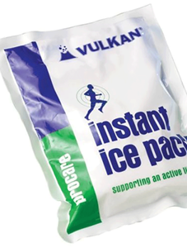
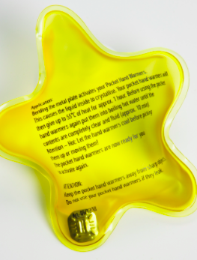
Home Learning Check In
Show you neighbour your leaflet and look at their work
Give a WWW and an EBI

Slide 3
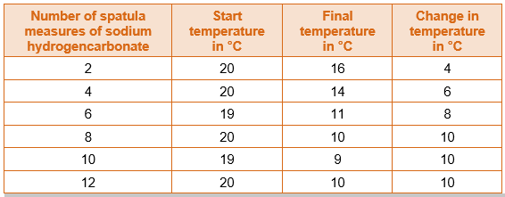
Starter – Data Analysis
Some students did an experiment to find the temperature change when hydrochloric acid reacts with sodium hydrogencarbonate.
State the type of energy transfer for this reaction.
Describe and explain, as fully as you can, the trends shown in the students’ results

Slide 4
Starter – Data Analysis - ANSWERS
a) It is an endothermic reaction because the temperature falls.
b) The more sodium hydrogencarbonate, the greater the temperature change, up to eight spatula measures.
When more sodium hydrogencarbonate is added, the temperature change is constant.
This is because all the acid has been used up.

Slide 5
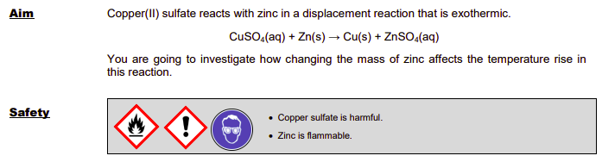
Experiment – Temperature Rise

Slide 6
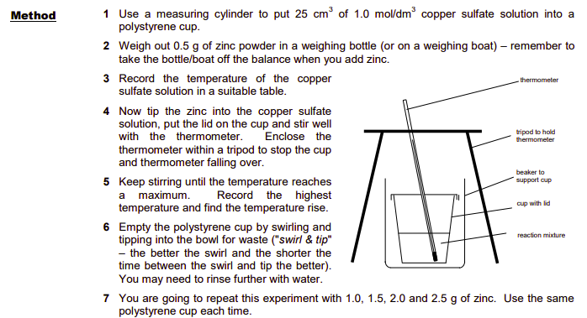
Experiment – Temperature Rise

Slide 7
Experiment – Temperature Rise
RECORD YOUR RESULTS IN A SUITABLE TABLE

Slide 8

Graph & Conclusions
Plot a graph of temperature rise against mass of zinc.
Describe what the results tell us how changing the mass of zinc affects the temperature rise in this reaction.
Predict the temperature rise if you reacted 10 g of zinc with 25 cm3 of 1.0 mol/dm3 copper(II) sulfate solution. Explain your answer.

Slide 9
Variables
Identify the independent, dependent and key control variables in this investigation.
Independent =
Dependent =
Control =
Explain why the control variables had to be controlled in this experiment.

Slide 10
Experimental details
Explain why it did not matter if the start temperature was the same in each experiment.
What was the resolution of the thermometer? Was this good enough for this experiment? Explain your answer

Slide 11
Evaluation
Did you get any anomalous results? Identify them or state that there are none, and explain your answer
Look at the results of some other students and explain whether the experiment is reproducible.

Slide 12
Home Learning
Watch the video
Write a detailed method with justification for the experiment described

Slide 13


