Slide 1

Energy Changes & Atmosphere
Year 9
TERM 5 WEEK 4
Reaction Profiles

Slide 2
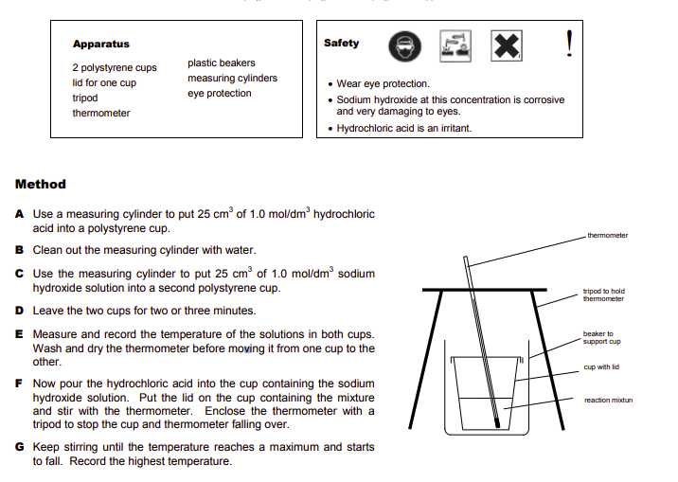
Home Learning – How did you do?

Slide 3
Learning Objectives
how to draw simple reaction profiles for exothermic and endothermic reactions, including the activation energy
the definition of activation energy
how to use reaction profiles to identify reactions as exothermic or endothermic

Slide 4
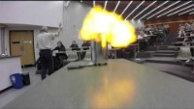
Example 1 – Burning Hydrogen

Slide 5
Questions
Write an equation for the reaction.
State whether the reaction is exothermic or endothermic.
Draw a labelled reaction profile diagram for this reaction.
Identify the number and type of bonds that are broken and formed.

Slide 6
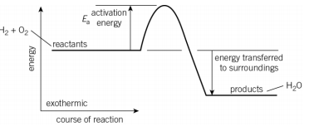
Answers
Write an equation for the reaction.
2H_{2 (g)} +O_{2 (g)} -> 2H₂O _{(l)}
State whether the reaction is exothermic or endothermic. Exothermic
Draw a labelled reaction profile diagram for this reaction.
Identify the number and type of bonds that are broken and formed.
Bonds broken: 2 × H–H and 1 × O=O Bonds formed: 4 × O–H

Slide 7
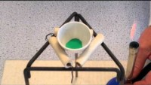
Example 2 – thermal decomposition of copper carbonate

Slide 8
Questions
Write an equation for the reaction.
State whether the reaction is exothermic or endothermic.
Draw a labelled reaction profile diagram for this reaction.

Slide 9
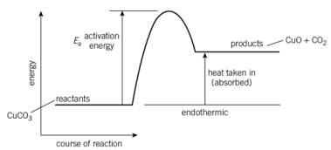
Questions
Write an equation for the reaction.
CuCO₃ _{(s)} -> CuO _{(s)} + CO₂ _{(g)}
State whether the reaction is exothermic or endothermic.
Endothermic
Draw a labelled reaction profile diagram for this reaction.

Slide 10
You Try
Draw labelled energy level diagrams for the following reactions:
a H₂ + Cl₂ → 2HCl; energy released to the surroundings = 184 kJ/mol
b ZnCO₃ → ZnO + CO_{2;} energy required from the surroundings = 71 kJ/mol
c C₃H₈ + 5O₂ → 3CO₂ + 4H₂O; energy released to the surroundings = 2200 kJ/mol
d HCl + NaOH → NaCl + H₂O; energy released to the surroundings = 57 kJ/mol

Slide 11
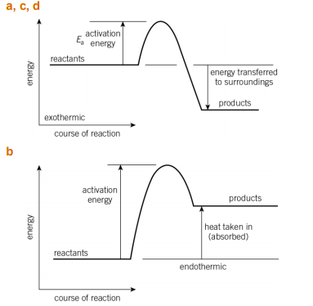
Answers

Slide 12
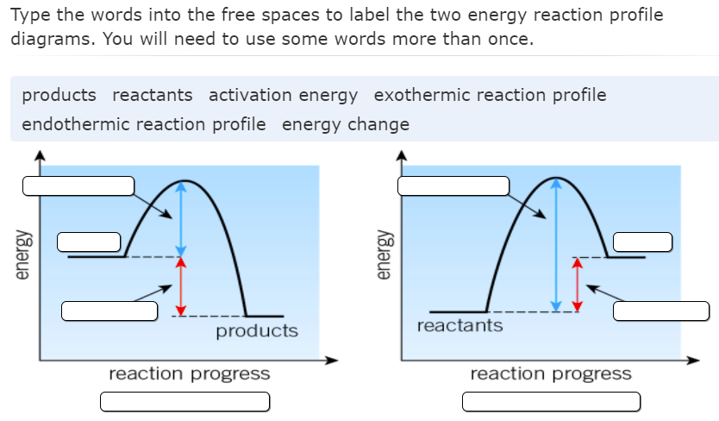
Plenary Activities

Slide 13
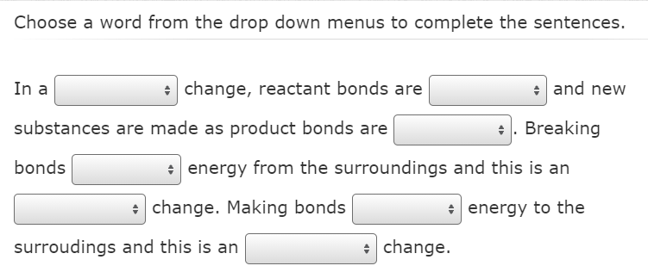
Plenary Activities

Slide 14
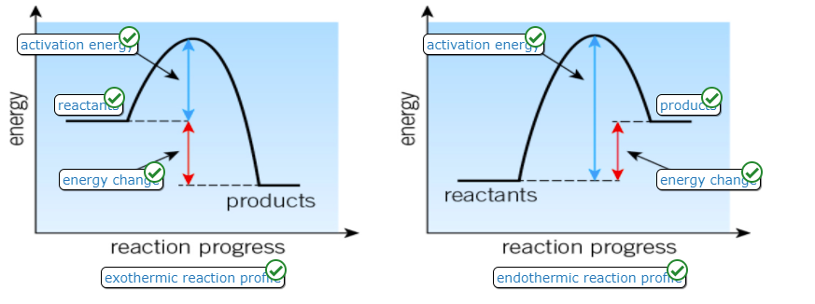
Plenary Activities - Answers

Slide 15
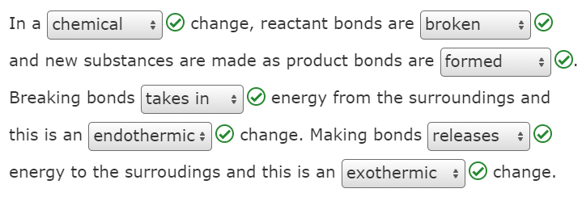
Plenary Activities - Answers

Slide 16
Home Learning
Home learning sheet is in the folder for this week.
Year 9 Home Learning Term 5 Week 4

