Slide 1

Energy Changes & Atmosphere
Year 9
TERM 5 WEEK 5
Our Evolving Atmosphere

Slide 2
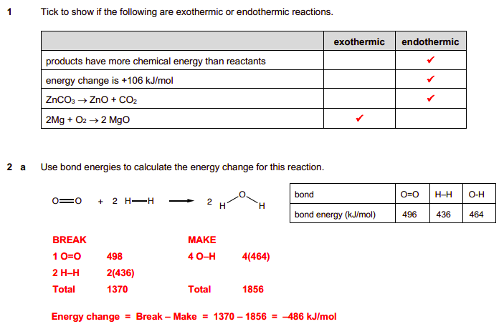
Home Learning – How did you do?

Slide 3
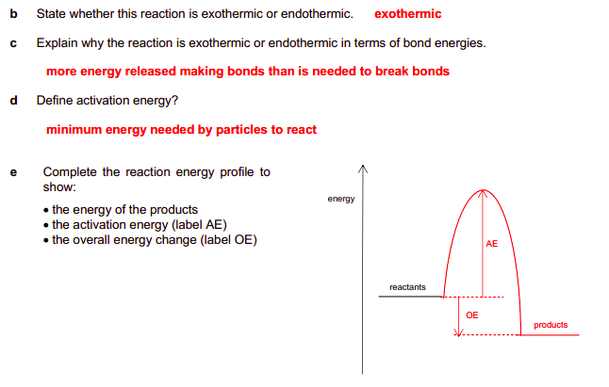
Home Learning – How did you do?

Slide 4
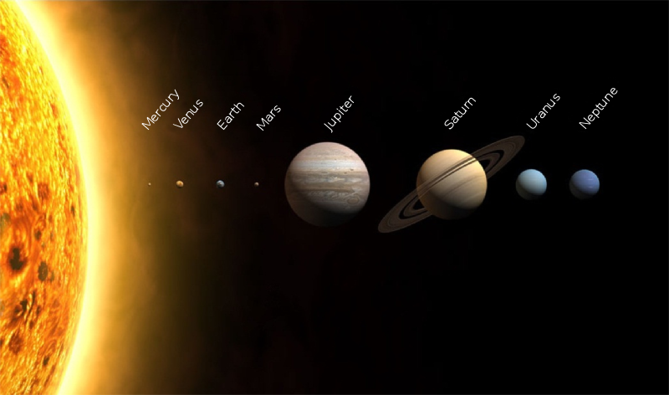
The Early Atmosphere
The Earth may have had an atmosphere like Venus and Mars when it was young?
Image from Wikipedia

Slide 5
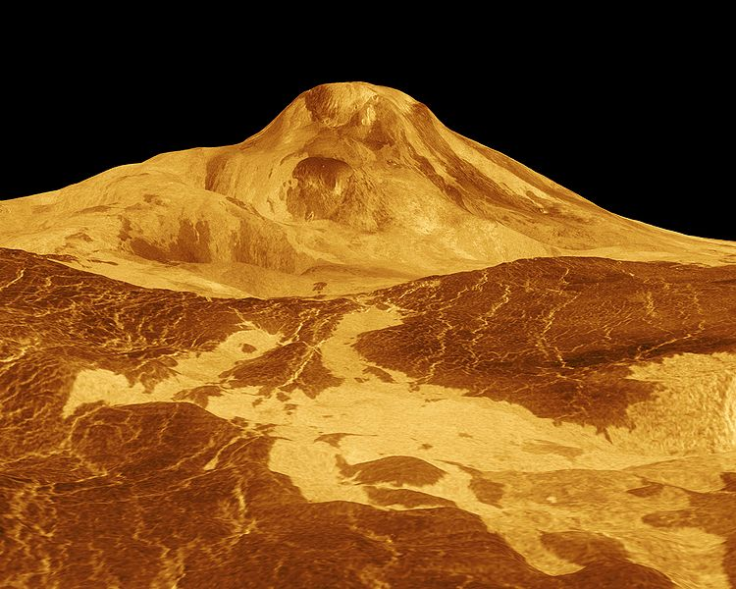
There was intense volcanic activity on the Earth when it was young
The gases in the early atmosphere may have come from inside planets through volcanoes
VENUS today
Image from Wikipedia

Slide 6
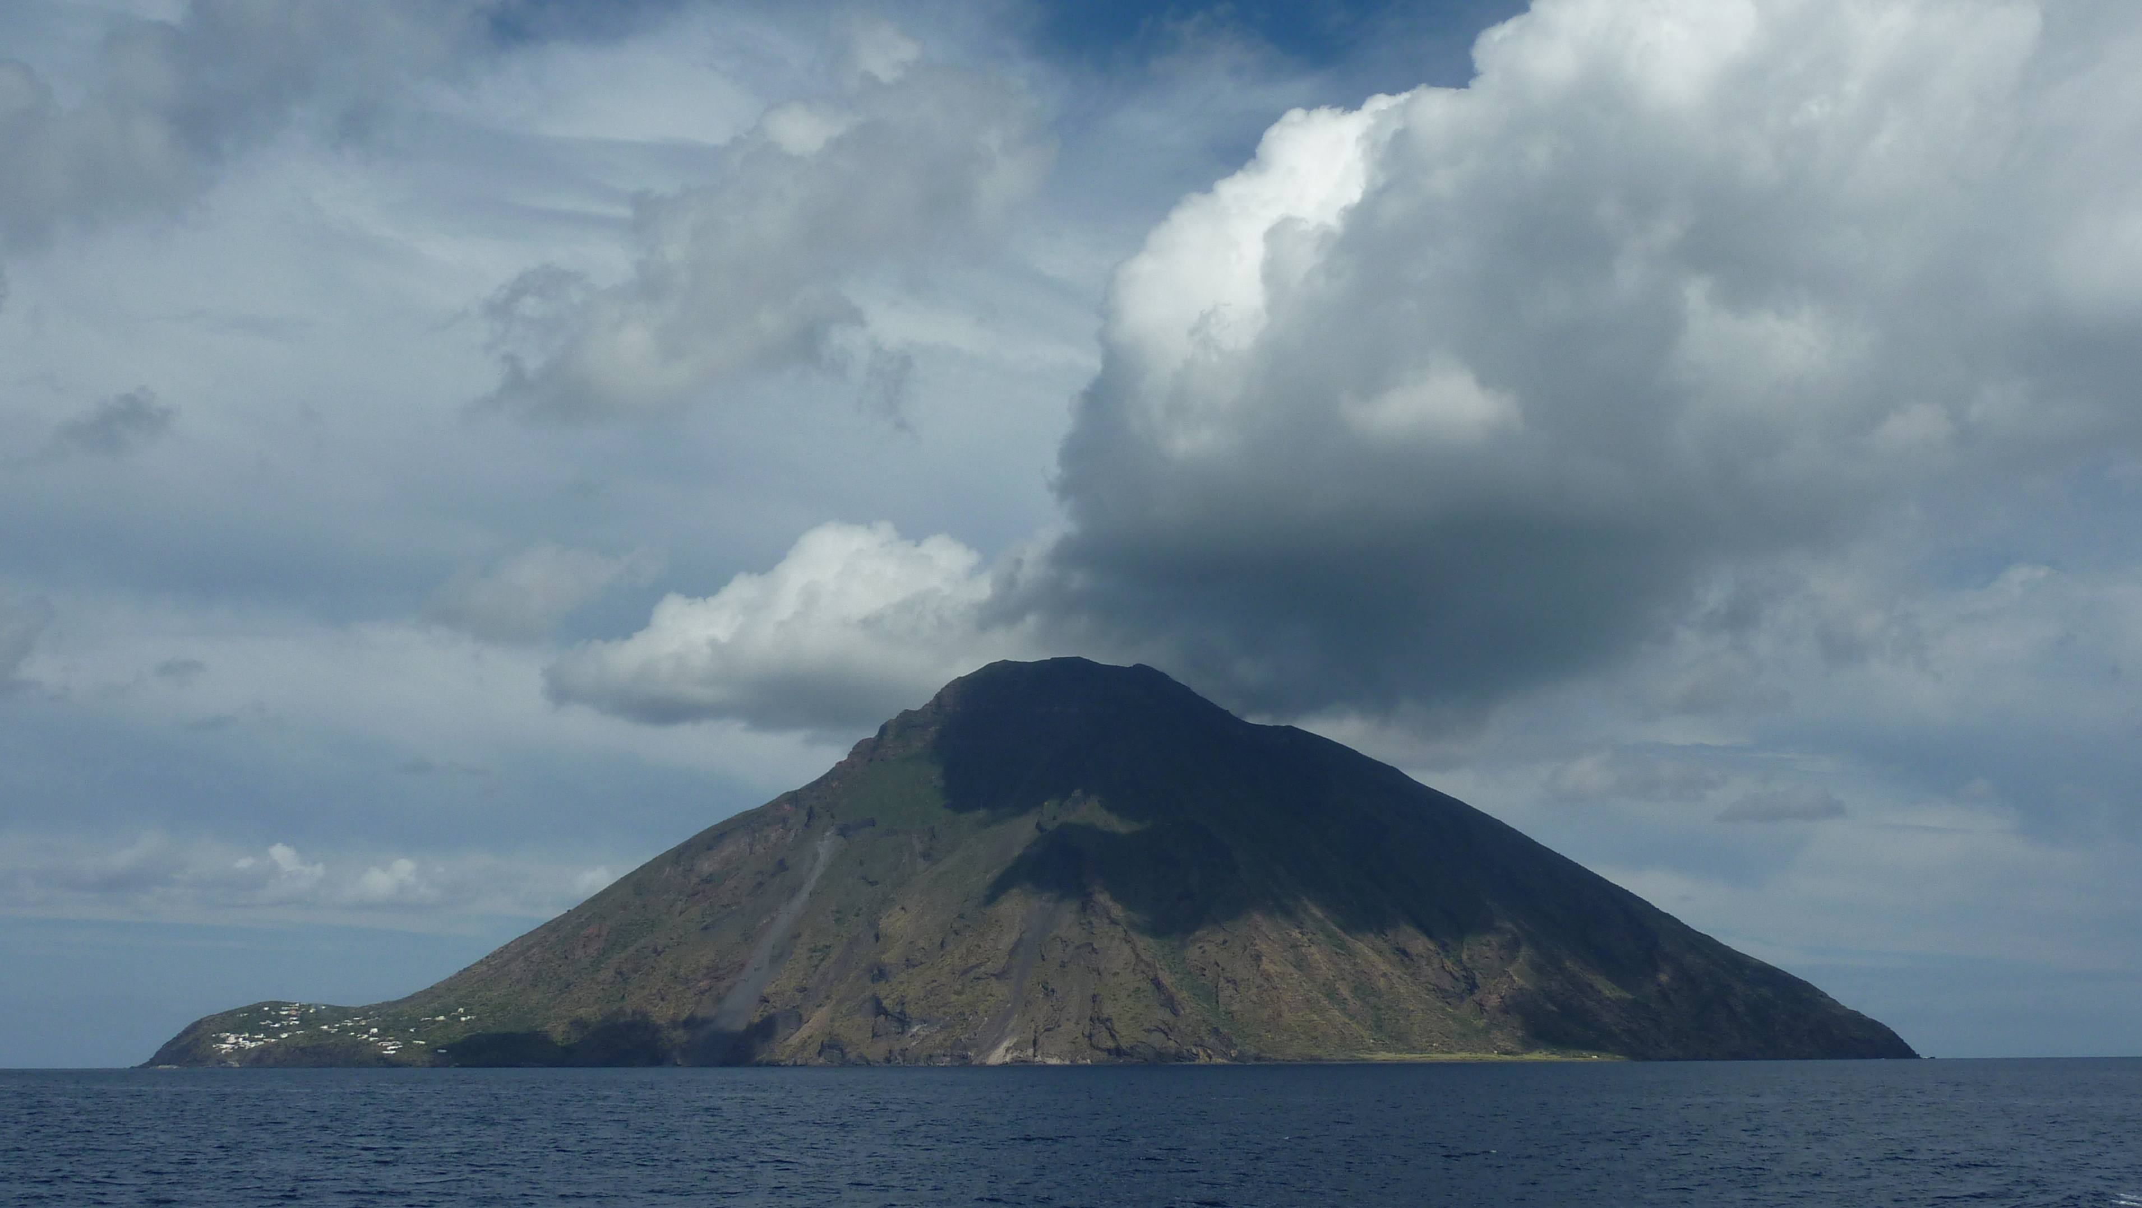
OCEANS may have formed as water vapour from volcanoes cooled and condensed as the Earth cooled down

Slide 7
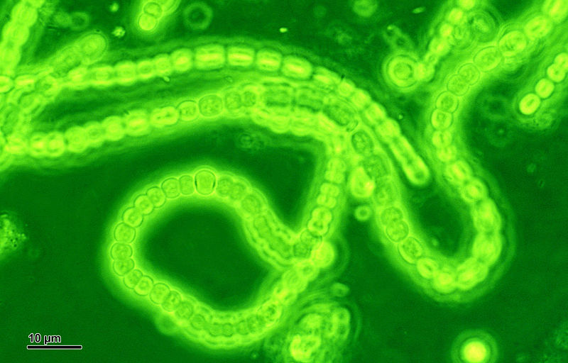
About 2.7 billion years ago - CYANOBACTERIA evolved
- first creature to photosynthesise
carbon dioxide + water ➔ oxygen + glucose
6CO₂ + 6H₂O ➔ 6O₂ + C₆H₁₂O₆

Slide 8
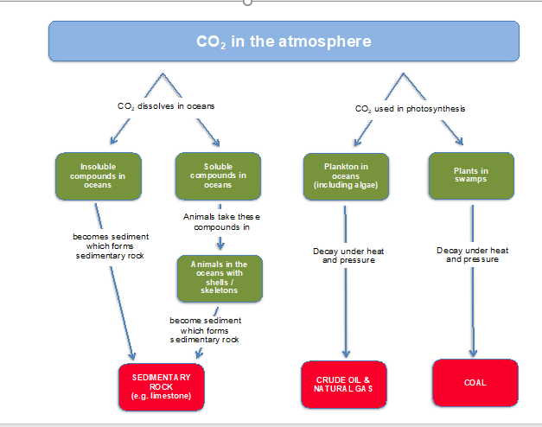

Slide 9
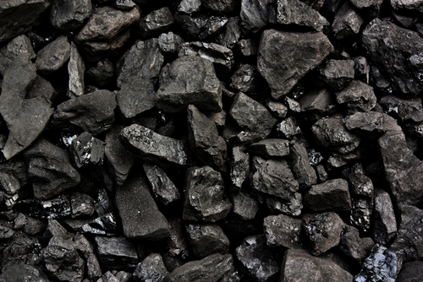
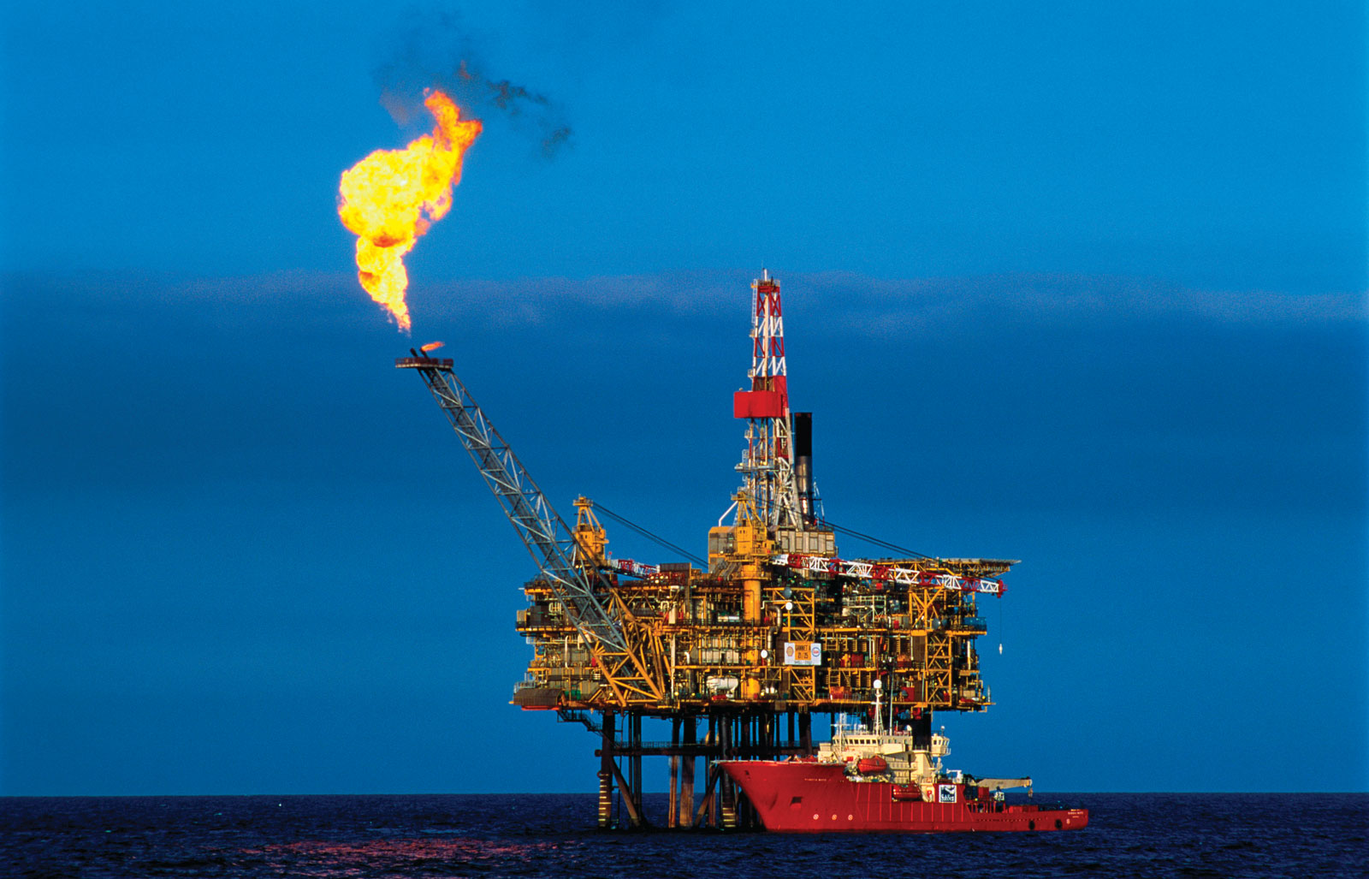
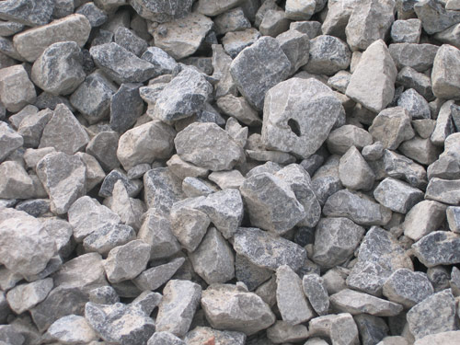
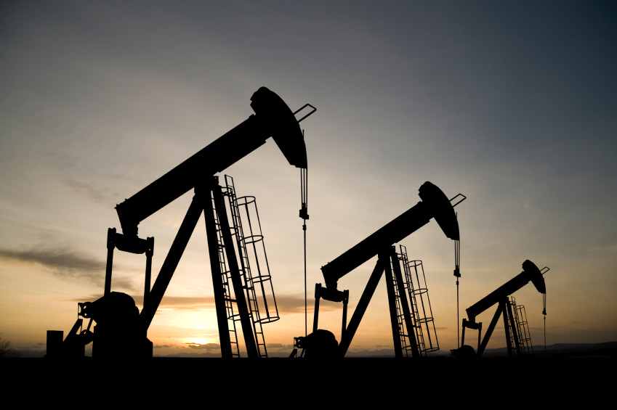
NATURAL GAS
COAL
Much of the C from the original CO₂ is now locked up in
OIL
SEDIMENTARY ROCK

Slide 10

Home Learning Project – Gases in the Air
For each of the gases in the modern atmosphere – research the following information.
Ensure you include nitrogen, oxygen, argon, carbon dioxide and water vapour.
Think about how to present the information in a clear and engaging way.

