Slide 1

Energy Changes & Atmosphere
Year 9
TERM 5 WEEK 6
% Oxygen in the Air

Slide 2
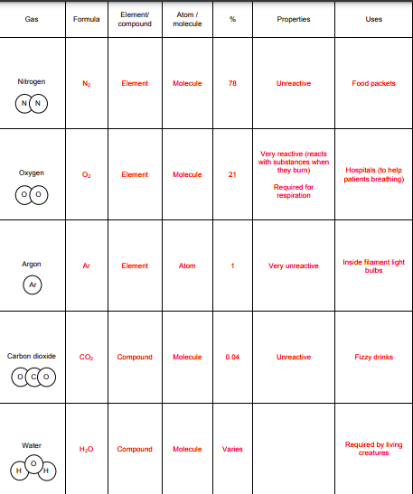
Home Learning Project – How did you do?

Slide 3
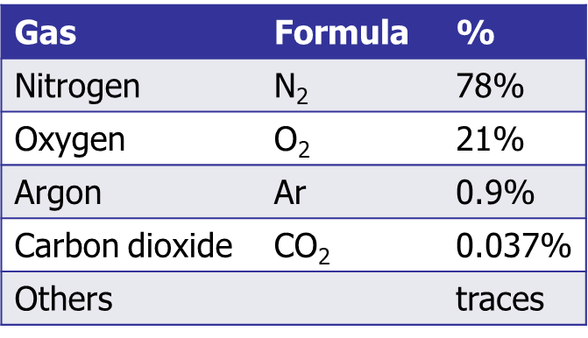
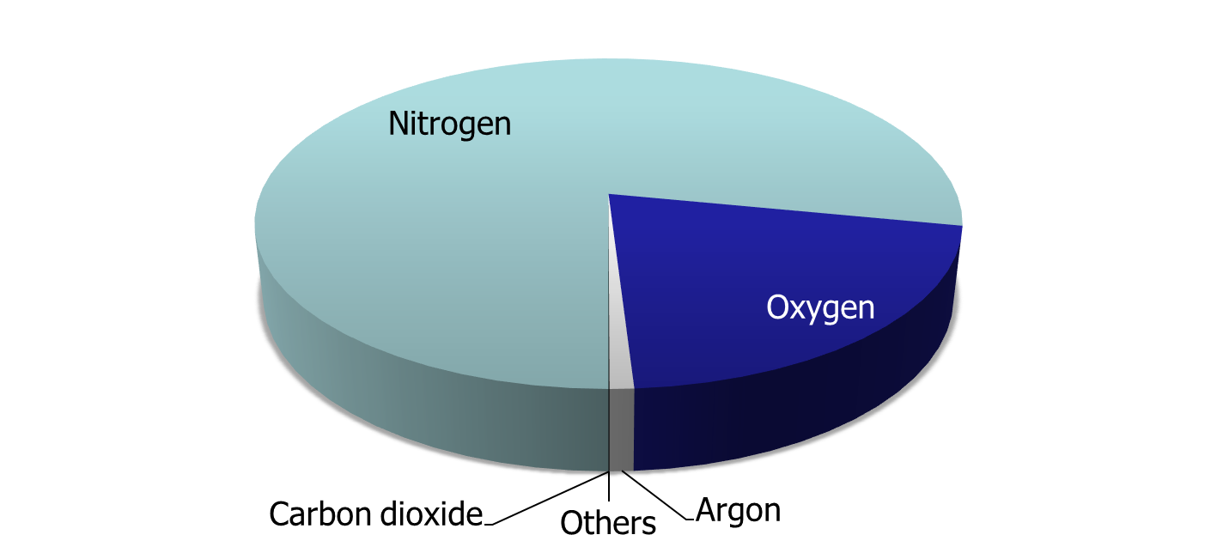
The atmosphere today

Slide 4
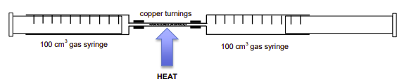
Percentage oxygen in the air demonstration
When copper is heated it reacts with oxygen. In this experiment, 100 cm³ of air is going to be passed over some copper turnings that are being heated strongly. As the air passes over the copper, the oxygen in the air will react with the copper. By seeing what volume of air remains after the reaction, we can work out the % of oxygen in the air. The air will be passed over the hot copper several times to give all the oxygen chance to react.

Slide 5
Method
100 cm³ of air is placed in one of the 100 cm³ gas syringes as shown in the diagram above. The other syringe is empty.
The air is passed to and fro, over the copper turnings which are heated strongly with a Bunsen burner. This is repeated until the volume of air stops decreasing
The apparatus is left for a few minutes to cool down and then the volume is recorded in the table below with data from some other experiments that other classes have done.

Slide 6
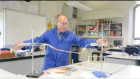
Video of the method

Slide 7
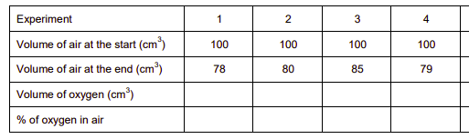
Results
Complete the table to find calculate the percentage of oxygen in air in each experiment.

Slide 8
Conclusions
Explain why the volume of air decreases during the experiment.
Write a word equation for the reaction between copper and oxygen.
Write a balanced equation for the reaction between copper and oxygen (copper oxide has the formula CuO).

Slide 9
Experimental Issues
Are there any anomalous results? Explain your answer and state which, if any, are anomalous.
Find the mean value for the percentage of oxygen in air using your results. Give your answer to the appropriate number of decimal places. (Remember to omit any anomalous results from your calculation).
Explain why you waited for the apparatus to cool down after the experiment before reading the volume of air in the syringe.

Slide 10
Evaluation
Explain why doing repeats and finding an average is helpful
Is the result accurate? Explain your answer.
What was the resolution of the gas syringe?
Was this resolution suitable in this experiment? Explain your answer.

Slide 11
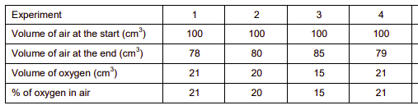
Results - ANSWERS
Complete the table to find calculate the percentage of oxygen in air in each experiment.

Slide 12
Conclusions - ANSWERS
Explain why the volume of air decreases during the experiment. Oxygen in the air reacts with the copper and so is used up
Write a word equation for the reaction between copper and oxygen. Copper + oxygen  copper oxide
Write a balanced equation for the reaction between copper and oxygen (copper oxide has the formula CuO).
2Cu + O₂ -> 2CuO

Slide 13
Experimental Issues - ANSWERS
Are there any anomalous results? Explain your answer and state which, if any, are anomalous. Experiment 3 – the value is significantly different to the others
Find the mean value for the percentage of oxygen in air using your results. Give your answer to the appropriate number of decimal places. (Remember to omit any anomalous results from your calculation). 20.7
Explain why you waited for the apparatus to cool down after the experiment before reading the volume of air in the syringe. Gases expand on heating; the air at the start was at room temperature and so we should wait for the air to cool back to room temperature at the end.

Slide 14
Evaluation - ANSWERS
Explain why doing repeats and finding an average is helpful Helps to spot anomalous results; allows an average to be found with these anomalous results omitted; the average will be closer to the true value as the effect of random errors is reduced
Is the result accurate? Explain your answer. Yes as the result is close to the true value
What was the resolution of the gas syringe? ±1 cm³
Was this resolution suitable in this experiment? Explain your answer. Yes, as volume of oxygen is significantly more than 1 cm³

Slide 15
Home Learning
Complete the quiz
https://WIVYNYE.exampro.net

