Slide 1
Distinguish between alternating and direct current
State the frequency and potential difference of UK mains electricity
Describe how the potential of the live wires varies with each cycle

Slide 2
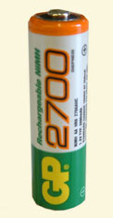
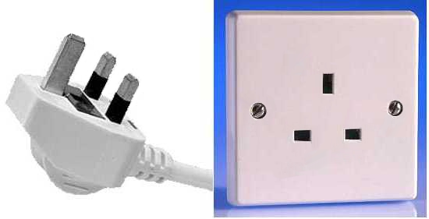
What are the similarities and differences between…
Write down some ideas in your books

Slide 3
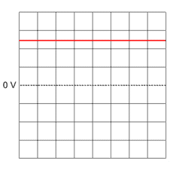
Distinguish between alternating and direct current
DC stands for “Direct Current” – the current only flows in one direction:
Time
If the current flows in only one direction it is called direct current (DC). Batteries and cells supply DC electricity, with a typical battery supplying around 1.5 V. The diagram shows an oscilloscope screen displaying the signal from a DC supply.

Slide 4
Parts of a wave
C
E
A
B
D
F
Which letter shows the peak or crest of a wave?
Which letter shows the trough of a wave?
Which two letters represent the amplitude of a wave?
Which two letters represent the wavelength of a wave?
Answers
C or E 2. D or F
3. B and C 4. C and E or D and F

Slide 5
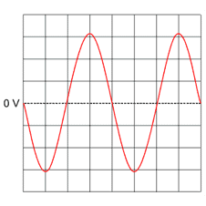
State the frequency and potential difference of UK mains electricity-C
If the current constantly changes direction, it is called alternating current (AC). Mains electricity is an AC supply, with the UK mains supply being about 230 V. It has a frequency of 50 Hz (50 hertz), which means it changes direction, and back again, 50 times a second. The diagram shows an oscilloscope screen displaying the signal from an AC supply.

Slide 6
Progress check
1. What is direct current (in terms of movement of electrons)? Is it produced in batteries or mains electricity?
2. What is alternating current (in terms of movement of electrons)? Is it produced by batteries or mains electricity?
3. What potential difference does the mains electricity supply have (in Volts)?
4. What frequency does the mains electricity supply have (in Hz) and what does this mean?

Slide 7
This is one wavelength. The number of wavelengths per second is the frequency of the wave, measured in Hz.
The time period of the wave is calculated as 1 ÷ frequency and is measured in seconds.
T = 1 / f
This is the amplitude of the wave. It represents the voltage.
What is the time period of mains electricity?

Slide 8
Progress check
Using graph paper, draw 5 graphs to show...
1.Direct current of 2V.
2.Direct current of 6V.
3.Alternating current of 4V and 20Hz.
4.Alternating current of 6V and 10Hz.
5.Alternating current of 8V and 40Hz.
Make sure you label the graphs to explain the relationship
Extension – calculate the time period for each of the alternating current traces.

Slide 9
Edison vs Tesla – watch the video
DC
AC
Described as safer than AC
Voltage and current can’t be changed
Large drop in voltage as high current flows through wires
Considered more dangerous
Voltage and current can be changed
High voltage and low current allowed electricity to be moved vast distances without a drop of voltage
https://www.youtube.com/watch?v=TxgZhhd8PyI&t=305s

Slide 10
Edison – hero or villain?
Invented the light bulb – huge benefits to society.
Invented over 1000 different inventions – produced the world’s first research laboratory
Created thousands of jobs in new industries
Tried to destroy the inventions of others through propaganda
Struggled to understand AC, and the benefits it could bring
Developed the electric chair, just to try and show the dangers of AC
Witheld payment to other inventors, and stole some of their ideas

