Slide 1
Wiring a plug

Slide 2
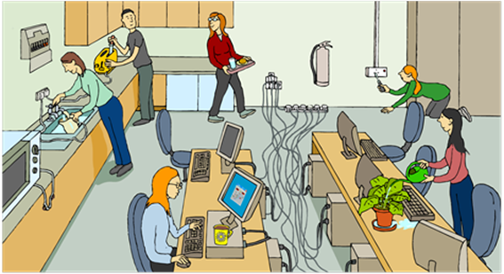
Identify the hazards

Slide 3
Wiring a plug
State the main parts of a standard electrical plug
Create a wired plug
Explain the role of the various parts of the plug

Slide 4
Wires
Brown = live. Carries the energy to the device. Has a potential difference of 230v.
Blue = neutral. Completes the circuit – has a potential difference of 0v.
Green and yellow = earth. Transfers energy away from the device if there is a fault.

Slide 5
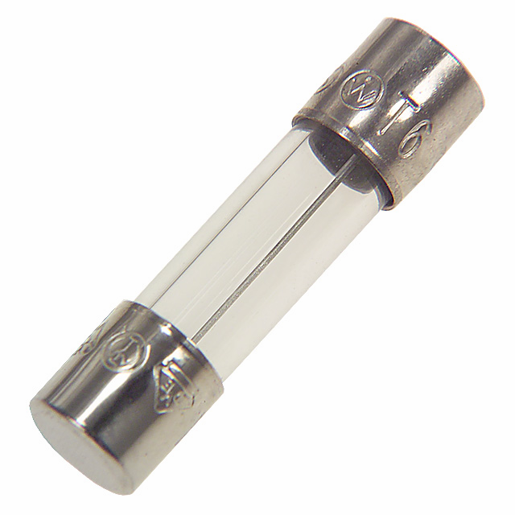
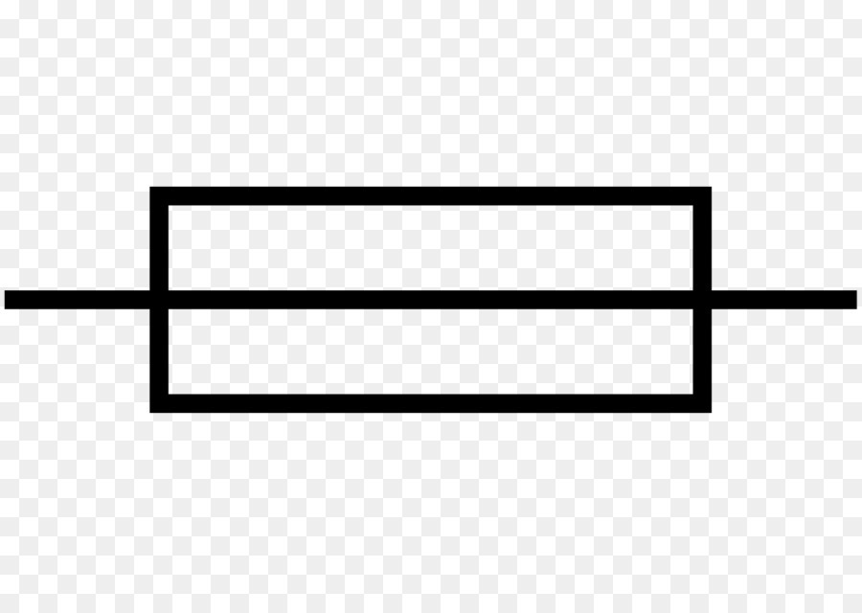
Fuses
They have a thin wire which melts when current exceeds its rating. E.g. 3A fuse melts when the current gets to three amps.
They are very cheap 20p.
Once they “blow” they cannot be used again. Fuses come in 3 sizes: 3A, 5A and 13A.
Fuses prevent fires not electrocution. You only need 0.1 A to stop your heart.

Slide 6
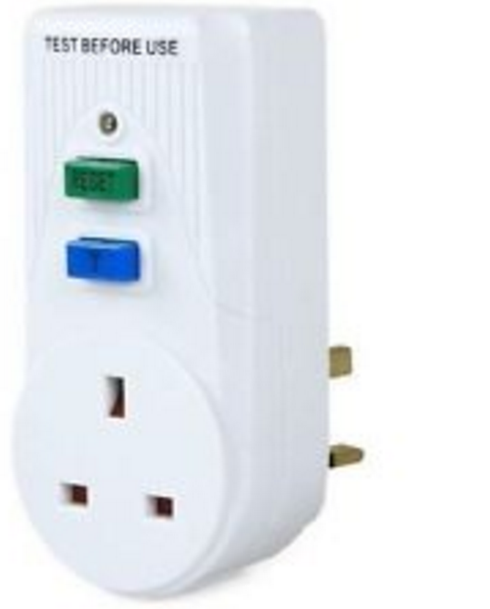
Other safety devices
Circuit breakers – if the current increases, it switches the device off. It has to be reset each time it is used.

Slide 7
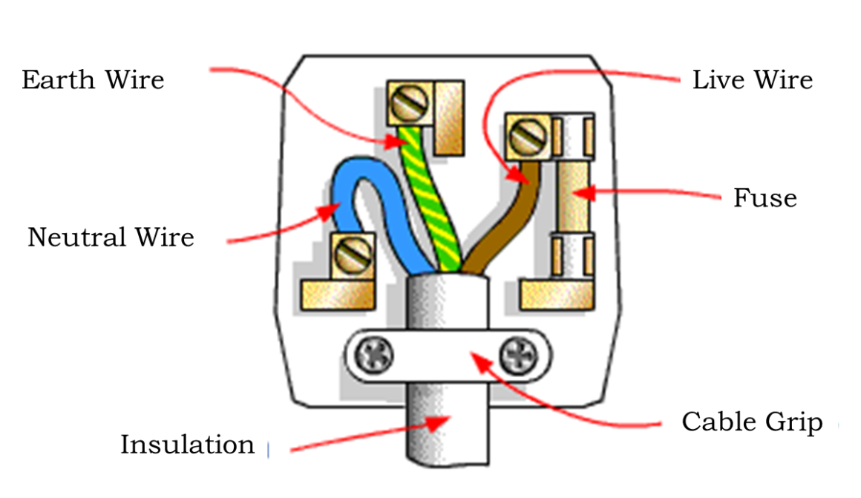
Task 2 - Wiring a plug
Watch the video on how to wire a plug.
https://www.youtube.com/watch?v=jqfsUGhAX9k

Slide 8
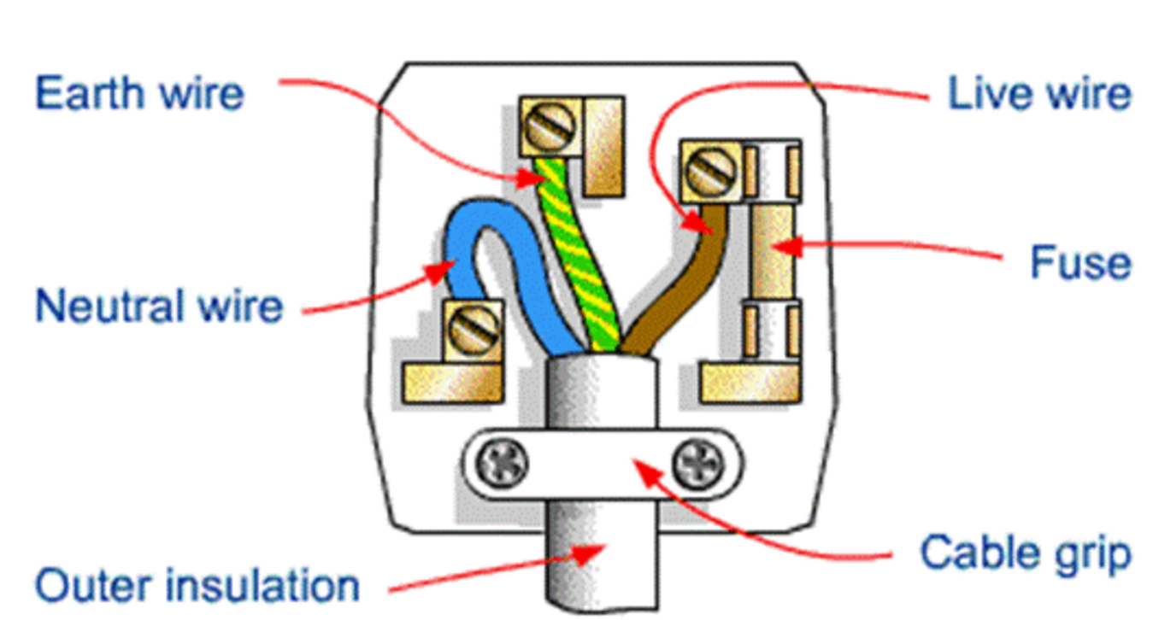
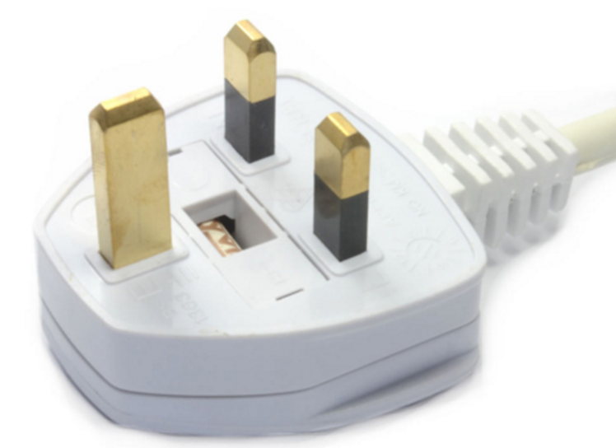
State the parts of the plug, and sketch a copy of a wired plug
Pin
Plastic casing
Earth wire Fuse Pin Plastic case Outer insulation
Cable grip Neutral wire Live wire

Slide 9
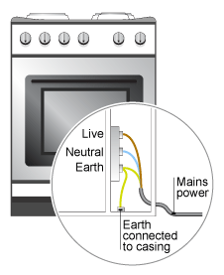
Earthing
The striped wire “earths” devices. It is attached to the top pin of plug.
If there is a fault in the device, the current flows through the Earth wire and into the ground.
This stops you getting an electric shock when you touch the metal device

Slide 10
If you have a phone charger in your bag, take it out and have a look. Can you see the metal Earth pin?
Why not?
For a P2, can you explain why you don’t need an Earth wire for a phone charger?

Slide 11
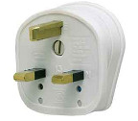
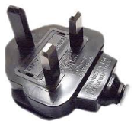
Spot the difference
Earthed plug
Non - earthed plug
Use the below information to write an explanation of the difference between the plugs
No Earth wire as the device is insulated
The case of the appliance is plastic – this means that the appliance cannot become live and electrocute you
Example – phone charger
Has an earth wire as the device is not insulated
The case of the appliance is metal – this means that the appliance can become live and electrocute you
Example – lamp, oven

Slide 12
Task 3 – plug quiz
Describe the three wires that are inside a UK plug. Explain their roles.
Explain the role of the fuse. What does it do and what does it help prevent?
How else can the current to a plug be stopped?
Think – some plugs only have two pins (mobile phone chargers for example). Which wire is missing? Why do you think that this device does not have this wire?
Identify what is wrong in each of the pictures below. Sketch them in your book and explain what you would need to do in order to correct them.
Write a step by step method for wiring a plug.

