Slide 1
Power in the home

Slide 2
Power in the home
What are the equations for calculating electrical power?
What is resistance heating?

Slide 3
Power in electrical circuits
What equation links time, Power, and energy?
A 40 W light bulb is turned on for 30 minutes. How much energy is used?
Power = current x voltage (P = I x V)
But voltage = current x resistance (V = I x R)
Use substitution to work out an equation for power that only uses current and resistance, and then simplify it

Slide 4
Power in electrical circuits
1. Energy = power x time
2. Energy = 40 x (30 x 60)
Energy = 72,000J
3. P = I x V but V = I x R
So, P = I x I x R
P = I²R
https://www.youtube.com/watch?v=iI3ym3Wu9i0
This video explains where the equations come from

Slide 5
What is resistance heating
In electrical circuits, power is calculating by multiplying the current (I) with the potential difference (V)
P = I x V
As you saw before, we can also calculate the power from the Current (I) and the resistance (R)
P = I² x R
The unit of power is the Watt (W)
When a current flows through a wire, the wire heats up. This is called resistance heating. If you increase the current, the power gets considerably higher.

Slide 6
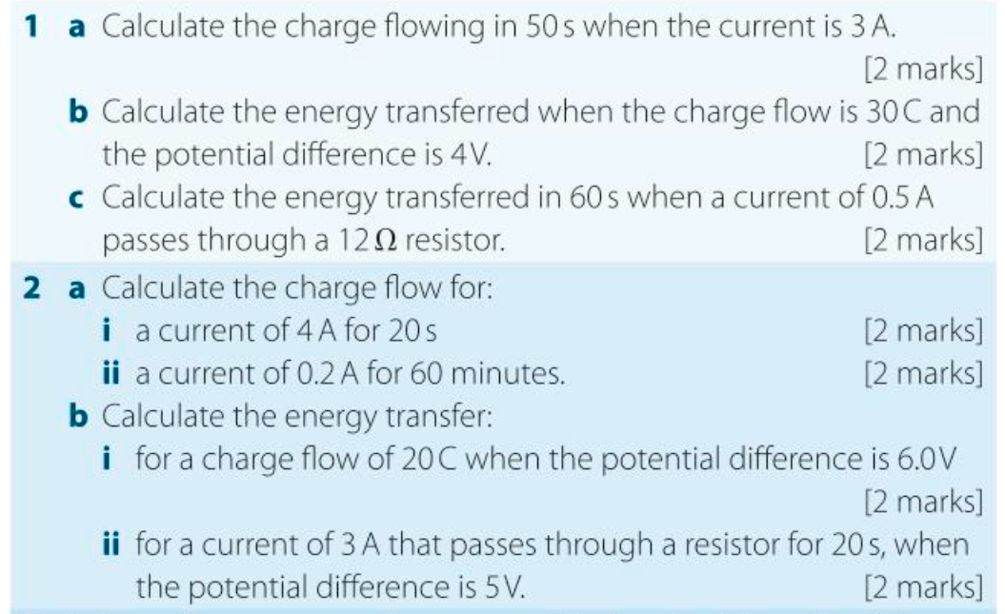
Have a go at the below questions
Use the equations from today’s lesson to help you

Slide 7
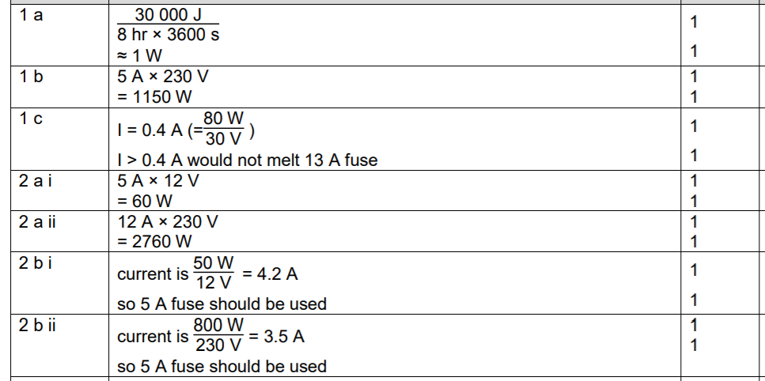
Check your answers!

