Slide 1
Energy in electrical appliances

Slide 2

Starter – how far up the ladder can you get?
6. Why is this unit used instead of the one in question 2?
5. What unit for energy do you often find on electricity bills?
4. Describe 2 ways that the computer could be made more powerful
3. It takes 2 minutes for a computer to use 13.5kJ of energy. Calculate its power
2. State the units of power and energy
1. What equation links power, time and energy

Slide 3
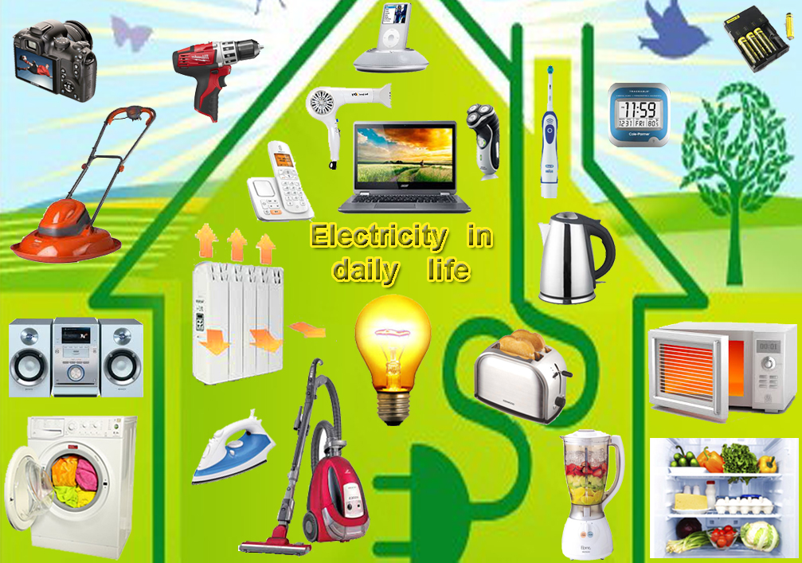
Energy in electrical appliances
What are the units for electrical energy in the home, and why are they used?
How can we convert between this and J?
Can we apply these ideas to some energy questions?

Slide 4
An couple of examples
A 40W lightbulb is used for 30 minutes to light a room. Calculate the energy used.
A typical kettle has a power rating of 2000W. To boil a full kettle, it takes about 3 minutes. How much energy is used?
A dishwasher has a power rating of 1.8kW. The average cycle is 2 hours. How much energy is used?
State the equation
Check for base units
Solve

Slide 5
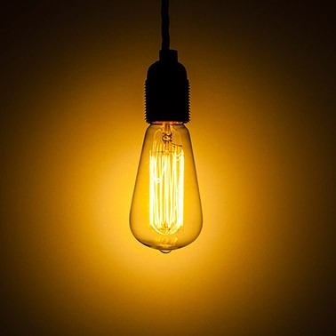
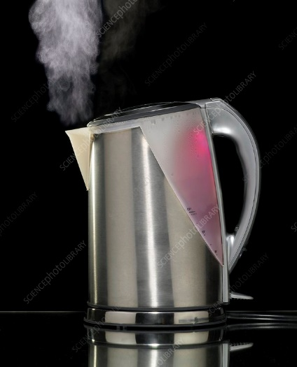
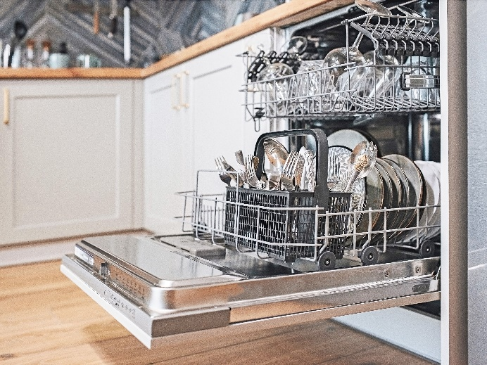
Answers below
72,000 J
360,000 J
12,960,000 J
These are all very large numbers. Imagine how much energy in J is used in a home each day!

Slide 6
The kWh – kiloWatt hour
To make energy bills more meaningful and easier to read, we use the kiloWatt hour.
A dishwasher has a power rating of 1.8kW. The average cycle is 2 hours. How much energy is used?
Energy = power x time
= 1800 x (2 x 60 x 60) = 12,960,000 J
OR!!! = 1.8 x 2 = 3.6 kWh

Slide 7
Try these
A 15kW industrial heater operates for 10 hours. Calculate the energy in kWh
A 2000W kettle is boiled for 10 minutes. Calculate the energy in kWh
5, 40W lightbulbs are left on overnight for 8 hours. How much energy is wasted in kWh?

