Slide 1
Week commencing 26th April
Year 7 Mandarin

Slide 2
Lesson 1 几点了？Jǐ diǎn le
What time is it?
LO：We are learning to tell time
I can
tell time
put time words in the correct order and in the right place in a sentence
use sentences in a more complex way

Slide 3
Task 1 Count from 1- 60
一 二 三 四 五 六 七 八 九 十
Let’s count to 60
You may use your number sheet (next slide) to help you

Slide 4
Work out the number patterns and try to say these numbers
一 二 三 四 五 六 七 八 九 十 百
yī èr sān sì wǔ liù qī bā jiǔ shí bǎi
一 | 二 | 三 | 四 | 五 | 六 | 七 | 八 | 九 | 十
十一 | 十二 |  |  | 十五 |  |  |  | 十九 | 二十
二十一 |  |  |  | 二十五 |  |  |  |  | 三十
三十一 |  |  |  | 三十五 |  |  |  |  | 四十
四十一 |  |  | 四十四 |  |  |  |  | 四十九 | 五十
 | 五十二 |  |  |  | 五十六 |  |  |  | 六十
 |  | 六十三 |  |  |  | 六十七
七十一 |  |  |  | 七十五 |  |  |  |  | 八十
 | 八十二 |  |  |  |  |  | 八十八
 |  |  | 九十四 |  |  |  |  | 九十九 | 一百

Slide 5
Task 2 Learn the new words in next few slides
Learn to say and recognise these words

Slide 6

上午
shàng wǔ morning

Slide 7
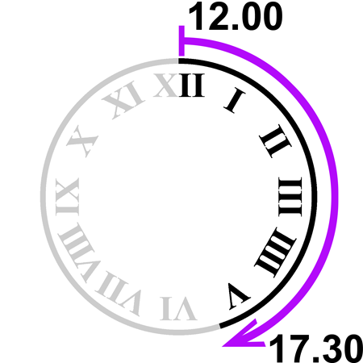
下午
xià wǔ, afternoon

Slide 8
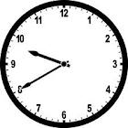
点
分
fēn, minute
diǎn, o’clock

Slide 9

afternoon
morning
上午
下午
shàng wǔ
xià wǔ
hour
minute
点
分
diǎn
fēn

Slide 10
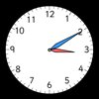
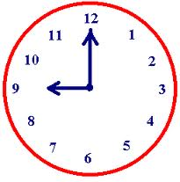

Chinese time format:
hour+minute
三点十分
九点
半：half bàn
三点半
九点四十分

Slide 11

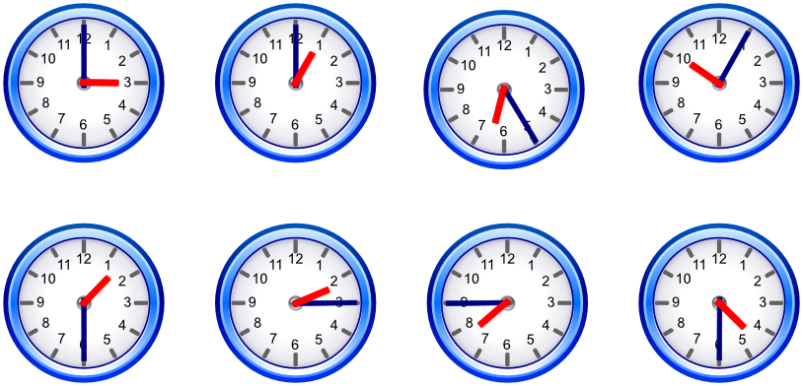

Slide 12
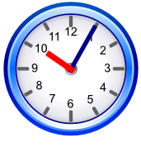
in the morning at 20 to 10
上午
上午九点四十分
shàng wǔ

Slide 13
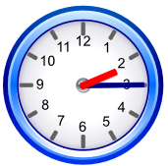
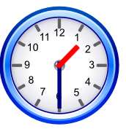
in the afternoon at half past 3
下午
下午三点半
xià wǔ

Slide 14
几点了？jǐ diǎn le
Task 3 Write down the following times in Chinese characters

Slide 15
Lesson 2 The order of Time phrases
LO: We are learning the order of time phrase
I can
say and write down the time phrase in the correct order in a sentence

Slide 16
The order of time words
From bigger time units to smaller time units
days of week → morning/afternoon → specific time
星期一上午九点 Monday morning at nine o’clock
Task 1 Write down the following phrases in Chinese and draw the clock
Wednesday afternoon at half past 3
Sunday morning at quarter past 8
Friday afternoon at 10 to 4

Slide 17
Task 2 Translate the following sentences into Chinese and write down Pinyin for each sentence. The first one has been done for you
I have maths on Monday morning at 10 o’clock.
我星期一上午十点有数学课。
2. I have PE on Tuesday afternoon at half past 1.
3. I have history on Thursday morning at quarter to 11.
4. I like Mondays, because I have Chinese and history.
because: 因为 yīn wéi
课: lesson kè
and: 和 hé

