Slide 1
Week commencing 10th May 2021
Year 7 Mandarin

Slide 2
A school day
Lesson 1
LO: We are learning school routine
I can
Use say and recognise at least 7/10 new words
Use understand where to place time phrases in a sentence
Use the comparative sentence structure to construct my own sentences correctly

Slide 3
Task 1 Learn and copy down the words in next few slides in Chinese characters, pinyin and English.

Slide 4



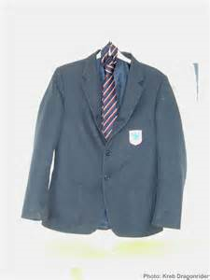
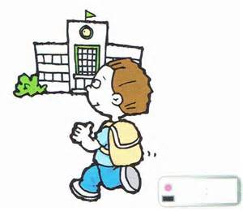
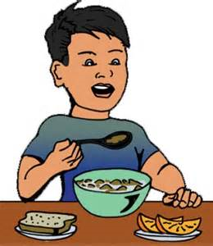
起床
刷牙
洗澡
qǐ chuáng
to get up
shuā yá, to brush teeth
xǐ zǎo, to have a shower/bath
吃早饭
上学
穿衣服
chī zǎo fàn, to eat breakfast
shàng xué, to go to school
chuān yī fú, to get dressed

Slide 5
Can you still say them?
起床
刷牙
洗澡
穿衣服
吃早饭
上学

Slide 6
Can you still recognise the words? Say them in English and Pinyin
起床
刷牙
洗澡
穿衣服
吃早饭
上学

Slide 7

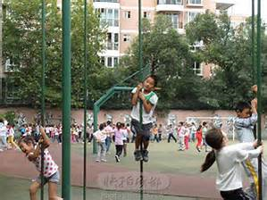
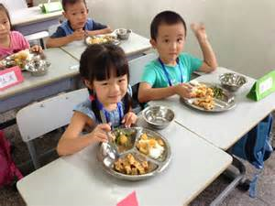
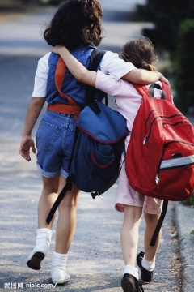
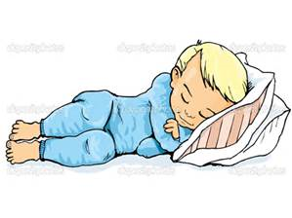
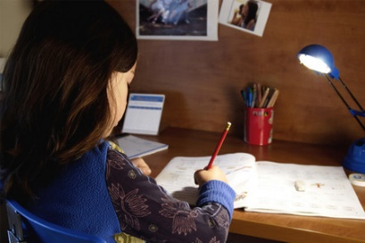
课间休息
上课
吃午饭
shàng kè, to attend a lesson
kè jiān xiū xí,
breaktime
chī wǔ fàn,
to eat lunch
做作业
睡觉
放学
fàng xué, to finish school
zuò zuò yè, to do homework
shuì jiào, to sleep

Slide 8
Can you still say them?
课间休息
上课
吃午饭
做作业
睡觉
放学

Slide 9
课间休息
上课
吃午饭
Can you still say these words in Chinese and English?
做作业
睡觉
放学

Slide 10
上课
课间休息
吃午饭
放学
做作业
睡觉

Slide 11
5
10
15
20
Task 2 Play the game to see how many points you can get
起床 | 刷牙 | 吃午饭 | 穿衣服
上学 | 吃早饭 | 课间休息 | 放学
睡觉 | 做作业 | 上课 | 洗澡

Slide 12
Lesson 2 I get up at 6
LO:
We are learning to talk about daily routine
I can

Slide 13
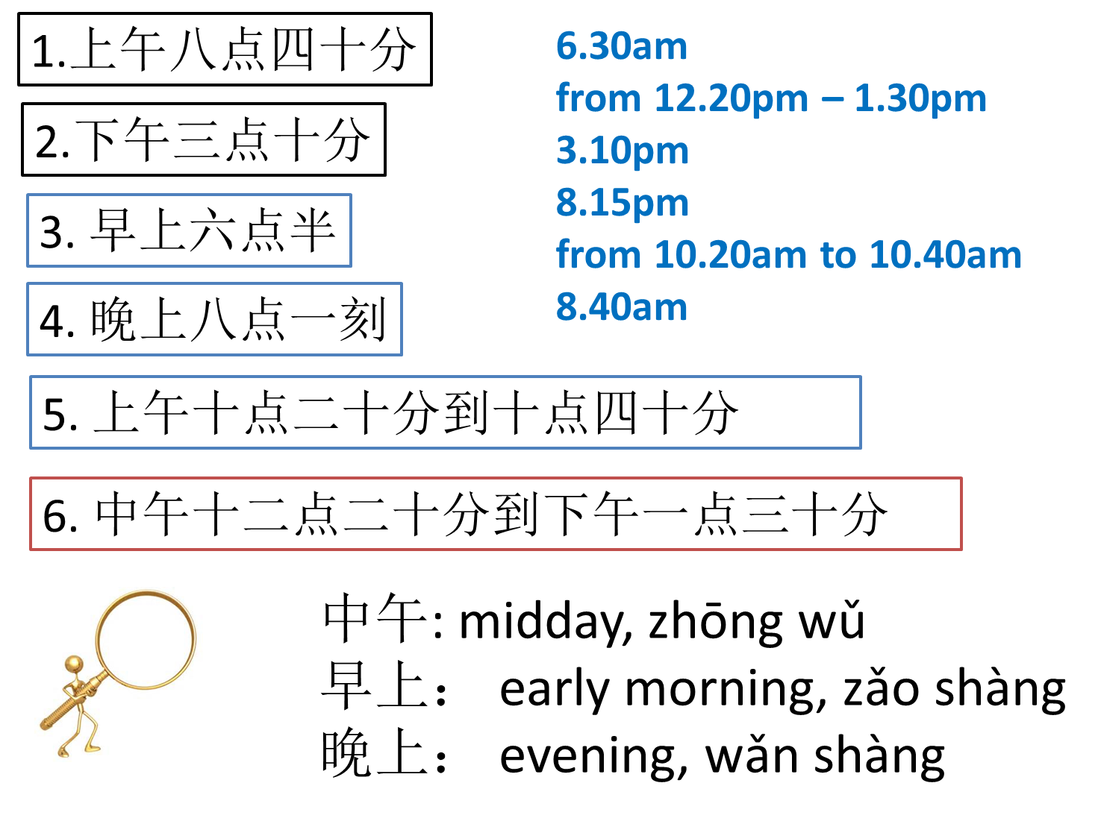
Task 1 Match up the phrases Example: 1. 8.40am

Slide 14

A sentence
Person
我
Time
早上六点半
Activity
起床
Task 2 Write two sentences in Pinyin and characters.

