Slide 1
Week commencing 24th May
Year 7 Mandarin

Slide 2
Lesson Personalities
LO: We are learning some adjectives to describe our teachers
I can
say and recognise at least 3 adjectives
write these words down correctly in characters
Challenge:
I can use paired connectives to extend my sentences

Slide 3
Task 1 Learn the new words. Practise recognition by sound and look.
Say the words aloud while going through the slides. You don’t need to write down

Slide 4


rè xīn
热心
helpful
严格
yán gé
strict
人很好
rén hěn hǎo
nice

Slide 5
Can you still say them and know what they mean?

Slide 6
热心
helpful
严格
strict
人很好
nice

Slide 7
Can you still say them and know what they mean?
热心
严格
人很好

Slide 8


有趣
yǒu qù
funny
亲切
qīn qiè
kind
易怒
yì nù
easy to get angry

Slide 9
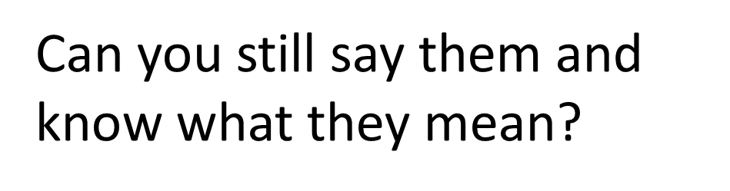

Slide 10
有趣
funny
亲切
kind
易怒
easy to get angry

Slide 11
有趣
Can you still say them and know what they mean?
亲切
易怒

Slide 12
热心
严格
易怒
亲切
有趣
人很好

Slide 13
Task 2 Reading Match the words in Pinyin and English to the words in characters
热心
a.rén hěn hǎo
nice
1
严格
b. yì nù
easy to get angry
2
3
人很好
c. yán gé
strict
d.qīn qiè
kind
易怒
4
e.rè xīn
helpful
5
亲切
f. yǒu qù
funny
6
有趣
Example: 1 e

Slide 14










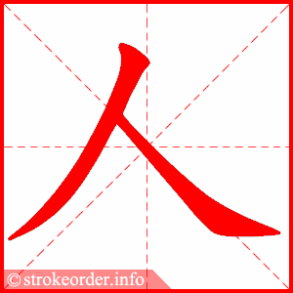


Task 3 Follow the stroke order and write down these words
qīn qiè, kind
rè xīn, helpful
yán gé, strict
yǒu qù, interesting
rén hěn hǎo, nice
yì nù, easy to get angry

Slide 15
Lesson 2 My maths teacher is kind
LO: I am learning to use the adjectives we learned from previous lesson to describe my teachers
I can
say and recognise the intensifiers in the lesson
describe my teachers using adjectives and intensifiers

Slide 16
Intensifiers
非常 fēi cháng, extremely
相当 xiāng dāng, quite
很 hěn, very
真的 zhēn de, really
越来越 yuè lái yuè, more and more
Task Copy these words down

Slide 17

Task 2 Use the example as a template to translate the following sentences into Chinese and Pinyin
Example: My maths teacher (is) very strict. 我的数学老师很严格。wǒ de shù xué lǎo shī hěn yán gé.
My Chinese teacher is kind.
My music teacher is extremely interesting.
Challenge: Use paired connectives to connect two sentences and intensifiers to make your sentences more interesting
.
不仅…而且… bù jǐn… ér qiě… not only… but also…
虽然… 但是… although… but…
Note: intensifiers are used to replace the verb to be in English. You cannot use is/am/are – 是 with adjectives in this sentence structure

