Slide 1
Lesson 1 Holiday Destinations
LO: We are revising family members, names of countries and past time phrases
I can
say when and where I went to on holidays
say who I went holiday with
understand the positions of time phrases, past marker and manner -“with + people”

Slide 2

Task 1 Can you say the following words in Chinese? Write them down in characters in your book.
Extension:
Older brother
Older sister
Younger brother
Younger sister
Dad
Mum
I
You (singular)
My
Your (singular)
Family
Friend

Slide 3
Check your answers and correct your mistakes with a green pen against your vocab sheet with a green pen.
Extension:
Older brother 哥哥
Older sister 姐姐
Younger brother 弟弟
Younger sister 妹妹
Dad 爸爸
Mum 妈妈
I 我
You 你
My 我的
Your 你的
Family 家人
Friend 朋友

Slide 4

Task 2 Make phrases – Use possessive pronouns
How to say the following phrases?
Magic 的
Pronoun/noun + 的 to form possessive pronouns
我 + 的 → 我的 my
你 + 的 →你的 your
妈妈+的→ 妈妈的 mum’s
My family
Your friend
My mum and dad
Your younger brother and older sister
Extension:
Mum’s dad
Dad’s mum
Dad’s older sister

Slide 5

The most common sentence structure - PTMPLA
Person
我
Time
去年夏天
去年春天
去年秋天
去年冬天
Manner
和+people+ 一起
和我的家人一起
和我的朋友一起
和我的爸爸妈妈一起
Place
去+place
去中国
去西班牙
去法国
去意大利
Action
度了假

Slide 6
Task 3 Read the text and highlight the following phrases with different colours
1. With… 和… 一起
2. Time phrases: 去年，春天，夏天，秋天，冬天
3. 去+place
4. Past marker：了
1. 我叫小明，我去年夏天和我的家人一起去中国度了假。
2. 我叫天一，我去年春天和我的朋友一起去法国度了假。
3. 我叫大星，我去年秋天和我的爸爸妈妈一起去西班牙度了假。
4. 我家小英，我去年冬天和我的家人一起去意大利度了假。
Task 4 Translate at least 2 sentences

Slide 7
Lesson 2 Describes Cities
Lo: We are learning to describe where the popular cities are and give our opinion about the cities.
I can
Use the location words to describe where the cities are in a country
Use a range of adjectives to describe the city
Use the 很 + adjective structure

Slide 8



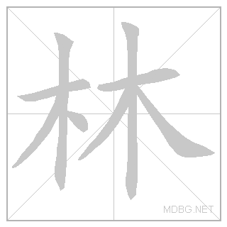
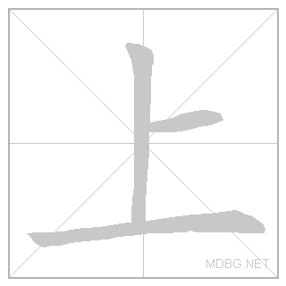




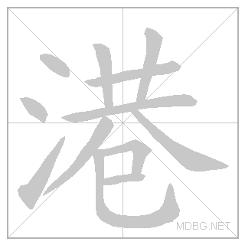

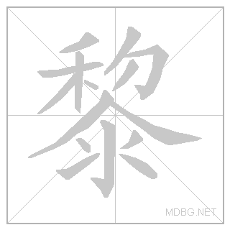

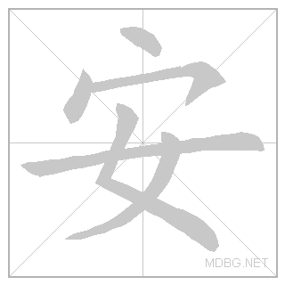


Cities Task1 Copied down these words
Beijing, běi jīng
Berlin, bó lín
Shanghai, shàng hǎi
London, lún dūn
Hong Kong, xiāng gǎng
Paris, bā lí
Guangzhou, guǎng zhōu
Xi’an, xī ān

Slide 9
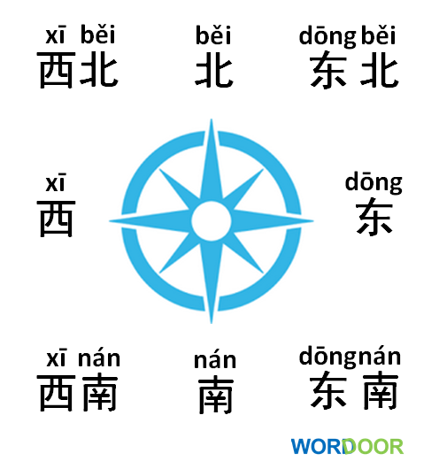
Direction Words – Write down these words

Slide 10
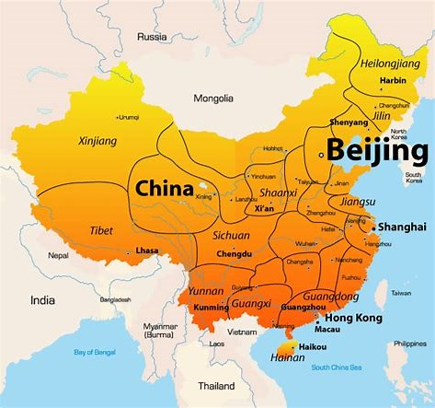
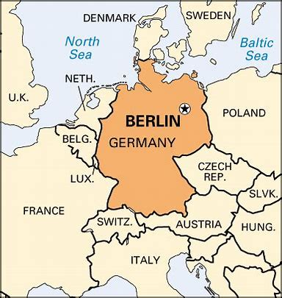
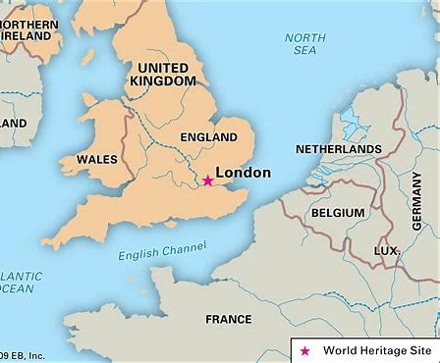
Task 3 A Sentence Use this structure to write 2 sentence
City
北京
上海
香港
伦敦
柏林
巴黎
Is located
在 zài
Country + 的
中国
英国
德国
法国
Direction word + 部 bù
东
南
西
北
东北
东南
西南
西北

Slide 11
大 dà, big
小 xiǎo, small
漂亮 piào liàng, pretty
热闹 rè nào, lively
拥挤 yōng jǐ, crowded
古老 gǔ lǎo, ancient
现代 xiàn dài, modern
吵 chǎo, noisy
脏 zāng, dirty
Use 很 structure to describe a city
Task 4 write a sentence using the following structure
City
很 hěn
Adjective

Slide 12
Task 5 Translation – extension task
我去年夏天和我的家人一起去上海度了假。上海在中国的东部。上海很大，也很现代，但是上海有的地方很拥挤。
我去年秋天和我的朋友一起去巴黎度了假。巴黎在法国的 北部。巴黎很很古老，也很漂亮，但是巴黎有的地方很吵。
有的: yǒu de, some
地方: dì fāng, place

Slide 13
Lesson 2

