Slide 1
Week commencing 10th May 2021
Year 9 Non-MEP

Slide 2
Lesson 1 I will sunbathe
LO: We are going to learn to use future time frame with holiday activities.
I can
say and recognise holiday activities
demonstrate how to future time marker with these activities
complete the reading task with little help

Slide 3
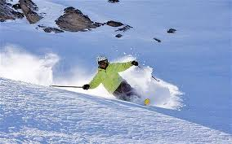
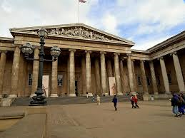
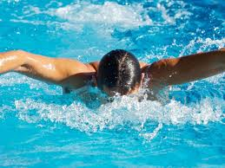

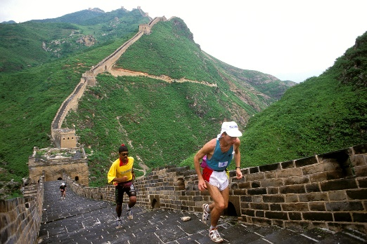
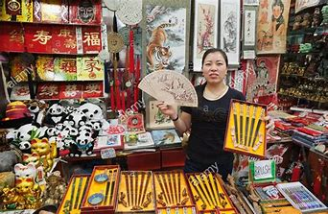
Can you say these words?
huá xuě
cān guān bó wù guǎn
yóu yǒng
to ski
to see the museum
to swim
mǎi jì niàn pǐn
shài tài yáng
pá cháng chéng
to buy souvenir
to sunbathe
to climb the Great Wall

Slide 4
Can you still say these words?

Slide 5

Can you still say these words?
滑雪
参观博物馆
游泳
买纪念品
晒太阳
爬长城

Slide 6
Do you know what these words mean?
滑雪
参观博物馆
游泳
买纪念品
晒太阳
爬长城

Slide 7
Do you know what these words mean?
晒太阳
滑雪
爬长城
参观博物馆
买纪念品
游泳

Slide 8
Do you know what these words mean?
滑雪
买纪念品
爬长城
参观博物馆
游泳
晒太阳

Slide 9
Let’s read together
滑雪
参观博物馆
游泳
买纪念品
晒太阳
爬长城

Slide 10

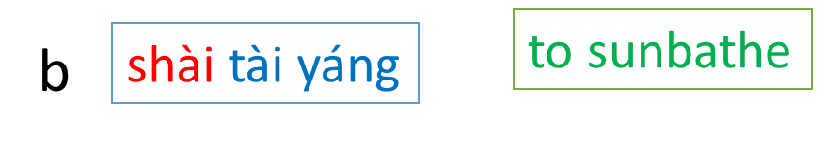

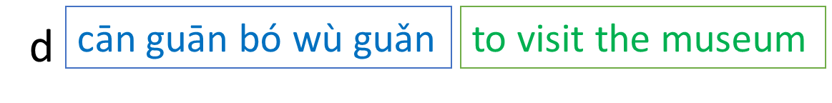
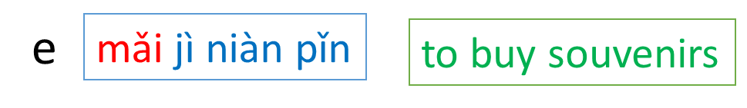

Task 1 Match the words in Chinese with the words in Pinyin and English. The words in Pinyin have already been matched up with the word in English. 3 minutes
滑雪
f
1
2
参观博物馆
游泳
3
买纪念品
4
5
晒太阳
爬长城
6

Slide 11
Task 2 Use future markers. Write a sentence using this structure
Person
future time phrase
去+ place
activity
Challenge
除了…. 以外，我还会…
Super challenge
Give a reason to say why you would like to do these activities

Slide 12
Task 3 Read and translate the text into Pinyin and English.
我明年夏天要去中国度假。我听说中国有很多好玩的地方。我想去参观故宫。除了参观故宫以外，我还打算去爬长城。我的朋友去过中国，他去年去了上海。在上海的时候，他不仅参观了漂亮的外滩，而且去豫园吃了很多好吃的小吃。他觉得中国的小吃比英国饭馆的小吃好吃多了。

Slide 13
Lesson 5 I Sunbathed
LO: We are going to recap past markers and use them with holiday activities.
I can
use past markers correctly in a sentence
demonstrate how to use varied past markers with these activities
complete listening and translation tasks with ease
Starter:
List future markers. Write each one 3 times
Challenge
Use one of these markers to make a sentence
Super challenge:
Use paired connectives or similar to make your sentence more interesting

Slide 14
Are these statements true or false?
Time phrases can either be placed before the subject or after the subject.
In the future time frame, the future marker goes after the first verb in the sentence
准备means “to prepare”, it also indicates something will happen in the future.
There is only one past marker, which is “了”.
Past marker “了” goes straight after the verb. If there are 2 verbs in the sentence, it goes straight after the second verb.

Slide 15
Task 1 Can you still say these words? Say these words in Chinese and English
滑雪
参观博物馆
游泳
买纪念品
晒太阳
爬长城

Slide 16
Task 2 Use past marker le Write a sentence using the sentence structure then translate your sentence into English
Person
Past time phrase
去年春天chūn tiān
夏天xià tiān
秋天qiū tiān
冬天 dōng tiān
去+ place
activity
verb + 了
滑雪
参观博物馆
游泳
买纪念品
晒太阳

Slide 17
Task 3 and translate these sentences
1. 我叫小明，我今年十三岁。我去年春天和我的家人一起中国爬了长城。爬长城太累了。
2. 我叫小小，我今年十八岁。我去年夏天和我的朋友一起去上海看了博物馆。我觉得很没意思。
3. 我叫美丽，我今年十二岁。我去年秋天和我的爸爸妈妈一起去北京参观了故宫。我非常喜欢故宫的建筑。
4. 我叫大年，我今年十五岁。我去年冬天和我的家人一起去西班牙晒了太阳。我们玩得开心极了。

