Slide 1
Week commencing 17th May
Year 9 Mandarin Non-MEP

Slide 2
Weather forecast
LO: We are talking about weather and use different time frames
I can
understand weather forecast
Describe the weather on my holiday location

Slide 3
Task 1 Write down the words on the following 3 slides

Slide 4
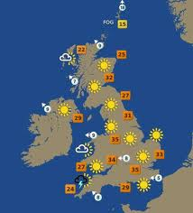
天气预报 tiān qi yù bào weather forecast

Slide 5





Task 1 Write these words down
风 fēng
wind
雨 yǔ
rain
雪 xuě
snow
Fog
___________
___________
___________
雾 wù
fog
晴天 qíng tiān
sunny day
云 yún
cloud

Slide 6
Time Phrases
昨天
zuó tiān
yesterday
今天
jīn tiān
today
明天
míng tiān
tomorrow

Slide 7


Weather forecast in Chinese
Task 2 Copy down the sentence structure
and practise to say a few sentences
Note down the exceptions
Place + time word + verb有+weather
北京今天 有雨。
北京 běi jīng
今天 jīn tiān
有 yǒu
伦敦 lún dūn London
Fog
_____
_____
_____
Exception
北京今天多云。
北京今天将会是晴天。
将会：will, jiāng huì

Slide 8
Lesson 2 It is going to ring tomorrow
LO: we are learning to talk about weather in more details

Slide 9
Talk about weather
It is very easy to talk about past and future weather in Chinese. All you have to do is to use the correct time words. You don’t need to change the verb at all.
Place + time word + verb有+ wind/rain/snow/fog
北京 明天 有 雨。
北京 昨天 有 风。
Task 1 Translate the following sentences into Chinese characters
It will rain in London tomorrow.
It rained in London yesterday.
It is going to rain in London today.
Time words:
明天：míng tiān tomorrow
今天：jīn tiān today
昨天：zuó tiān yesterday

Slide 10

The weather forecast for today
běi jīng jīn tiān tiān qì zěn yàng
北京今天天气怎样？
běi jīng jīn tiān shàng wǔ yǒu wù xì wǔ duō yún wǎng shàng yǒu xuě
北京今天上午有雾，下午多云，晚上有雪。
píng jūn wēn dù shí dù
平均温度10度。
平均 píng jūn average
温度 wēn dù temperature
Task 2 Translate these sentences into English.

Slide 11
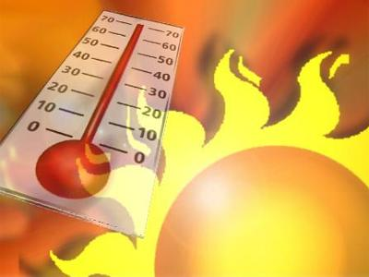
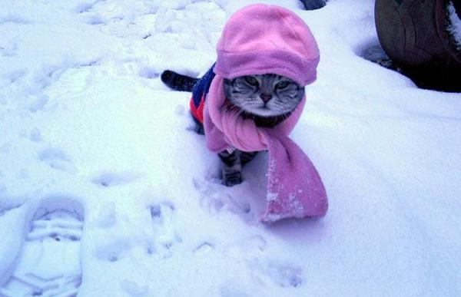
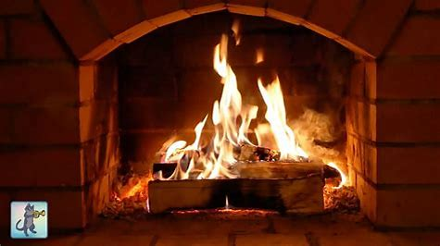
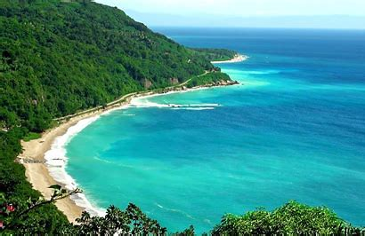
Task 3 Use adjectives associated with temperature. Write at least two setences
Copy down the Grammar explanation.
Grammar
很 (hěn) is a stative verb. You always use it with adjectives. In Chinese, You cannot use “是 am/is/are” with adjectives.
tā hěn piào liàng
她很漂亮。
She is pretty.
wǒ de fáng zi hěn dà
我的房子很大。
My house is big.
热 rè
冷 lěng
暖和 nuǎn huo
凉快 liáng kuài
伦敦今天很热。

