Slide 1
Week Commencing 19th April

Slide 2
春节 – Spring Festival
Lesson 1
LO: We are learning to talk about Spring Festival
I can
say some Chinese New Year traditions
Read and understand more Chinese New Year traditions

Slide 3
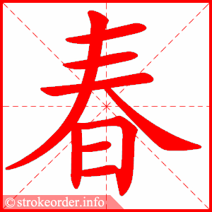
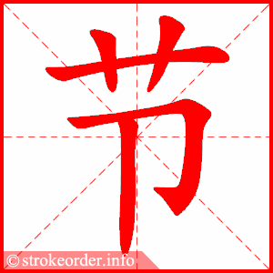
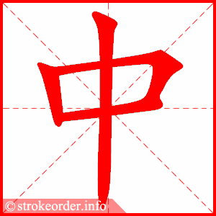
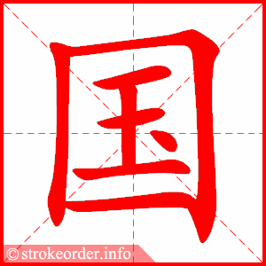
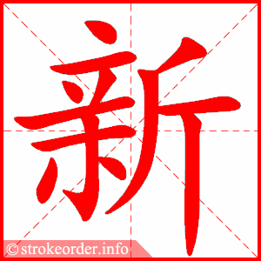
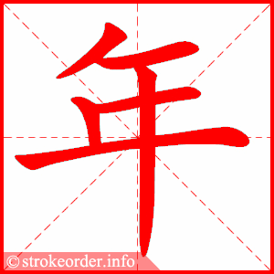
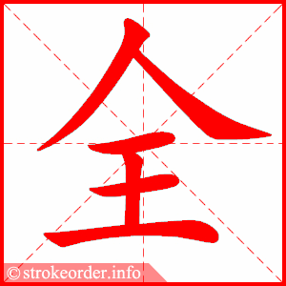
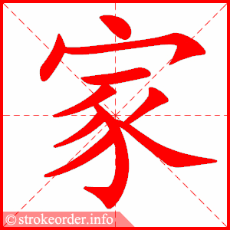
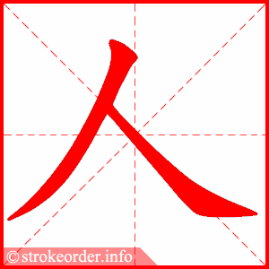

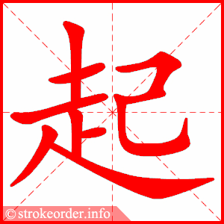
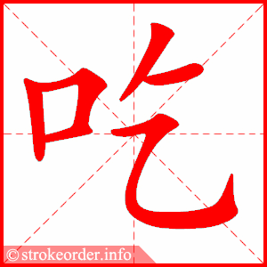
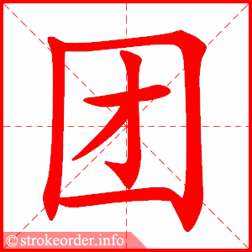
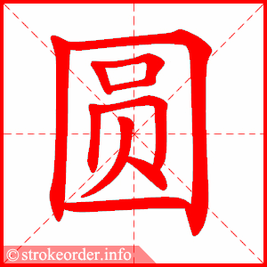
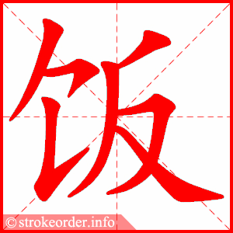
Task 1 New words- copy down these words. while writing, say them at the same time
Spring Festival, chūn jié
Chinese New Year, zhōng guó xīn nián
the whole family, quán jiā rén
together, yì qǐ
to eat reunion dinner, chī tuán yuan fàn

Slide 4
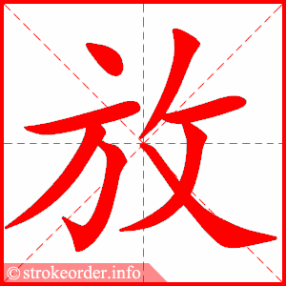
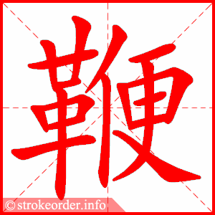
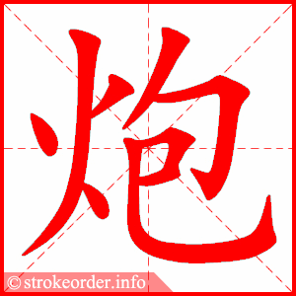
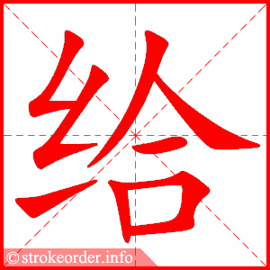
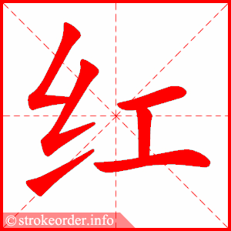
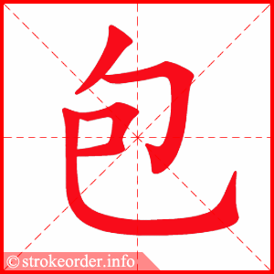
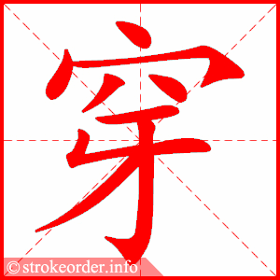
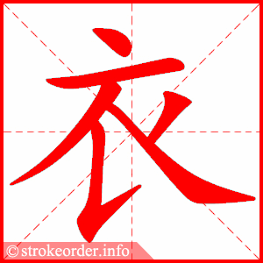
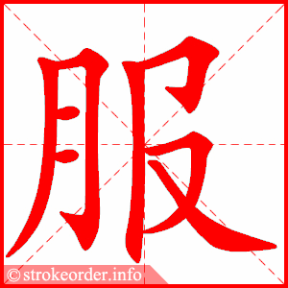
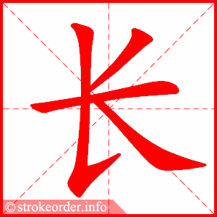
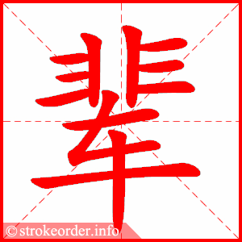
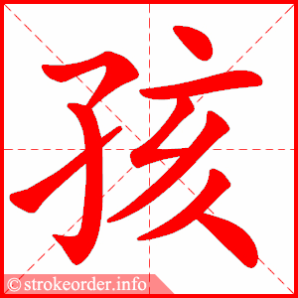
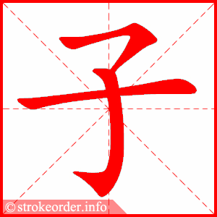
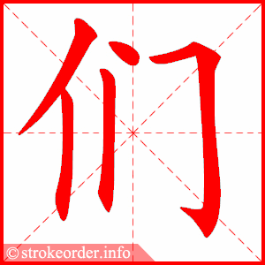
Task 1 continued New words- copy down these words. while writing, say them at the same time
to light up firecrackers, fàng biān pào
to give red envelope, gěi hóng bāo
to wear new clothes, chuān xīn yī fú
older generation, zhǎng bèi
children, hái zǐ mēn

Slide 5
Task 2 Read the following text and translate them into Pinyin and English. Use the words in the box to help you do this task.
中国人一般在春节的时候，都会回家和家人团聚。在除夕的时候，全家人一起吃团圆饭。人们在午夜的时候，放鞭炮迎接新年的到来。
除夕chú xī, New Year’s Eve
午夜 wǔ yè, midnight
迎接 yíng jiē, to welcome
到来 dào lái, arrival
第一天 dì yī tiān, the first day
压岁钱 yā suì qián, good-luck money
双数 shuāng shù, even number
吉利 jí lí, lucky
送 song, to send
祝福 zhú fú, good wishes
方式 fāng shì, method, way
在新年的第一天，长辈给孩子们红包，红包里的钱叫压岁钱。钱是双数，因为中国人认为双数吉利，这是一种送新年祝福的方式。

Slide 6
Lesson 2 Quizlet Tasks
LO: use Quizlet to consolidate your vocabulary

Slide 7
Log onto your Quizlet account and complete “learn, spelling, writing and test”
Use your class link to sign up if you have not done so – this is not an option. You must do this
https://quizlet.com/join/Fsekv4ejf
Use this link if you are unable to sign on , but I will not be able to see your progress
https://quizlet.com/_9h1ng4?x=1qqt&i=4krqz

