Slide 1

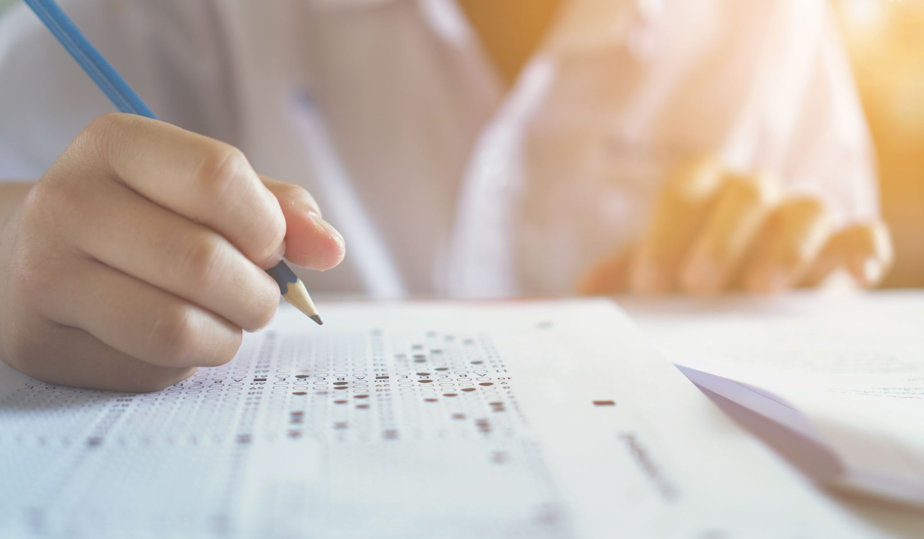
All you need to know about exams

Slide 2


You must be on time for all of your exams.
Remember to:
Eat and drink before the exam
Leave home in plenty of time
Go to the toilet before the exam starts

Slide 3
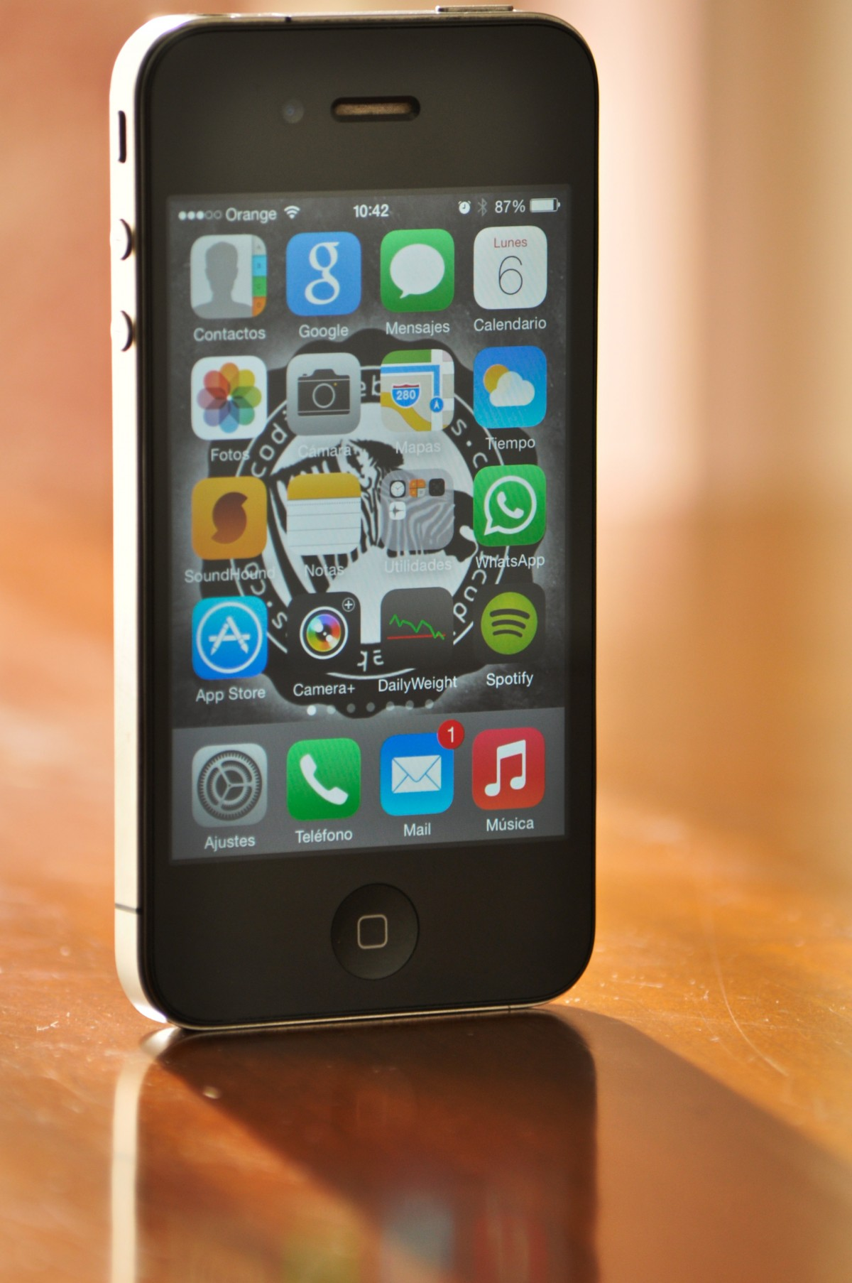
Unauthorised materials which must not be taken into the exam.
Mobile Phones
Airpods
Watches of any type
Fitness Trackers
Notes / revision material
Calculator lids
Coats or outdoor jackets

Slide 4
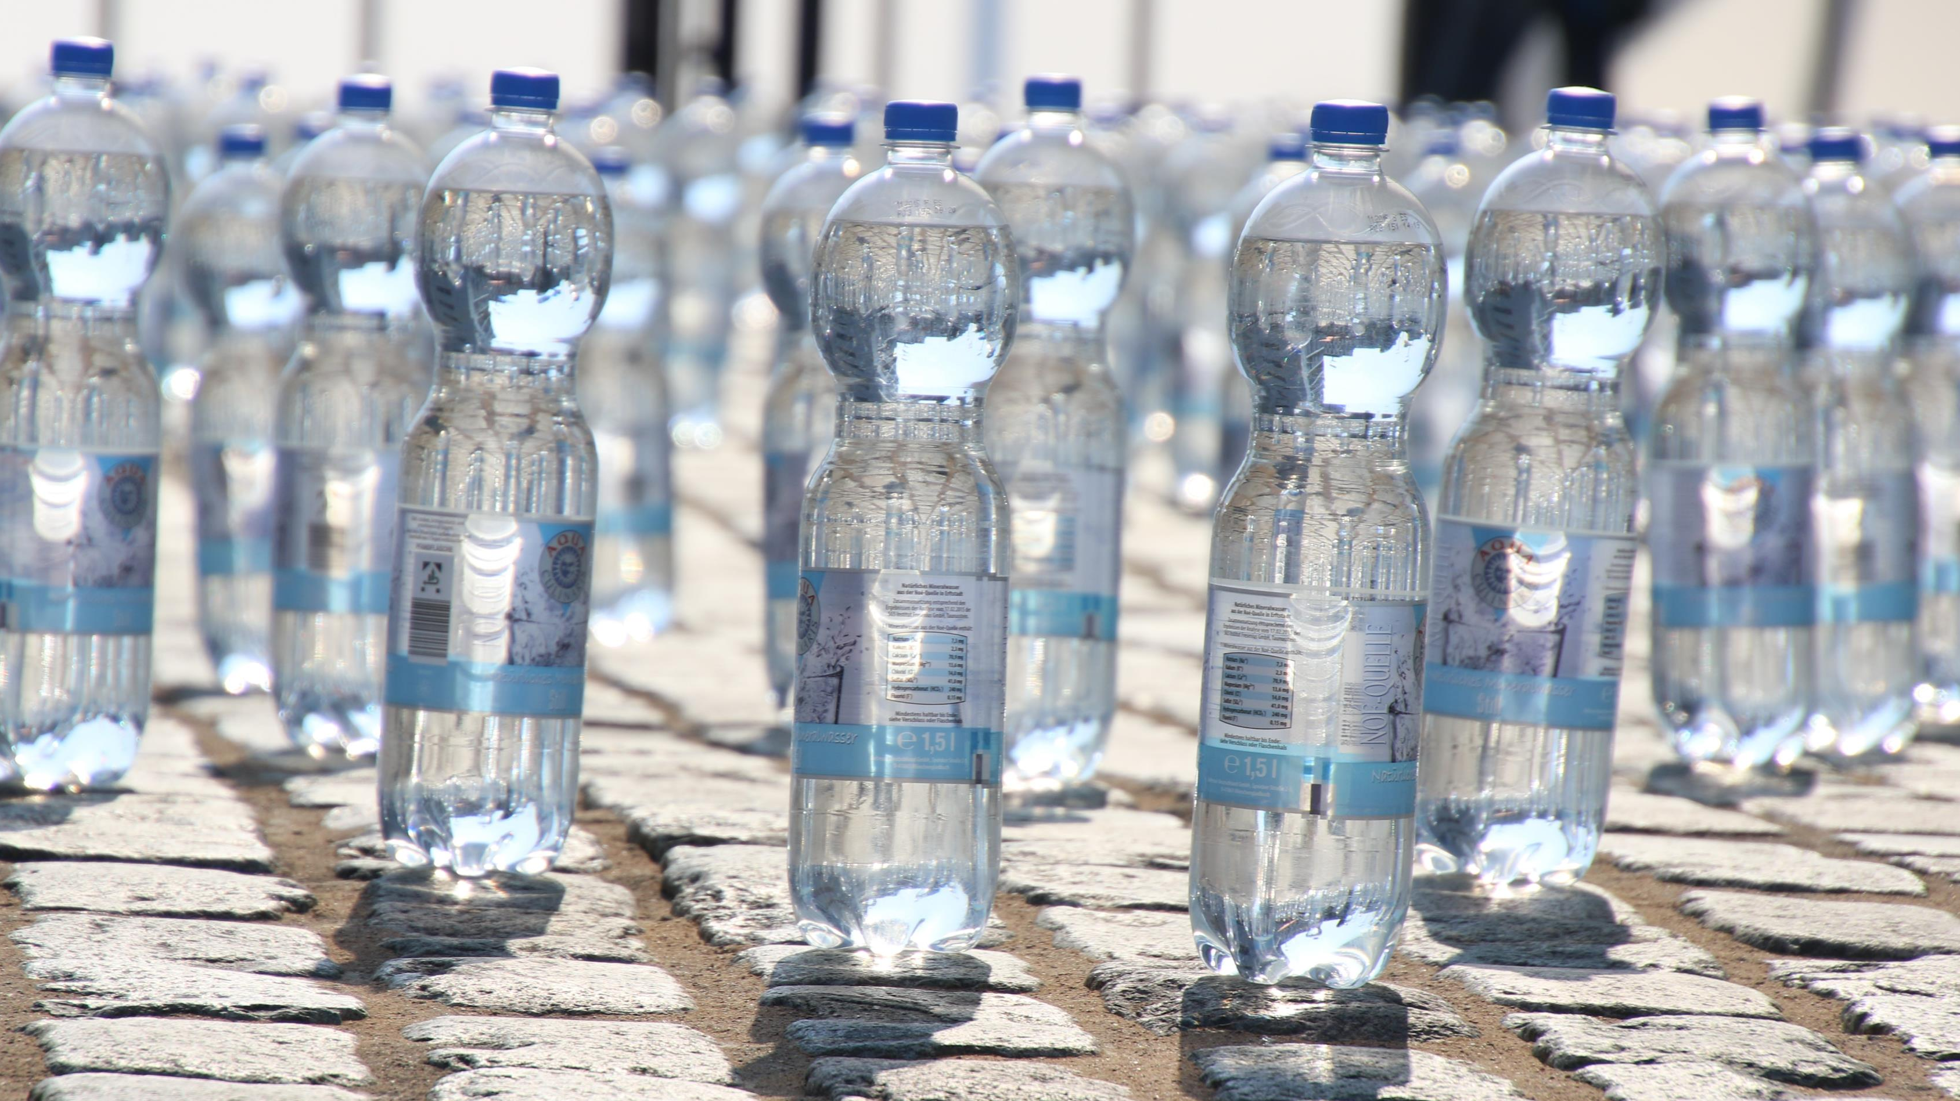
You may take into the exam a water bottle.
Remember:
it must be clear
Have no writing on it
Have no logos on it

Slide 5
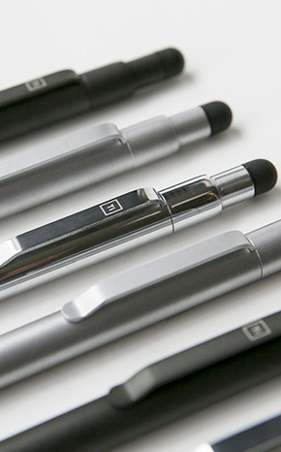
Stationery
Must be in a clear pencil case or a clear bag and contain the following items:
Black pens (at least 2)
Ruler
Pencil and sharpener
Protractor
compass
This Photo by Unknown Author is licensed under CC BY-NC-ND

Slide 6
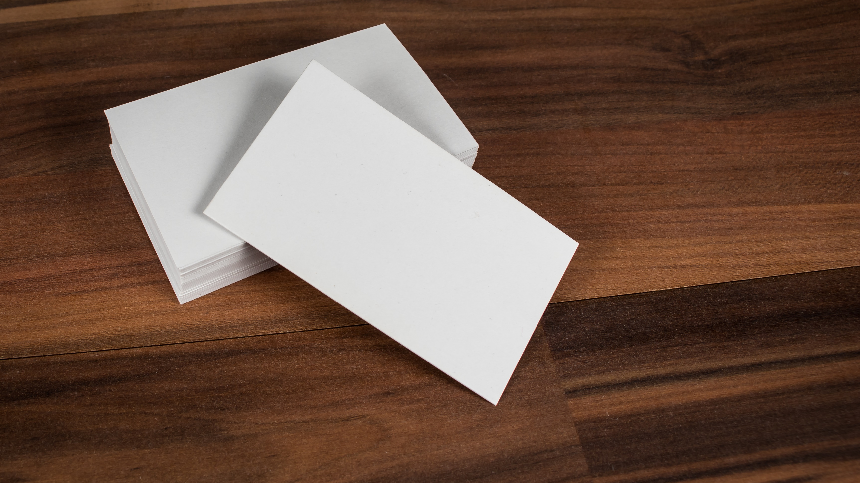
Dos and Donts
Do not:
Use correction fluid or Erasable ink. If you make a mistake cross
through it neatly
Try to communicate with other students in the room. This includes talking,
hand signalling, face pulling or making noises
Write anything on the exam paper until told to do so by the invigilator
Sit in another student’s seat
Do:
Follow the instructions of the invigilator
Check the paper to ensure it is the one you are expecting to do especially the tier

