Slide 1


Writing a Successful Personal Statement

Slide 2
What is a personal statement?
A chance to get noticed for your unique talents and experiences
Demonstrate your passion for the course you are applying to
Chance to “sell yourself” and show your personality
Talk about yourself away from your grades
An opportunity to stand out from the crowd
Secure an offer / interview / portfolio request

Slide 3
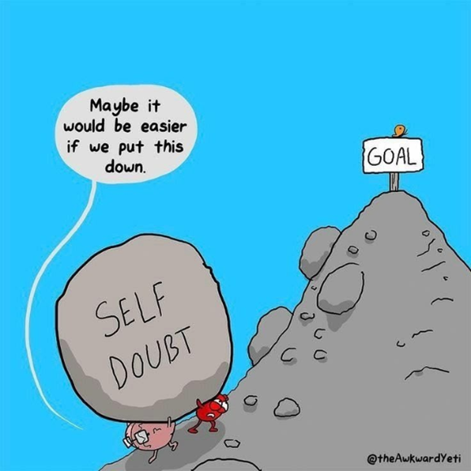
What are you good at?
BE PROUD OF THE THINGS YOU ARE GOOD AT!
Being positive about yourself can often be a challenge… but it is a vital skill to develop
Personal Statements
University interviews
Job applications/interviews
Meeting new people
Notes:
Ask students to share with the group – then ask them to share with their friends

Slide 4
Why has the personal statement changed?
Changed from one longer piece of text to 3 separate questions
Aims to make the process easier and more structured
Questions are aimed to give you a starting point
Scaffold answers to include exactly what universities want to see and succeed in your application
What should be included has stayed the same:
Passion & knowledge about subject area you want to study
Relevant skills, experiences & potential to be a great student
Notes:
Q1) What are your interests in this area, what are your motivations for carrying on to HE
Q2) Academic achievements, extracurricular and skills you have developed

Slide 5



How long is the statement?
4000 total character count still remains – including spaces
Minimum of 350 characters per question of the statement
NO LINE COUNT
Students are able to choose how they split the character count per question – allowing for individual preference
Notes:
4000 characters is still very restrictive – make sure you do not waffle and that you stick to answering the questions clearly and directly – think to yourself if it isn’t adding any value does it need to be in the statement?
Students are able to use more characters in a section if they feel they have more to say about a particular section – they might have more experiences to speak about depending on the course they are applying to or what they have done
As long on the minimum character characters for each is achieved
There is not maximum for the sections
You can use the UCAS personal statement builder online to help monitor the character counts for each section clearly – some formats can count the characters differently so worth checking

Slide 6
What are the new questions?
Why do you want to study this course or subject?
How have your qualifications and studies helped you to prepare for this course or subject?
What else have you done to prepare outside of education, and why are these experiences helpful?
No section is more important than the other, the statement will be reviewed as a whole by universities.
Notes:
Do not agonise over which section to include information in – the important thing is that it is included

Slide 7
Question 1 – Unpicked
Your motivations for studying this course(s)
Have you been inspired by a key role model or moment in your life?
Do you want to pursue this subject further?
Your knowledge of this subject area and interests
Is there a particular subject area you have researched and want to find more about?
A book that has sparked your interest?
Highlight super-curricular activities
Your future plans and why this is a good fit for you
How will you use this degree to launch your career?
Think about what’s important for you and your future
Notes:
Showcase to universities your passion and knowledge of your chosen subject area and demonstrate why it’s a good fit for you and your future ambitions

Slide 8
Question 2 – Unpicked
How your studies or training relate to your chosen course or subject area
Can include current/previous studies
Focus on most recent and relevant
What relevant or transferable skills you have that make you a great candidate
Have your subjects helped develop a core set of skills required
A particular module helped understand interests
Any relevant educational achievements
Don’t waste time talking about your grades
Highlight achievements – head student, winning a competition or landing the lead role in a play
Notes:
This is your chance to shout about the relevant or transferable skills you’ve gained from your formal education and highlight your understanding of how they will help you succeed in this subject area.

Slide 9
Question 3 – Unpicked
Work experience, employment, or volunteering
Reflect on your experiences and the skills gained relevant to your chosen course
Personal life experiences or responsibilities
Have you overcome a situation that has influenced you?
Do you have responsibilities that have developed essential qualities?
Hobbies and extracurricular activities
Sports, reading, community work, summer schools
Achievements outside of school
Captain for your local club, musical achievement, competition you won, qualifications attained outside of the classroom
Notes:
This is your chance to talk about any other activities you have undertaken outside of your formal education or personal experiences which further demonstrate your suitability for the course. This section is likely to be highly personal to you and anything you do include should reflect on why you’re including it.

Slide 10

Can I use AI?
When you complete your application, you now have to declare that your personal statement hasn't been copied or provided from another source, including artificial intelligence software
Use it to inspire, clarify & articulate your own ideas
IT’S CALLED A PERSONAL STATEMENT
Check each universities guidelines you are applying to for their stance on AI in your statement

Slide 11
How not to start…
According to UCAS, the five most common opening lines used in personal statements were:
From a young age….
For as long as I can remember….
I am applying to this course because….
I have always been interested in…
Throughout my life I have always enjoyed…
Notes:
Sometimes opening sentences can be really generic – almost like you copied it off a tik tok
Try to avoid quotes – especially of they don’t relate to your course at all
Admissions tutors want you to use your own words – IT IS A PERSONAL STATEMENT
Don’t waste your precious characters

Slide 12
How to structure the Personal Statement?
Point - what did you do?
Evidence - key detail and information
Explain - how is it relevant?
Link - link to how that will relate to the course you’re wishing to study
It is all very well telling someone you’re great at something,
but we want to see the evidence!
Notes:
Do not waste characters on listing qualifications and subjects. Focus on giving examples depth and context in relation to your chosen course.

Slide 13
More than one course?
You only get 1 personal statement – most of the time!
Some courses may not make offers if the statement lacks focus – due to tailoring to multiple courses
It is very common for students to apply to joint honours courses & mixed single subjects – make sure each discipline or subject is addressed the same
It might be possible to blend your statement that is relevant
You can choose to be honest…
Be careful with competitive courses
Notes:
If you're in this scenario, take care with how you approach your application. But equally, don't be put off from applying to a variety of courses if you're genuinely interested in them.

Slide 14
Finally….Top Tips!!!
Top Don’ts | Top Do’s
Leave it to the last minute | Start Writing Early
Do not lie or make it up.. You will get caught out | Brainstorm before writing
Be modest or shy | Use proper English to sound natural
Overthink or worry about it | Make sure it flows in a logical way
Just write lists / use long sentences | Be enthusiastic and clear
Have too many proof-readers | Proofread and get someone else to proofread
Plagiarise other statements!!! | Make sure you stand out!!
Notes:
BEST ADVICE IS START NOW – GIVE PLEANTY OF TIME TO MAKE IT PERFECT!!

