Slide 1

Introduction to the
UCAS Process 2026

Slide 2
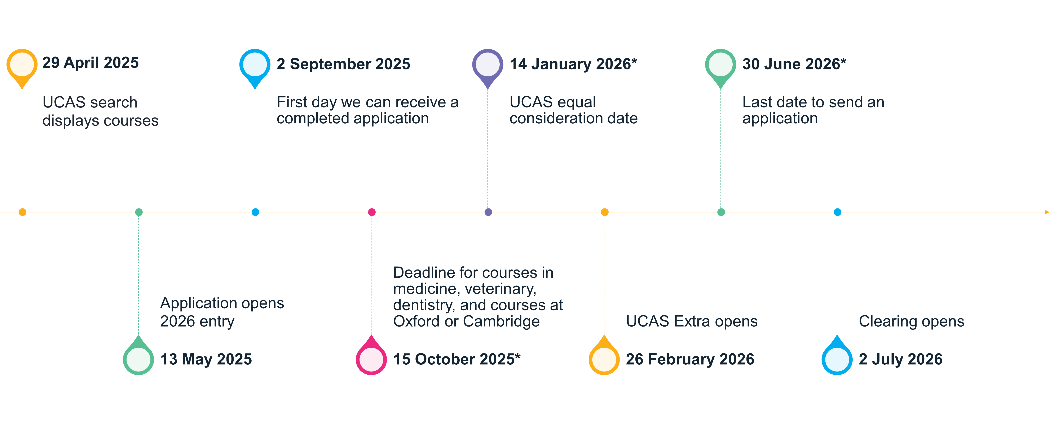

Overview of the 2026 cycle:
Key Dates

Slide 3

Applying

Slide 4

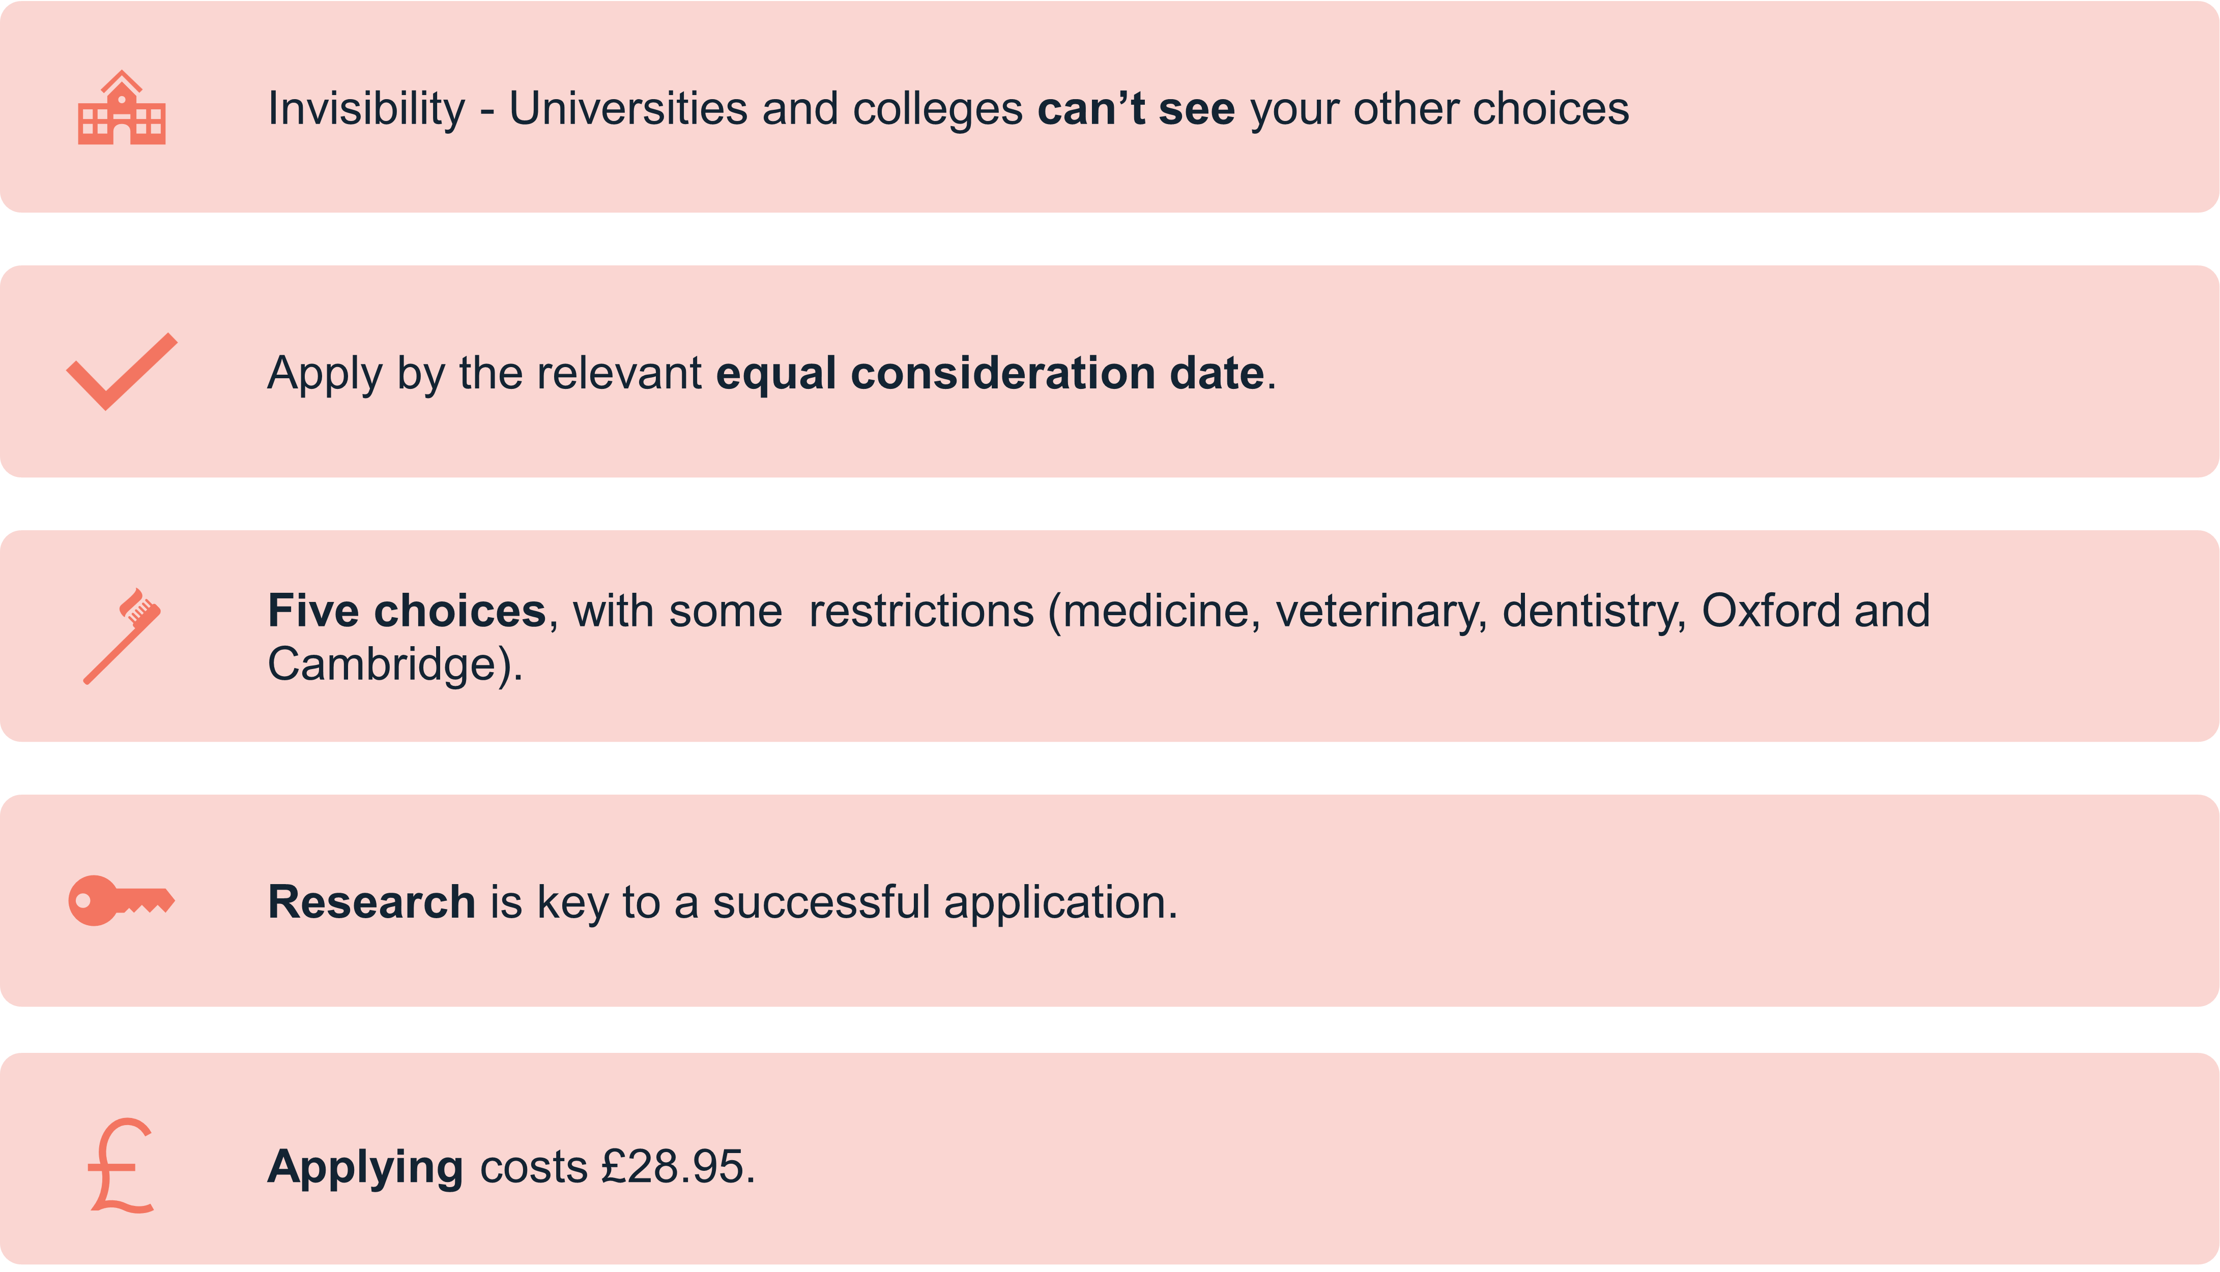
Key Facts
Notes:
Students who are currently enrolled at the school or college and have been in receipt of UK government funded free school meals at some point during the last six years (i.e. during their secondary education), will be eligible to have the application fee waived by UCAS (UK students only).

Slide 5
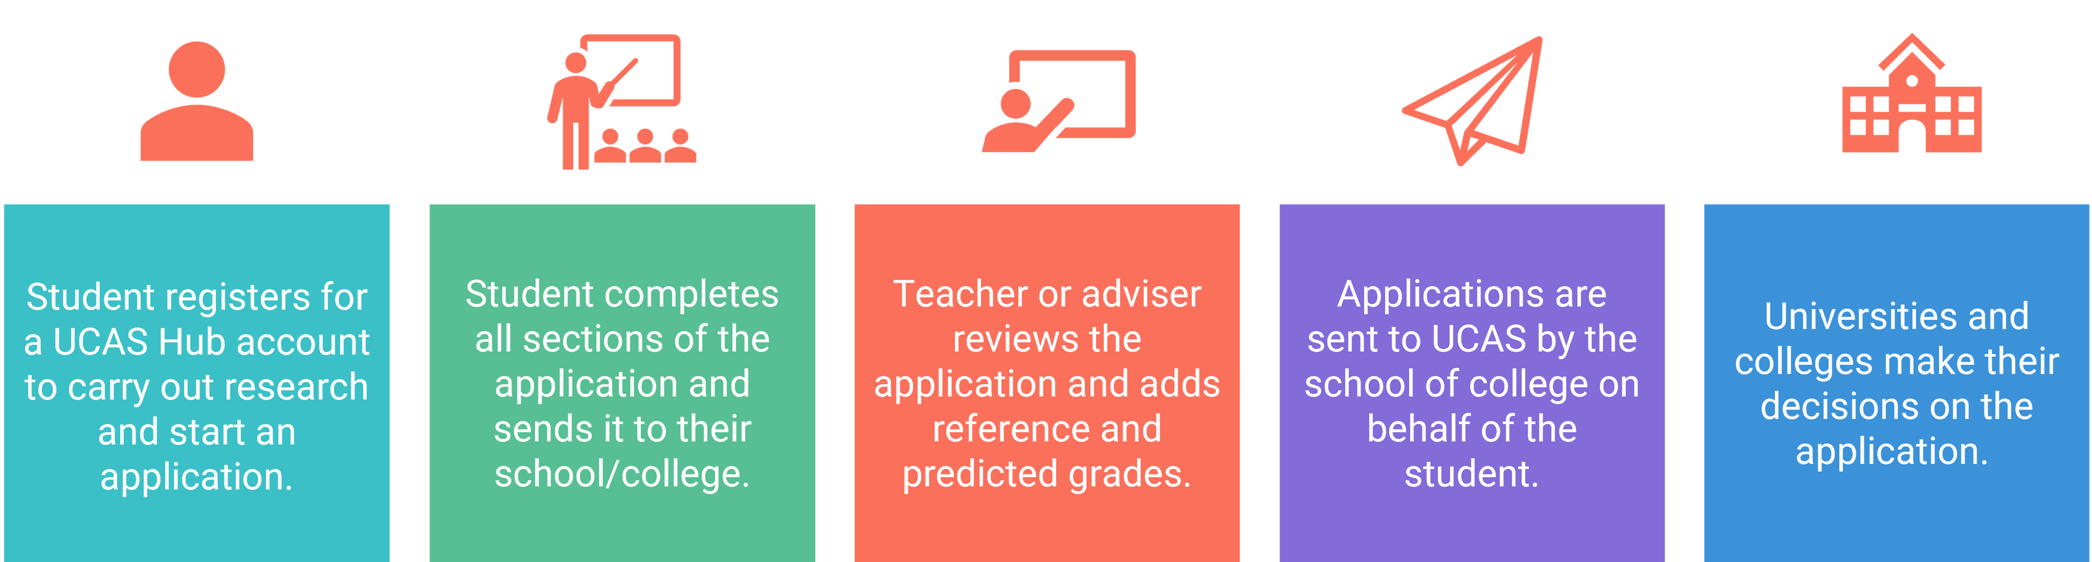
Applying

Slide 6
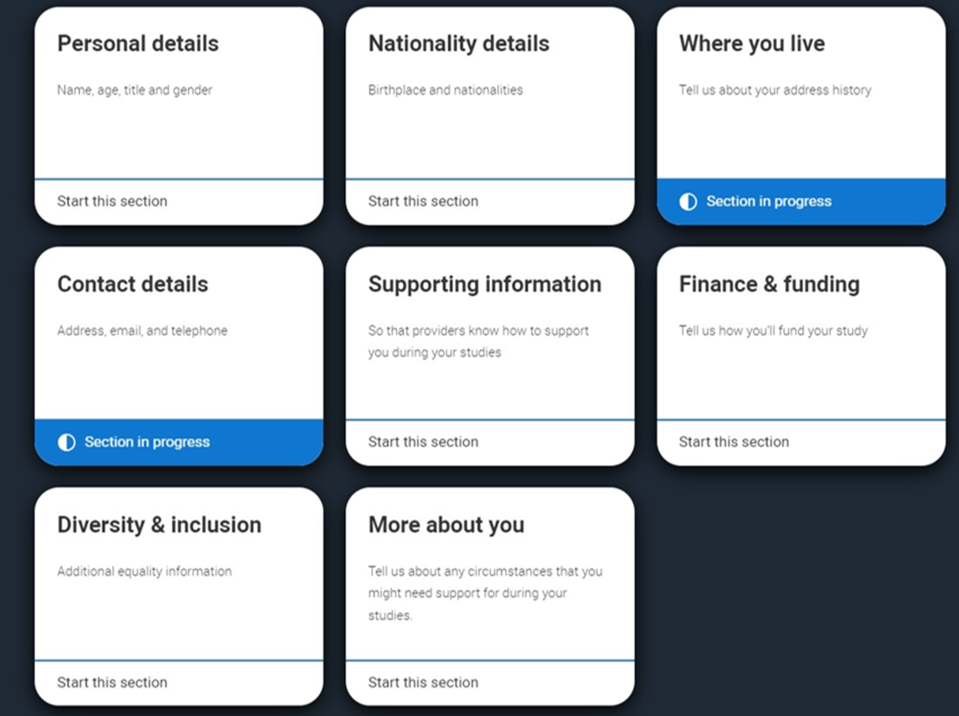
Application: Profile
Applying
Personal details
Nationality details
Where you live
Contact details
Supporting information
Finance and funding
Diversity and inclusion*
More about you
Notes:
* students with UK home address

Slide 7
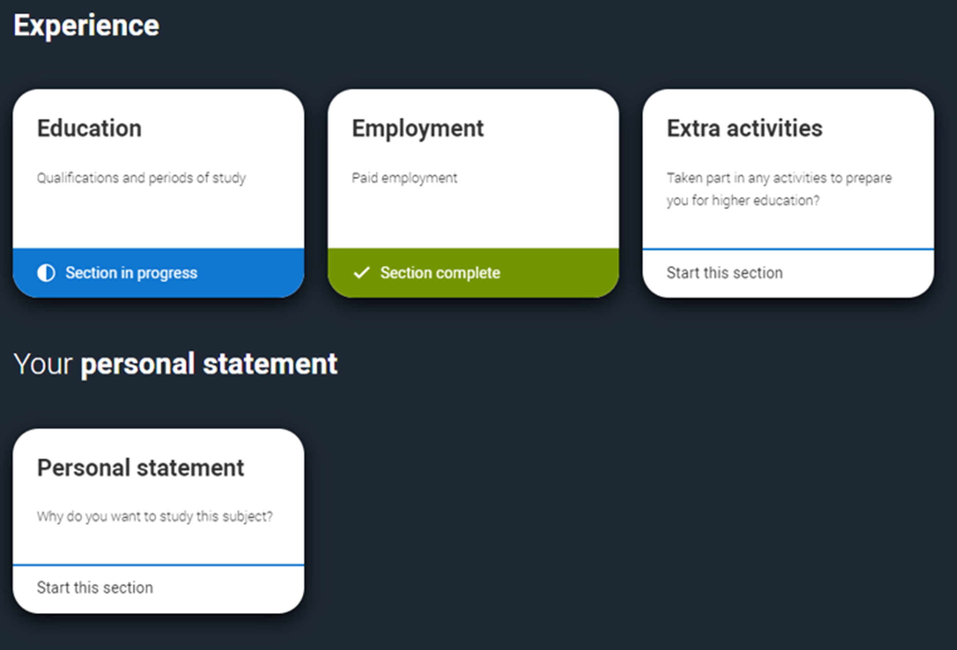
Application: Experiences
Applying
Education
Employment
Extra activities*
Personal statement
Reference**
Notes:
*(for students with a UK home address)
**(not visible if linked to your school/college)

Slide 8

Offers & Decisions

Slide 9

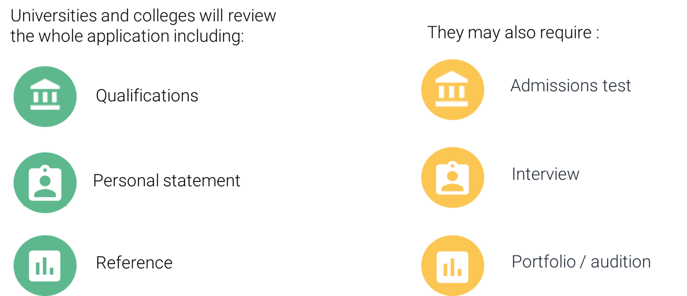
Decisions
Notes:
The universities and colleges begin their decision-making process. This differs between them, and even for different courses at the same university or college. The application forms are viewed holistically, each section is important and will be used by universities and colleges in different ways – this is why is it so important for students to do detailed research to know what is being looked for by each choice. There may even be differences across individual universities in how they are used.
Most admissions tests happen between August and November the year before you're due to start your studies. Some have a registration deadline before you need to submit your UCAS application. You should check the UCAS course search to check whether the course you are applying for requires an admissions test. www.ucas.com/applying/applying-university/admissions-tests.
Depending on the kind of courses you apply for, your chosen unis and colleges may invite you for an interview or audition – in fact they’re compulsory for some courses, such as teaching and nursing. It could either be sent to you directly, or through your UCAS application. It’s best to contact the uni or college to find out how and where you will receive information about your interview. For more advice www.ucas.com/applying/after-you-apply/undergraduate-interview-invitations

Slide 10
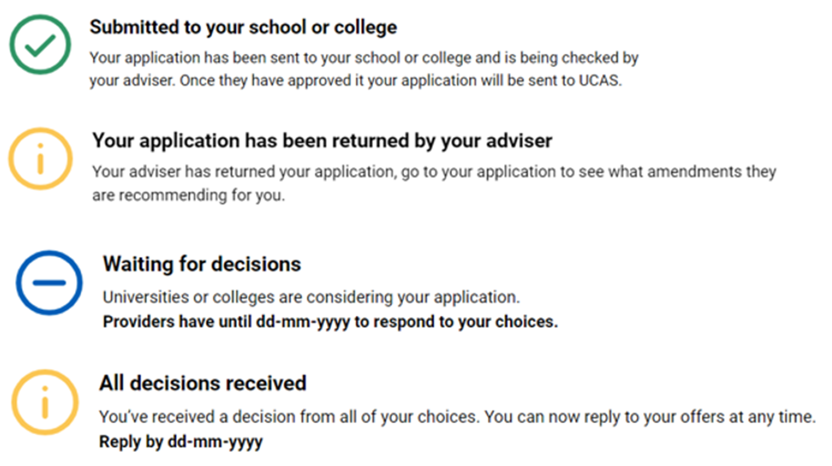
Tracking
Follow your application to:
check progress
see your choices
update contact information
view and reply to your offers
One of three decisions:
unconditional offer
conditional offer
unsuccessful
Notes:
Your application will update as the status of your application changes. We always advise students use a personal email address for their UCAS application so they can have access to this at all times.
You will hear about each of their choices at different times – sometimes you might be contacted very quickly, or it may be several months before you hear anything.
An offer will be either conditional or unconditional.
Conditional offer – the offer has conditions. For example, certain qualification results have to be achieved. The conditions may include achievement of specific grades, possibly in named subjects, or a certain number of UCAS Tariff points.
Unconditional offer – this usually the university or college’s entry requirements have already been met for the course. They might still have to meet other requirements, such as financial or medical conditions.
They may also receive:
Unsuccessful – the university or college has not offered a place on the course.

Slide 11
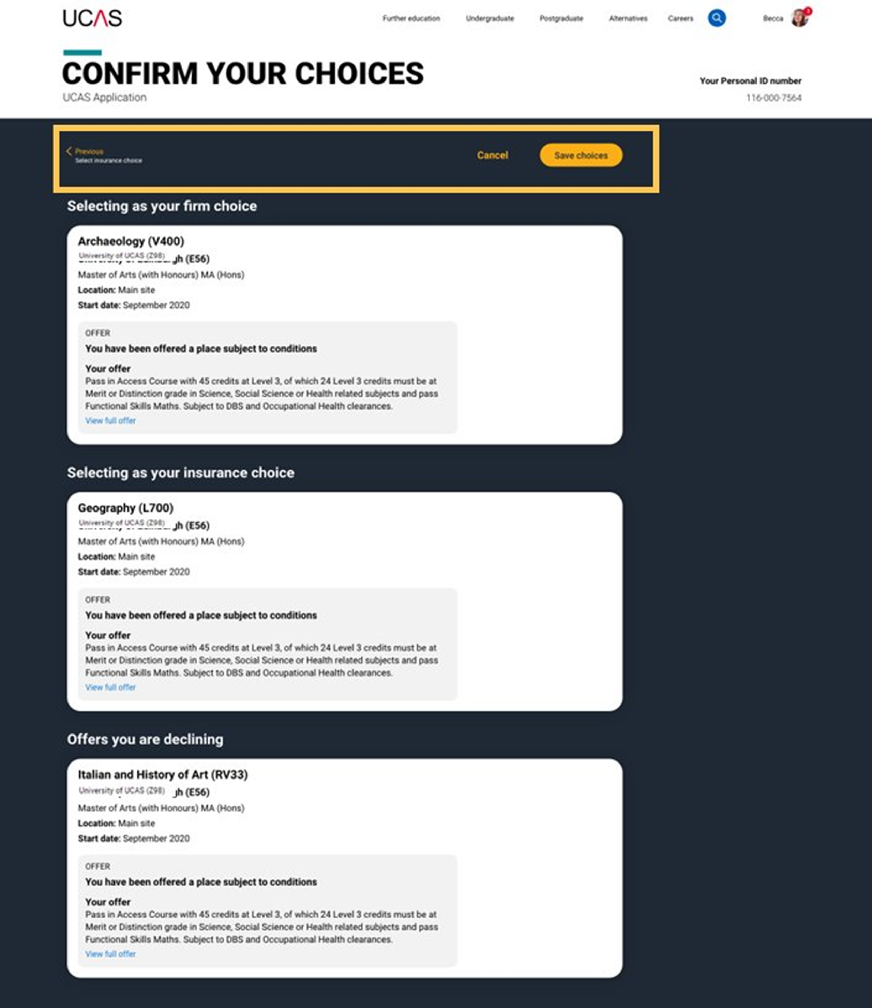
Replying
Once you've made your decisions, choose a 'firm' and 'insurance' choice.
Decline any remaining offers.
If you're not holding an offer, use Extra or Clearing to find available places.
Notes:
When you’ve had all decisions from your choices, you need to decide which one(s) you want to accept. The date you must reply to your offers is shown in your application.
You can accept one offer as your firm choice.
If that’s a conditional offer, you can accept a second offer as an insurance choice, if you want to, in case you don’t meet the conditions of your firm choice.
You don’t have to have an insurance choice. If you aren’t sure any of your other offers are right for you, it might be better to wait and see what’s available in Clearing once you have your results.
Remaining offers are automatically declined when the 'Firm' and 'Insurance' are selected.
If you firmly accept an unconditional offer, you cannot hold an insurance choice.
Choosing the right course and university or college is a very important decision, and it can be difficult to change later in the admissions process. To help you make an informed decision about where to apply, what to study, and whether to accept an offer, the university or college you should read all the information the university or college has shared with you; before making a decision. You need to think very carefully, and make sure you do not accept an offer from any university or college if they you’re not prepared to study there.
AN IMPORTANT MESSAGE FOR YOUR STUDENTS
If you don’t reply to your offers on or before the reply date shown in your application UCAS will decline them on your behalf (often referred to as declined by default [DBD]). This means you will lose all your offers.

Slide 12

Next Steps

Slide 13

Next Steps
research, research, research
attend open days and events
independent learning
work experience
volunteering
focus on this year’s studies
Notes:
Parent, Guardian and Carer Guide: UCAS Parent Guardian Carer Guide 2026.pdf

