Slide 1



Higher and
Degree Apprenticeships

Slide 2


What is a Higher Apprenticeship?
Combines on-the-job training with classroom learning
Study at an accredited University to achieve a higher level qualification
Higher Apprenticeships take between 3 – 6 to complete
Earn at least the National Minimum Wage while you train
Notes:
So what is an Apprenticeship?
Combine on-the-job training with classroom learning.
Study at an accredited University
Higher Apprenticeships take between three and six years to complete.
Earn at least the National Minimum Wage while you train.
You are earning whilst you are learning.

Slide 3
What is an Apprenticeship equivalent to?
Higher Education, NVQ4+, HNC,
Foundation Degree, HND,
Degree Apprenticeship, Degree
Degree (Level 6- 7)
(Bachelors / Masters)
Higher (Level 4- 7)
(Foundation-Masters Degree, Higher Diploma)
Advanced (Level 3)
(2 A levels)
Notes:
What levels of apprenticeship are they? Its knowing your levels.
Advanced Apprenticeships – Level 3 qualification & are equivalent to 2 A-levels
Higher Apprenticeships – Between Level 4 (Foundations degree) to Level 6 Bachelors degree or of even Level 7- Maters Degree
You can start at Apprenticeship Level 2 with the aim to progress up to 3-4-5-6-7

Slide 4
How much can I earn?
Over 19 and completed your first year?
Minimum Wage is £10.00 per hour (ages 18-20)
Under 19 or first year of apprenticeship?
Minimum Wage is £7.55 per hour
Like all jobs, employers set the salaries, which vary depending on the apprenticeship
However, Higher Apprenticeships & Degree Apprenticeships often pay higher
(Data September 2025)
Notes:
Legally, an employer must pay an apprentice the National Minimum Wage for apprentices, which is £4.15/hr.
Financial support for apprentices :
There is additional support of £1000 available for Care Leavers who are starting an apprenticeship.

Slide 5
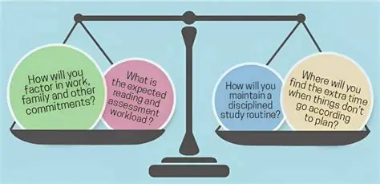
Balancing Work and Study
Notes:
Balancing work and study
Prioritising work or study
A student needs to be organised – co-ordinated – and able to communicate any difficulties which arise
The student will be mixing on campus with other who are in full time study and this bring its own challenges when other seem to have the time to enjoy the STUDENT EXPERIENCE
An apprentice will be studying and have a full time job to commit too – is the student ready for this commitment??

Slide 6
Who Benefits?
Career Advancement
  Apprentices progress their careers by acquiring valuable skills and experience
Skill Development
  Apprentices gain practical skills and qualifications that enhance their employability and expertise
Employment Opportunities
  Successful apprentices often secure jobs with leading organisations after completion
Reduced Recruitment Costs
  Tailored workforce development lowers recruitment expenses by filling roles internally with trained employees
Skilled Workforce Development
  Developing a skilled workforce ensures employees meet specific employer needs and improves overall productivity
Improved Retention and Engagement
  Investing in employees increases retention rates and fosters higher engagement and job satisfaction

Slide 7
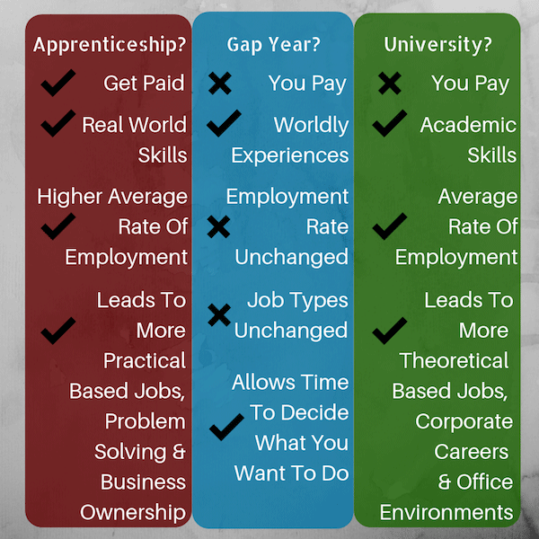
Notes:
There are benefits for the employer also
Reduced recruitment costs
Skilled workforce development
Improved retention and Engagement
EMPLOYEES WHO ARE LEARNING AND DEVELOPING IN INDUSTRY WITH INDUSTRY SPECIFIC SKILLS

Slide 8
How to find and apply for
Higher Apprenticeships and
Degree Apprenticeships
Sounds great! Where can I apply?
Notes:
I think that sounds great? So how do you apply for these?

Slide 9


Useful Websites
.
The Student Room
www.thestudentroom.co.uk
Job websites
Company Websites
UCAS
www.UCAS.com
Find an Apprenticeship
www.gov.uk/apply-apprenticeship
Notes:
There are a variety of websites you will be able to find vacancies; The Student room, Job and Company websites such as Indeed and Monster as well as the Government website.
Some employers will ask you to apply directly to them. If this is the case, you’ll be directed to the right place on the “Find an apprenticeship” website.
If you want to work for a particular employer, look on their website - most businesses have a jobs page for apprenticeships or vacancies.
Linkedin – is also a developing resource
6th Form mentors will also share any information with 6th form students – including careers fairs in school and local recruitment events.

Slide 10

KEY POINTS
This is a job application
Many students will be applying for these roles
The role may require relocation
The employer does not have to look for candidates – candidates look for the role
Some employers advertise as early as the October of Year 13
RESEARCH vacancies
RESEARCH the company before applying
RESEARCH the reasons you want the role before interview

Slide 11


If you want to further support your child in making career decisions:
Encourage your student to talk about their choices with you, their teachers and careers advisors
Support your student to reach out to education or training providers who offer the course they are interested in, to ask what they are looking for before you apply
Engage in careers conversations with your student to help them feel more supported, informed and confident in their decisions

