Slide 1
Typography

Slide 2
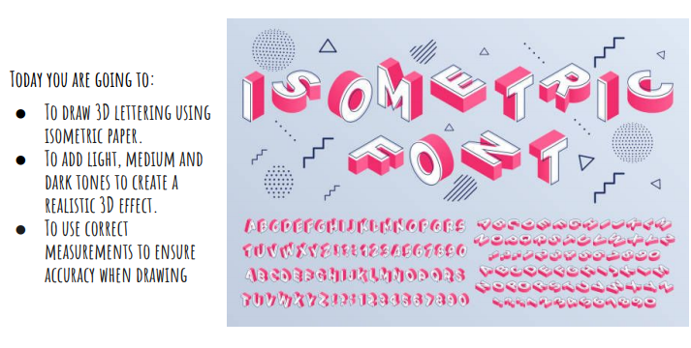

Slide 3
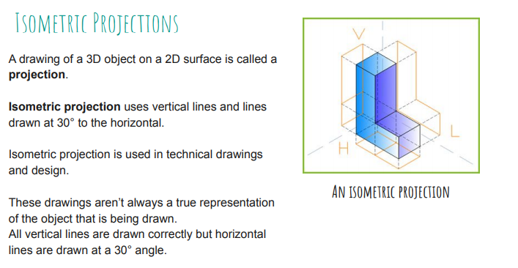

Slide 4
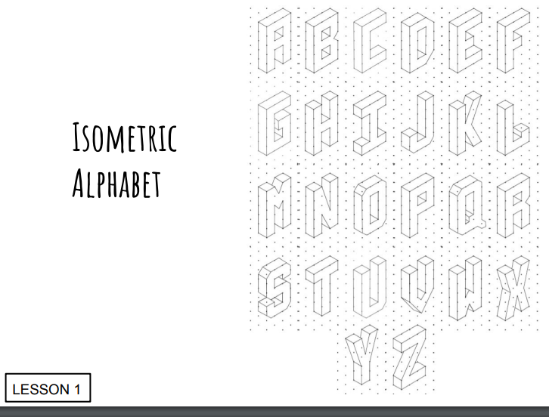
Print the isometric paper file and use it to write your name in isometric. Use the letters here to help you. Add colour or shading to make it appear more 3 dimensional.

