Slide 1
Product Analysis
Music on the Move
Week 1

Slide 2



Listening to Music
Consider how, when and where you listen to music.
How do people listen to music?
Where do people listen to music?
When do people listen to music?

Slide 3
Learning Objective
To investigate a variety of different music playing options.
To build on an understanding of the product analysis process.
Success Criteria
To understand how market pull has influenced sales and the introduction of new products.
To compare and contrast a variety of music players.
To identify opportunities for future development, considering customer requirements and retro design.
To further investigate product analysis using ACCESSFM.

Slide 4

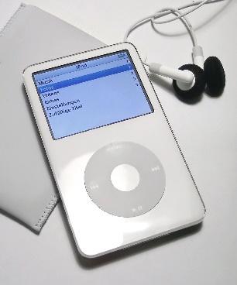
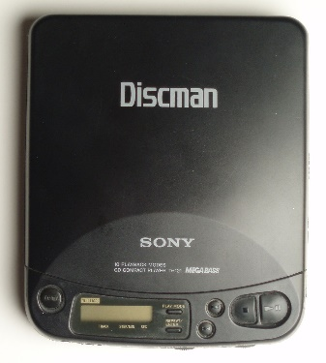
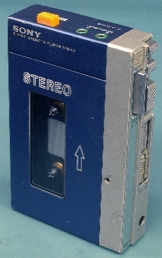
Compare and Contrast
Use the Venn diagram as a way to identify similarities and differences between the three products.
Apple iPod
2010s
iPod
Discman
Walkman
Sony Discman 1990s
Sony Walkman
1980s

Slide 5
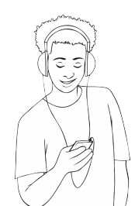
Design and Technology: Music on the move
Venn diagram
Date:
Using the diagram below, make notes on each product to help write your product analysis. What similarities and differences can you find?
iPod
walkman
discman

Slide 6

Product Analysis
Using ACCESSFM, answer the following questions about portable media players.
Topic | Compulsory Question | Higher level question
Aesthetics | What does the product look like? | How can the product be made to look better?
Cost | How much do these products cost to buy? | What are the differences in running costs of the product?
Customer | Who is the intended user of this product? How easy is the product to use? | Could the design be adapted for users with additional needs?
Environment | What environment is the product used in? What is the environmental impact? | Could manufacturers do more to help protect the environment during manufacture?
Safety | What are the safety features of this products? | Could the design be adapted to make them even more safe?
Size | How does the size suit the purpose and the user? | How could the design be adapted to suit different sized people?
Function | What is the primary function of each product? | Do the products have any other features/functions?
Materials | What materials have been used? | What are the original sources of these materials? (The raw material)

Slide 7
Design and Technology: Music on the move
Product Analysis - ACCESSFM
Date:
A__________ | S__________
C__________ | S__________
C__________ | F__________
E__________ | M__________

