Slide 1
Product Analysis
Music on the Move
Week 2

Slide 2
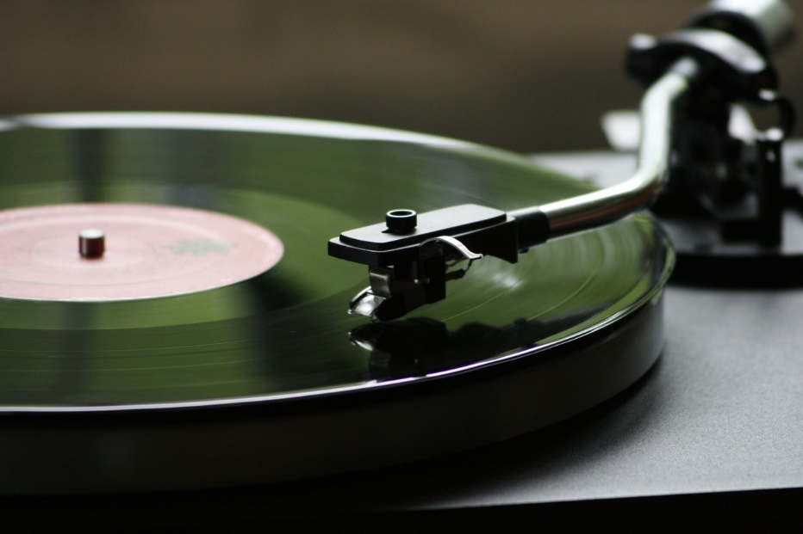
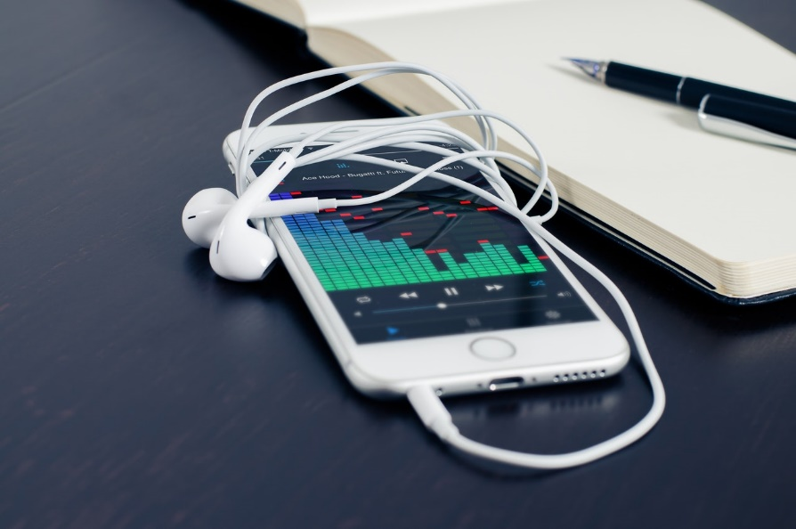
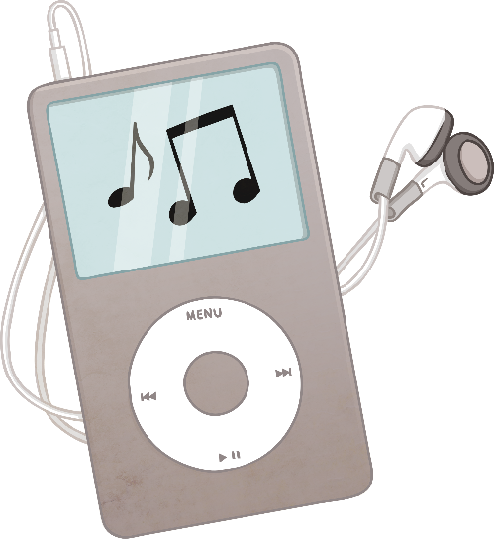
Future Design Developments?
Will products become more simplified to consider the environment or will market research indicate more complex technology?
How do you think we will be listening to music in the future?
Does design repeat itself?

Slide 3

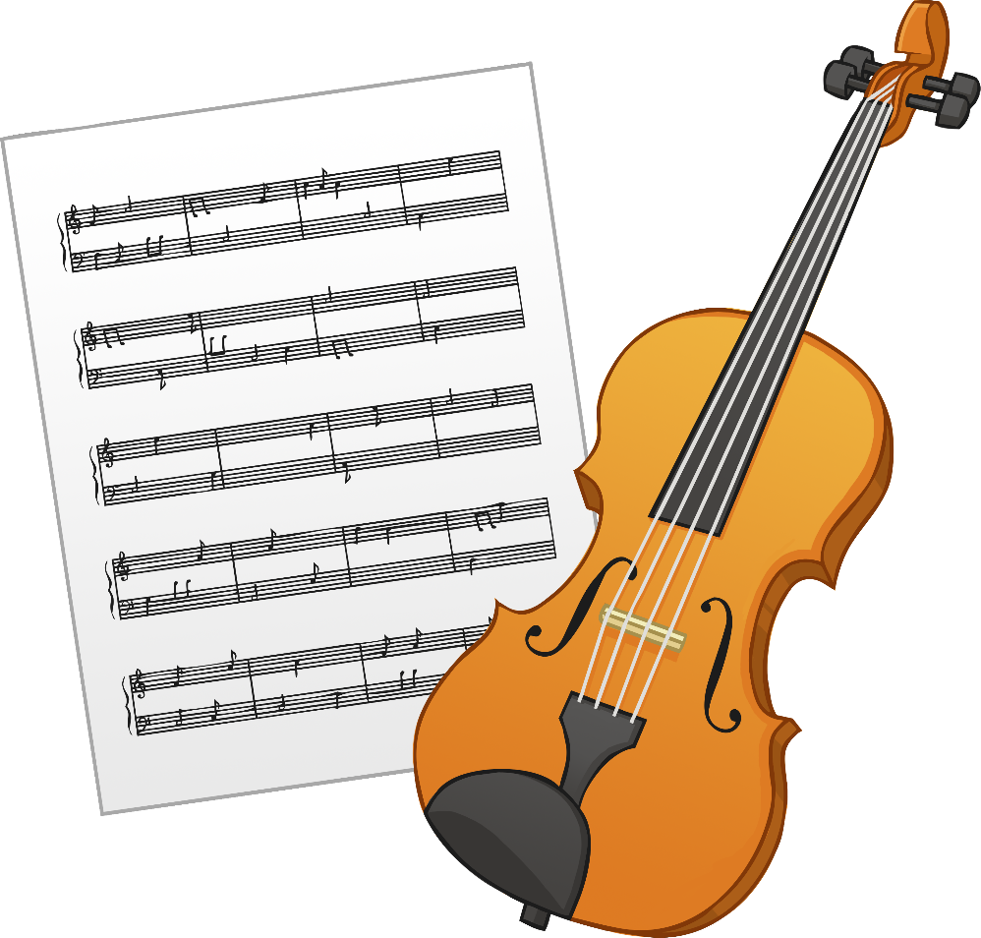
Design Activity
Consider the following questions and design a product to change how we listen to music in the future.
What will music technology look like?
What will their functions be?
How will we use it?
How will it change/improve our lives?

Slide 4
Using the boxes below, create four designs to create the music player of the future. What could you change to improve upon current designs?
Design and Technology: Music on the move
Music Player Design – Initial ideas
Date:

Slide 5

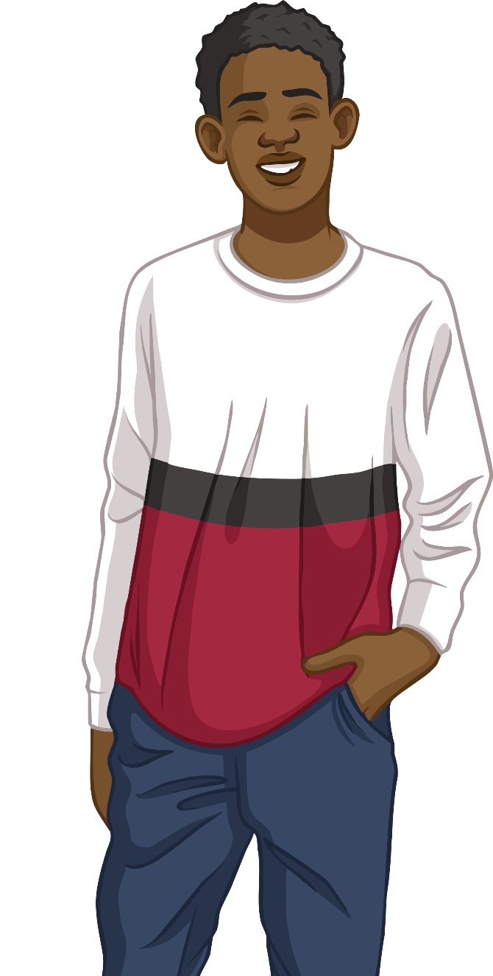
Plenary Questions
Hot questions
What is market pull?
Explain, with an example, what is meant by retro design.
Are personal music products becoming more or less environmentally friendly?
Name three ways in which we listen to music on the move.
How are personal music players made easy to use?

