Slide 1
Year 9
Designers

Slide 2
Lesson 1

Slide 3

Who thinks up the ideas for all our new things we buy and uses?
Page 1 of student booklet
Notes:
Students to discuss in small groups/pairs their ideas and to note them one page one of the booklet (top box on page)
Class discussion of ideas.

Slide 4
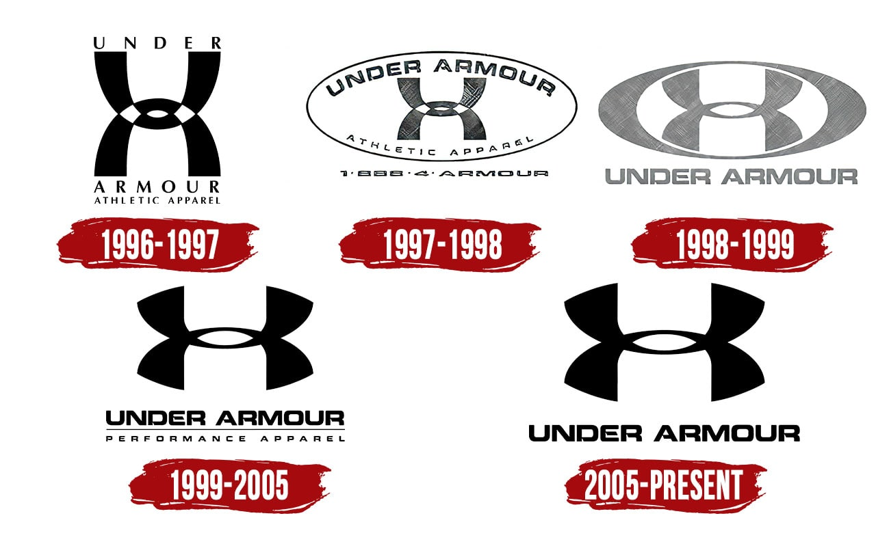
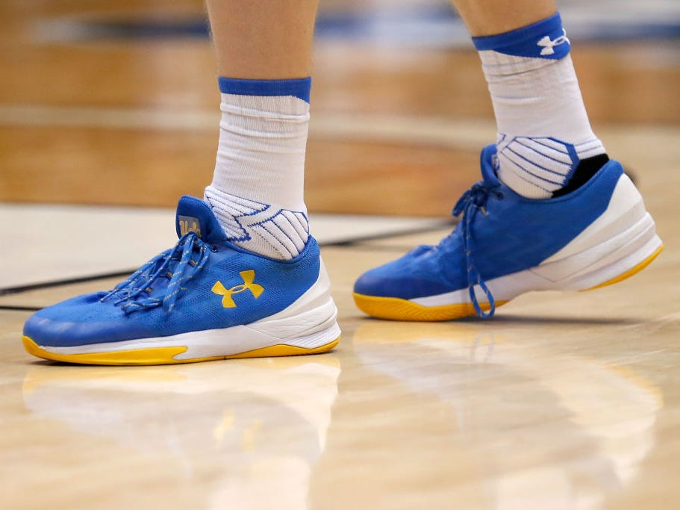
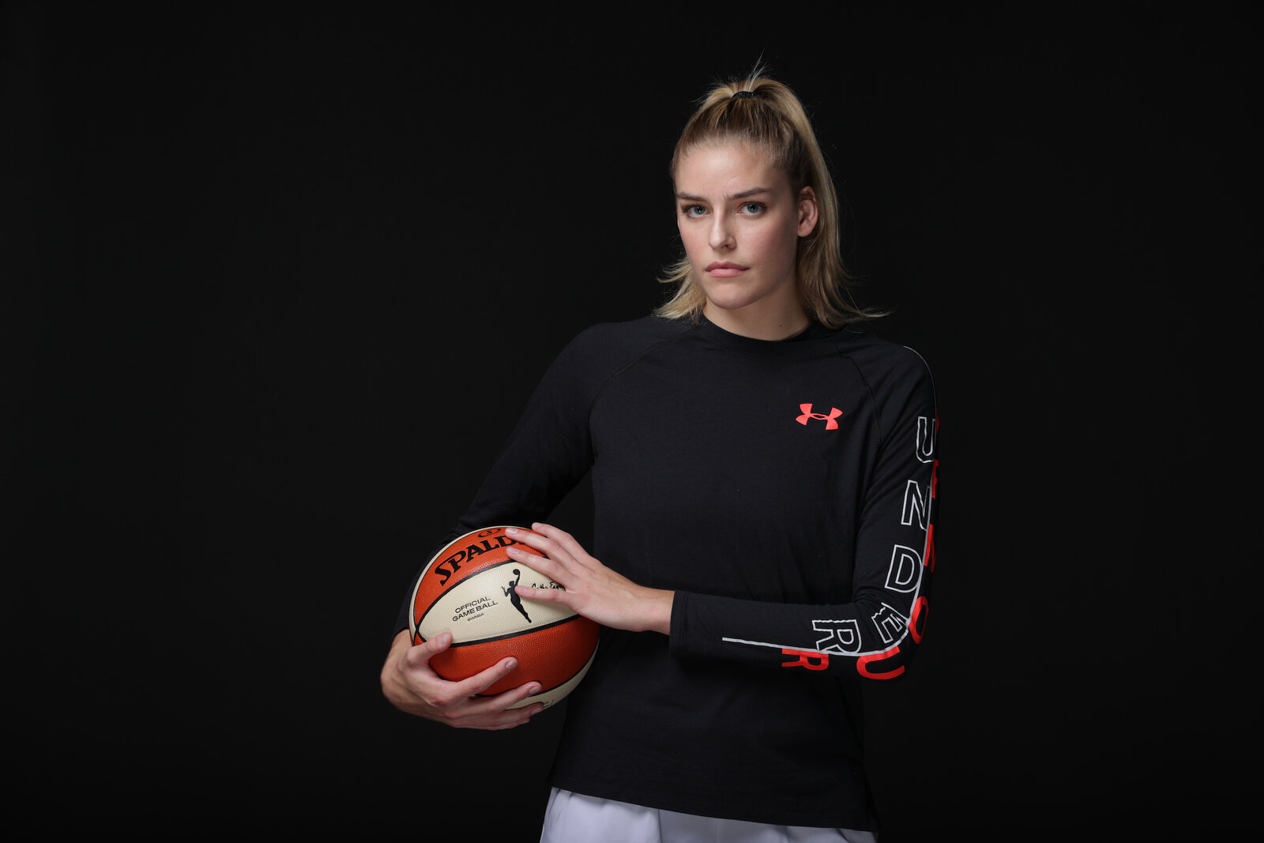
Who's Who in the Designing World?
Under Armour
Under Armour was founded in 1995 by Kevin Plank. A 23-year-old former special teams captain of the University of Maryland football team. The brand originally began business from his grandmother's basement in Washington DC. It was due to Planks sporting background that the brand was established.
Under Armour, Inc. is an American company that manufactures footwear, sports, and casual apparel
Under Armour received its first big break in 1999 when Warner Brothers contacted Under Armour to outfit two of its feature films
The following year, Under Armour became the outfitter of the new XFL football league, gaining even more attention during the league's debut on national television
Notes:
Teacher is talk though all 4 of the designers/brands
Students are to pick their favorite 3 and fill in their booklet. Page 1 and 2. How to fill in the student booklet is on the slide after the designers/brands.

Slide 5
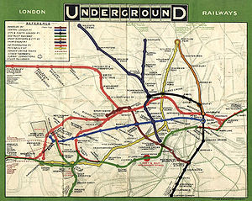
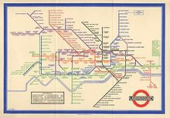
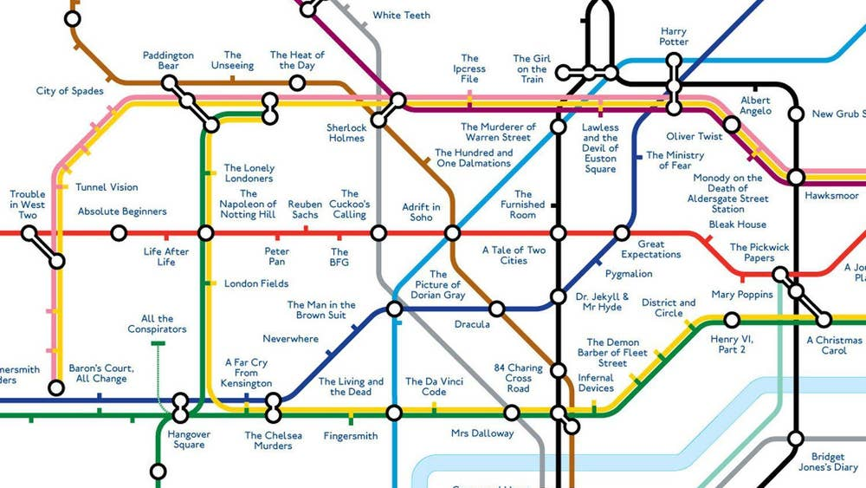

Who's Who in the Designing World?
Harry Beck
Born in 1902, Beck was an English engineering draftsman who sparked a small revolution in the early 1930s when he created a radical new map of the London Underground. His linear, color-coded diagram was at first greeted with apprehension from transit authorities, but soon proved popular among London commuters.
It was Beck who had the idea of creating a full system map in colour. He believed that Underground passengers were not concerned with geographical accuracy and were more interested in how to get from one station to another and where to change trains. While drawing an electrical circuit diagram, Beck came up with a new idea for a map that was based upon the concept of an circuit diagram on which all the stations were more-or-less equally spaced rather than a geographic map.
Notes:
Teacher is talk though all 4 of the designers/brands
Students are to pick their favorite 3 and fill in their booklet. Page 1 and 2. How to fill in the student booklet is on the slide 7 after the designers/brands.

Slide 6
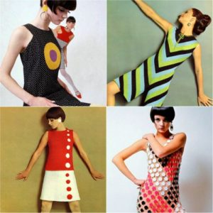
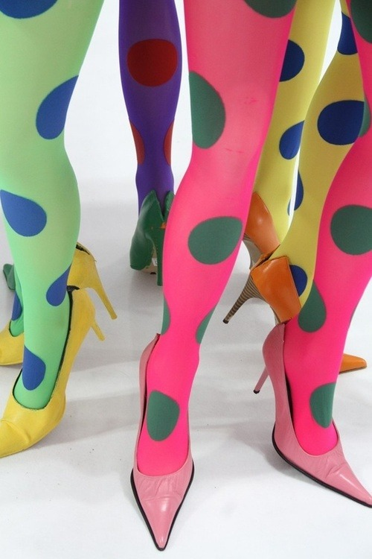
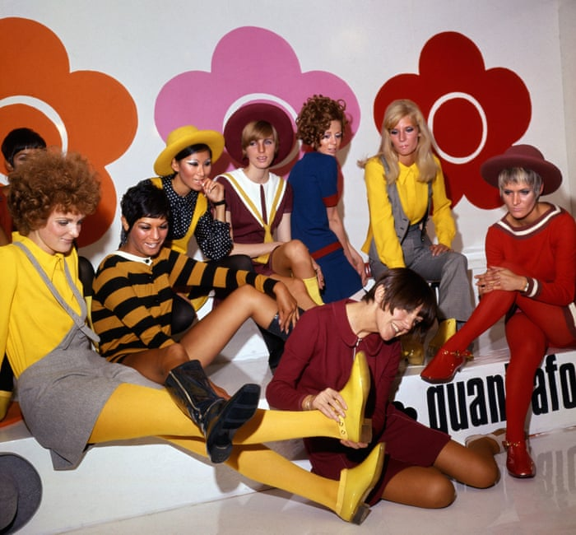

Who's Who in the Designing World?
Mary Quant
Mary Quant was born on February 11, 1934, in Blackheath, London, England, to Welsh teachers Jack and Mary Quant, who were originally from mining families. She went to Blackheath High School before studying illustration at Goldsmiths College.
She became an instrumental figure in the 1960s London-based Mod and youth fashion movements.^{[3][5]} She was one of the designers who took credit for the miniskirt and hotpants, and by promoting these and other fun fashions she encouraged young people to dress to please themselves and to treat fashion as a game.
Quant is often credited with inventing the coloured and patterned tights that tended to accompany the garment
Notes:
Teacher is talk though all 4 of the designers/brands
Students are to pick their favorite 3 and fill in their booklet. Page 1 and 2. How to fill in the student booklet is on the slide after the designers/brands.

Slide 7


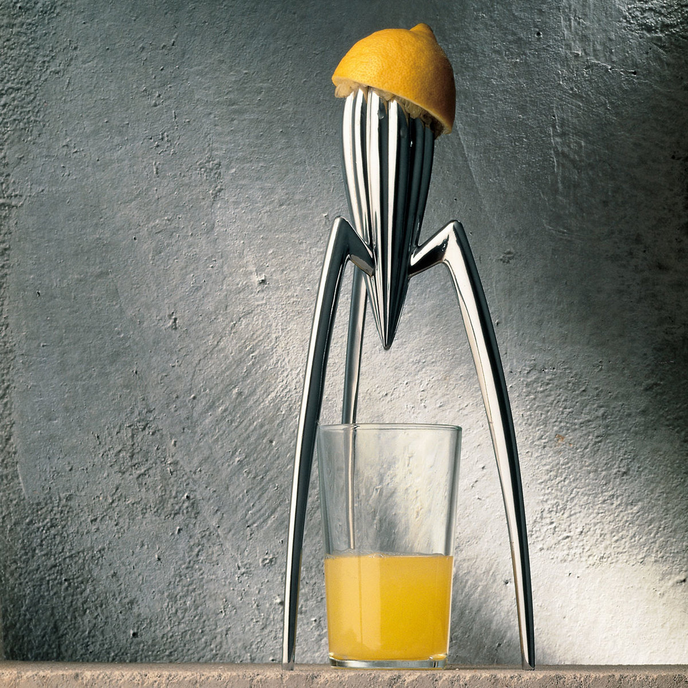


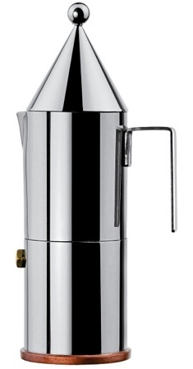

Who's Who in the Designing World?
Alessi
Alessi was founded in 1921 by Giovanni Alessi who was born in Italy and raised in Switzerland. A few years after World War 1, Alessi started with producing a wide range of tableware items in nickel, chromium and silver-plated brass.
In 1970, Alberto Alessi was responsible for the third transformation of the company. Alessi was considered one of the "Italian Design Factories".
In the 1990s Alessi started to work more with plastics, at the request of designers who found it an easier material to work with than metal, offering more design freedom and innovative possibilities.
Alessi colaberated with a wide range of designers including Philippe Starck
Notes:
Teacher is talk though all 4 of the designers/brands
Students are to pick their favorite 3 and fill in their booklet. Page 1 and 2. How to fill in the student booklet is on the slide after the designers/brands.

Slide 8
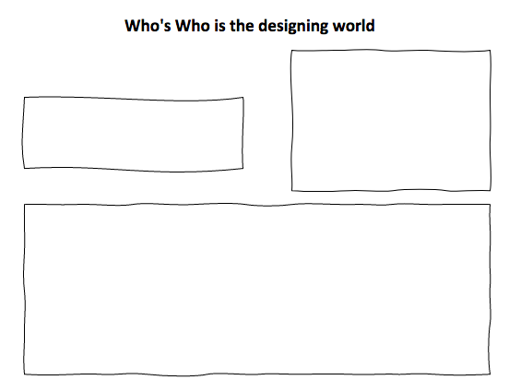
Who's Who in the Designing World? Task
Now you have had a look at the designers and brands in more detail, you need to choose 3 of your favourite ones to write up in your booklets.
Example below:
Image relating to the designer/brand
Name of designer/brand
Background information
Page 1/2 of student booklet

Slide 9

Home Learning Task​
​
Write 3 Tweets that you think your favorite designer might Tweet when brining out a new product. ​

