Slide 1
Year 7 Food and Nutrition
Pizza Project
Food Safety

Slide 2
Design your ultimate pizza
For this project, you are thinking about your ultimate pizza
You will be designing the pizza, and along the way we will cover some of the considerations we need to make when cooking
TASK:
In your booklet, draw your ultimate pizza! Label the ingredients and toppings, and include a menu description

Slide 3
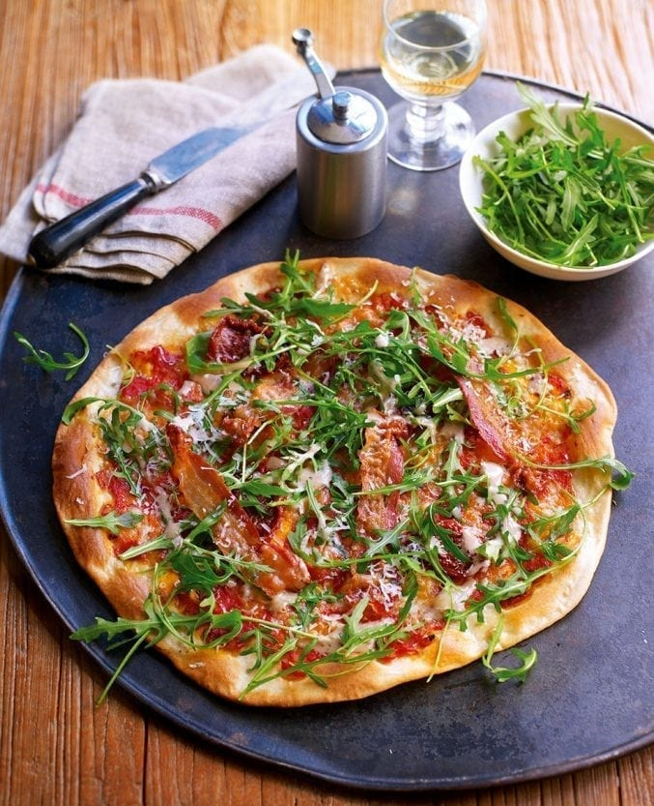
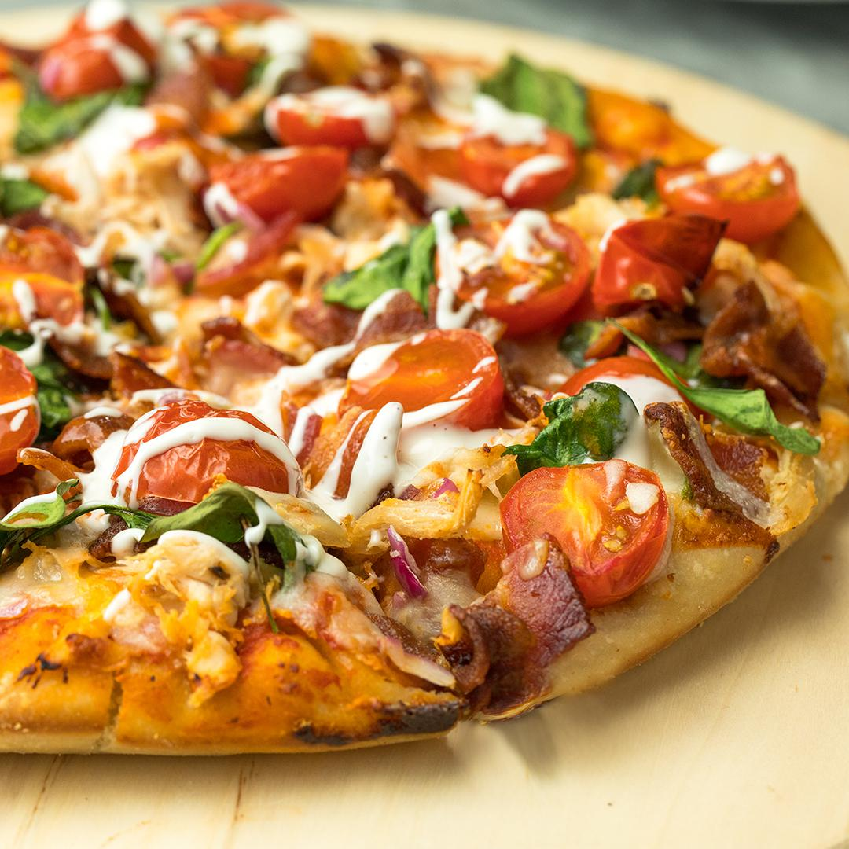
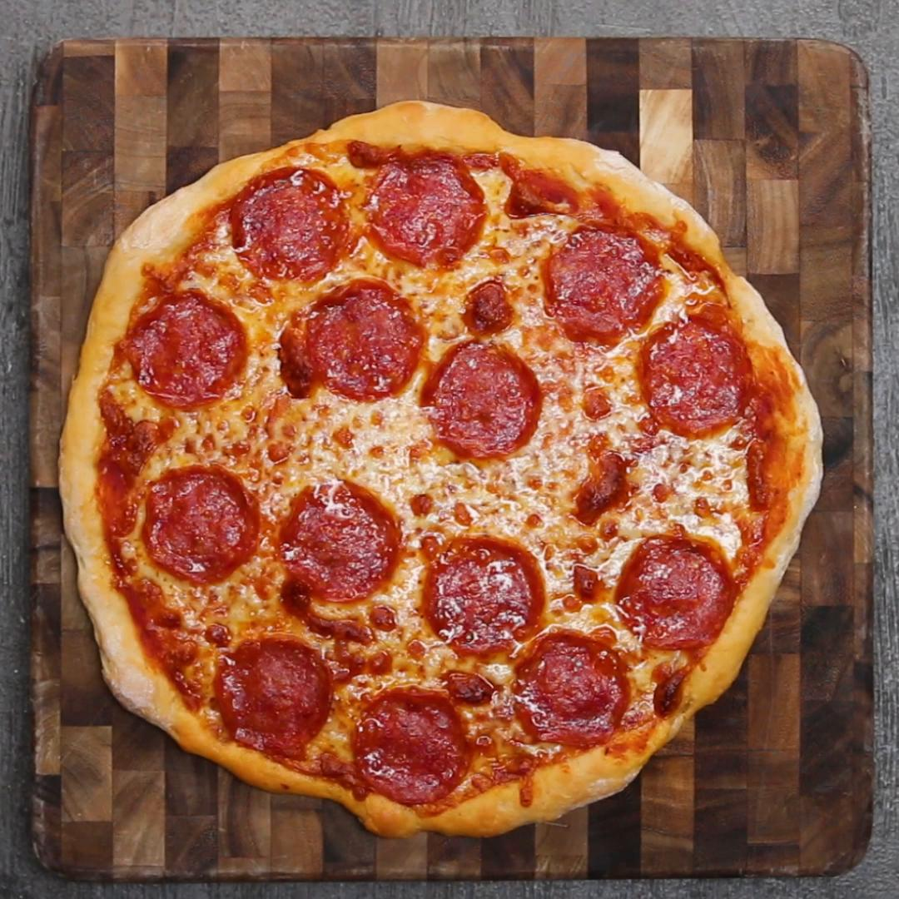
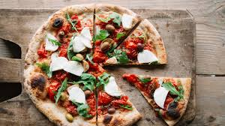
Inspiration

Slide 4
Keeping Food Safe

Slide 5
Learning Objective
To understand how and why we need to keep food safe.
Success Criteria
To identify important food storage facts.
To understand the best places to store food in the fridge with their ideal storage temperatures.
To explain how to keep food safe at home and in a working kitchen.

Slide 6

The Thermometer
Where do the temperatures and statements go on the thermometer?
5°C - 63°C
Chilling
-18°C
The Danger Zone
0°C - 5°C
Freezing
75°C
Cooking/Reheating

Slide 7
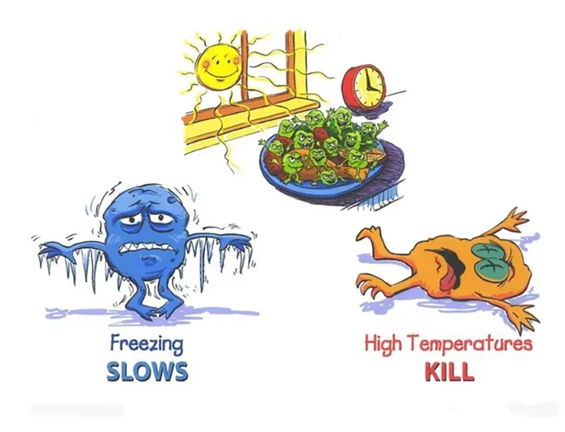
The Danger Zone – 5 to 63 Degrees

Slide 8
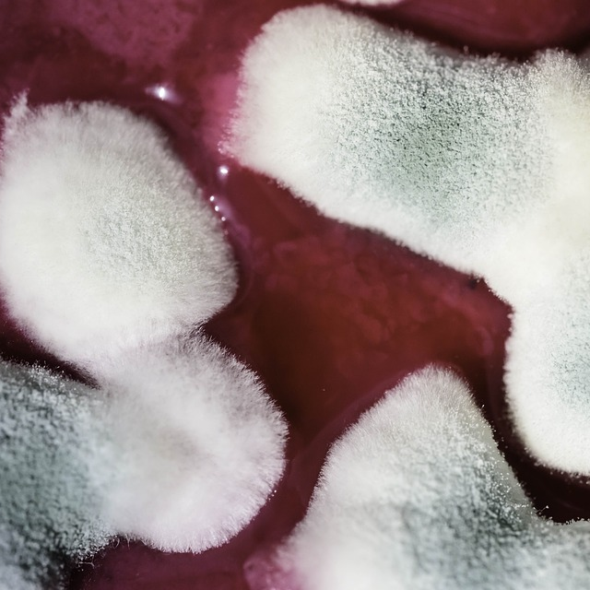
Why Is It Important to Store Food Safely?
Food needs to be stored or preserved in conditions bacteria cannot grow.
Although we need good bacteria in our bodies to help digest food and maintain a good digestive balance, some bacteria is harmful and can cause serious illnesses.

Slide 9
Which Statement Matches the Temperature Term?
Cooking/
Reheating 75°C
?C is the perfect bacteria-breeding temperature.
37°C is the optimal temperature for bacteria to breed.
Chilling
0°C - 5°C
? food below ?°C stops the growth of bacteria.
? extends the shelf life of food without losing nutrients.
Bacteria aren’t killed when frozen, they are classed as dormant and become active when food is thawed.
The Danger Zone
5°C - 63°C
Keeping food at ?°C slows down the growth of bacteria.
? doesn’t change the properties of food.
? extends the shelf life of food.
Freezing
-18°C
Cooking food above ?°C kills bacteria.
? food to above 75°C.
It is important to ? food properly and only once.

Slide 10
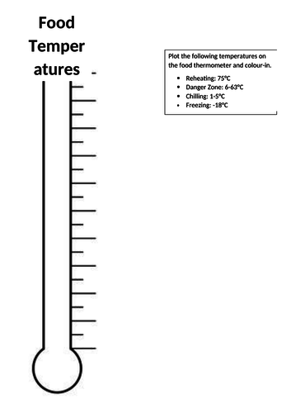
In your booklets:
Write these next to the right temperatures :
Body temperature
Cook/ re-heat to here
End of danger zone – bacteria start being destroyed
Start of danger zone – bacterial growth speeds up
Freezer temperature – bacteria become dormant
Keep food being served at or above this temperature
Bacterial growth starts slowly
Food temperature zones
75
63
60
37
5
0
-18
Label and colour the various zones:
Hot food zone
Danger zone
Cold food zone
Frozen food zone

