Slide 1
Year 7 Food and Nutrition
Pizza Project
Food Safety

Slide 2
TASK: In your booklets, pick 2 colours – add these to your key, and colour code the statements for either the fridge or freezer
Fridge vs Freezer
Ideal for chilling foods – especially high risk ones.
Food should be covered or stored in containers to prevent cross-contamination.
Bacteria remain dormant.
Temperature should be set at around -18°C.
Don’t let blood and juices of raw meat drip onto other food.
Should be kept between 0°C and 5°C.
Greatly extends the shelf life of food products.
Food should be defrosted thoroughly before cooking.
Food should have clear labels with the date on.
Raw food should be stored on the bottom shelf.

Slide 3
Fridge vs Freezer
Fridge
Freezer
Ideal for chilling foods – especially high risk ones.
Greatly extends the shelf life of food products.
Should be kept between 0°C and 5°C.
Temperature should be set at around -18°C.
Food should be covered or stored in containers to prevent cross-contamination.
Food should have clear labels with the date on.
Don’t let blood and juices of raw meat drip onto other food.
Food should be defrosted thoroughly before cooking.
Raw food should be stored on the bottom shelf.
Bacteria remain dormant.

Slide 4
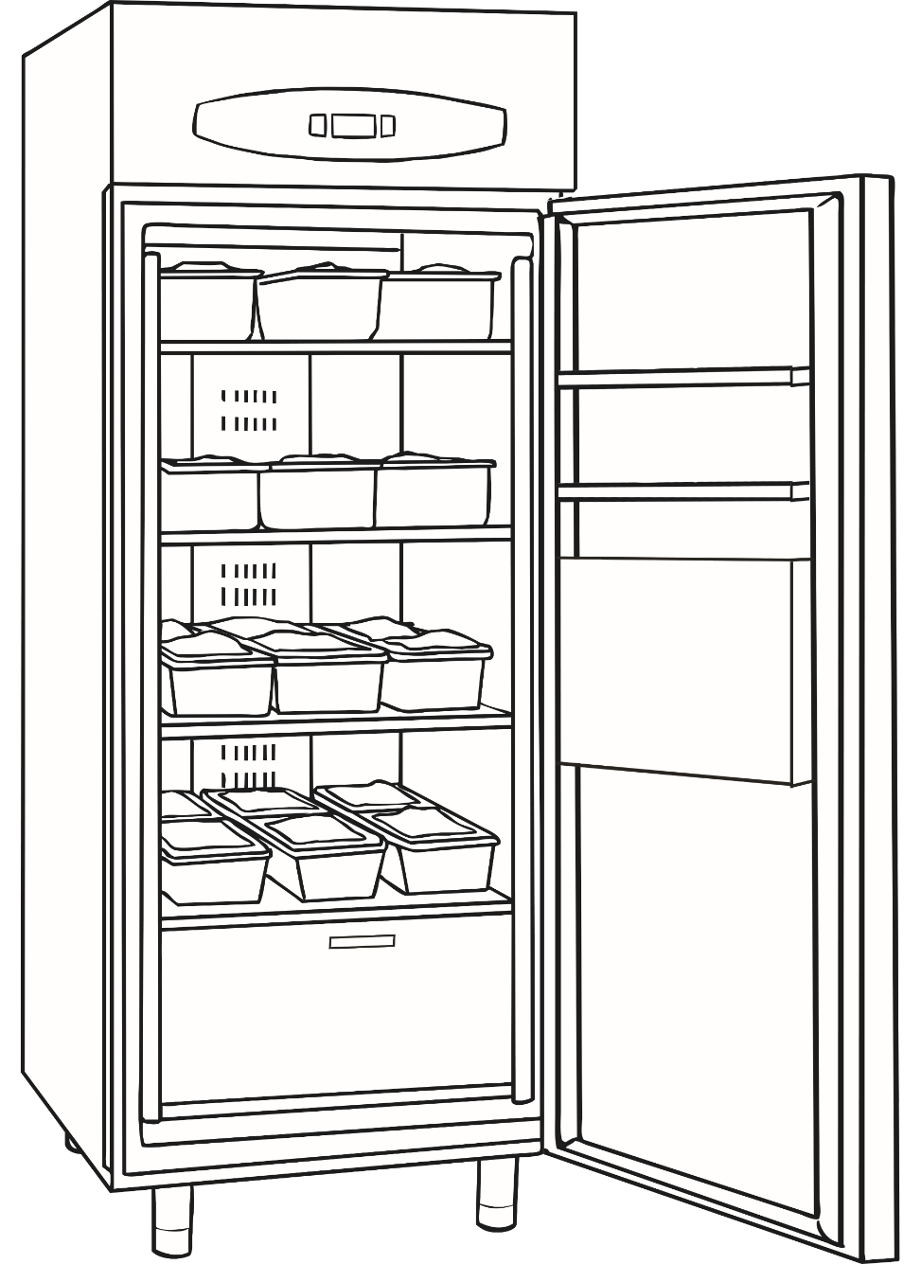
Where in the Fridge?
Which part of the fridge would the following items be stored?
6
cheese
raw chicken
milk
tomatoes
fruit juice
yoghurt
lettuce
apples
cooked meats
dips
sauces
ready meals
1
2
3
4
5

Slide 5

Where in the Fridge?
Which part of the fridge would the following items be stored?
1) Top shelf – moderately cold:
6
fruit juice, milk
How does this compare to the organisation of your fridge at home?
2/3) Middle shelves – coolest and cooler:
1
dips, cooked meats, ready meals
2
4) Bottom shelf – moderately cold:
What other items do you have in your fridge not listed here?
Where do they go?
3
raw chicken
4
5) Bottom drawer – warmer:
5
salad and fruits
6) Door storage:
dairy at the top, sauces towards the bottom

Slide 6
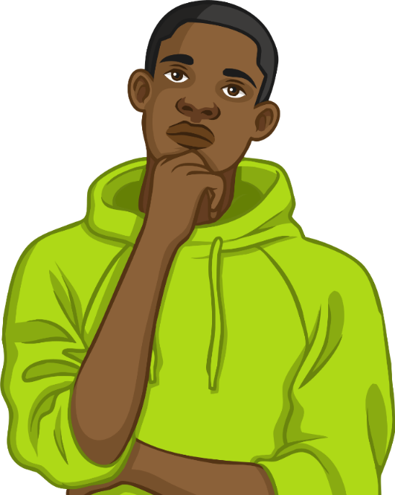
Sell By, Use By, or Best Before?
Shown on products with a short shelf life.
Given as a safety warning.
If used after this date – you are putting yourself at risk of food poisoning.
Shown on products with a longer shelf life. Given as a warning about quality.
If used after this date, it’s probably safe but may not taste as good.
Shown on perishable products.
Indicates the end of shelf life at the store.
Can usually be eaten after this date if it is still within its ‘use by’ date.

Slide 7
Sell By, Use By, or Best Before?
Sell by
Shown on perishable products.
Indicates the end of shelf life at the store.
Can usually be eaten after this date if it is still within its ‘use by’ date.
Use by
Shown on products with a short shelf life.
Given as a safety warning.
If used after this date – you are putting yourself at risk of food poisoning.
Best before
Shown on products with a longer shelf life. Given as a warning about quality.
If used after this date, it’s probably safe but may not taste as good.
Eggs have a best before date – would you still use them after this date?

Slide 8
Give Me 5…
5
rules to follow when storing food safely.
4
temperature ranges for storing food safely.
3
food products you would store in the drawer of the fridge.
2
dates you may find printed on a food product.
1
reason why it is important to store food safely.

