Slide 1
Year 7 Food and Nutrition
Pizza Project
Food Safety

Slide 2

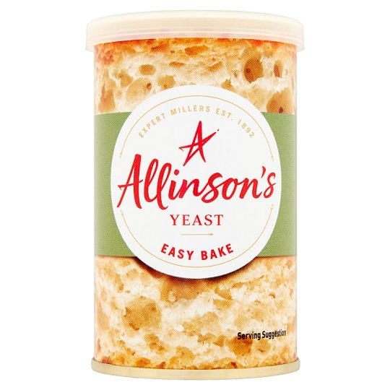
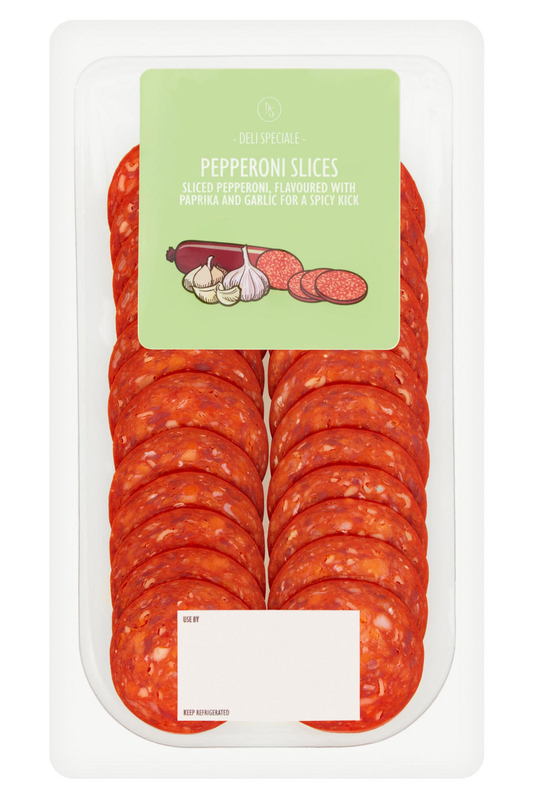
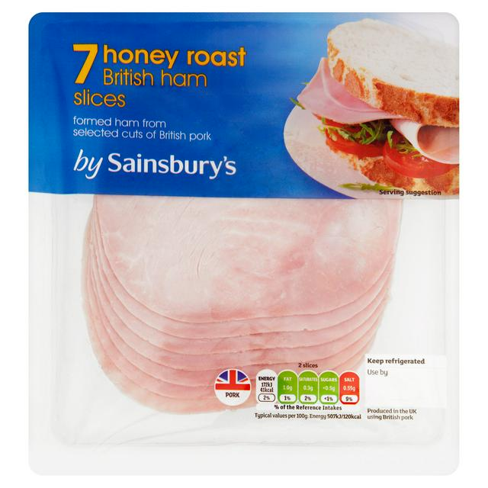
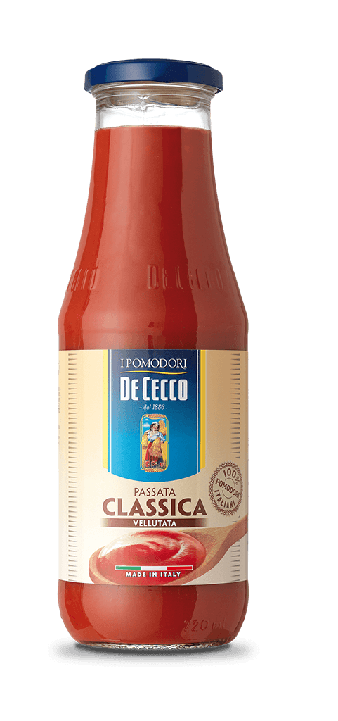
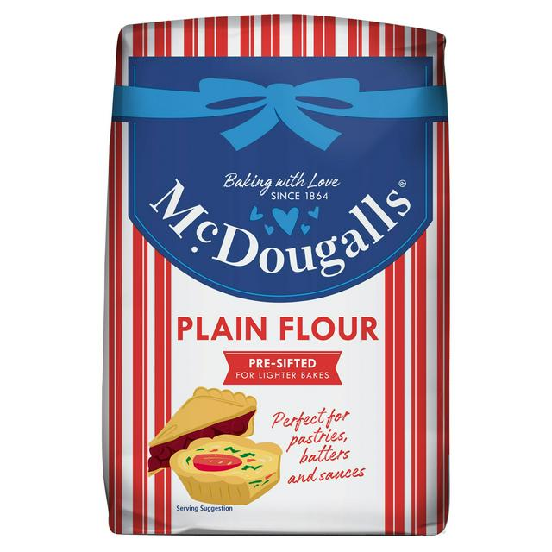

Where should these ingredients be stored?

Slide 3
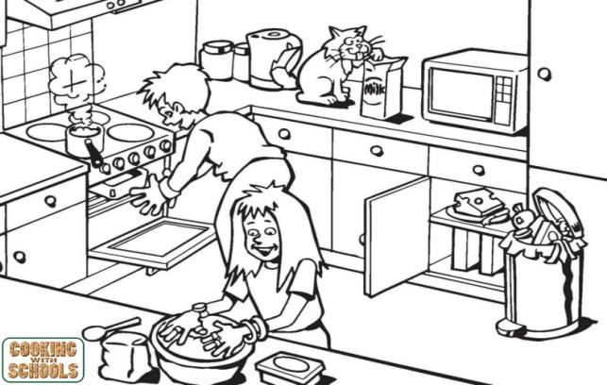
Task: To identify potential hazards in the kitchen and state how to be safe and hygienic in the food room.
Challenge: To analyse potential hazards in the food room and explain how to avoid them. To understand the importance of following health, safety and hygiene processes in the food room.

