Slide 1


Slide 2
Starter: 2 easy questions
What is free range?
If the food has the red tractor logo on it what does it mean?

Slide 3
Whilst watching the video, you will need to answer the questions in your booklet:
what does ‘food miles’ mean?
Where does the young girl get her lamb from?
Why does she think living close to the supermarket it good?
What are the four ways the farmer suggest you could reduce food miles?

Slide 4
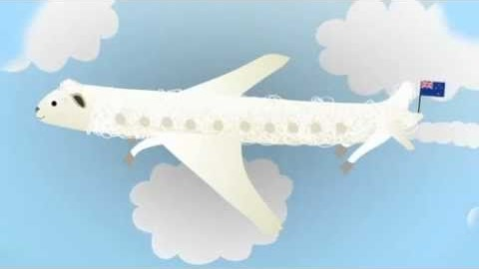

Slide 5
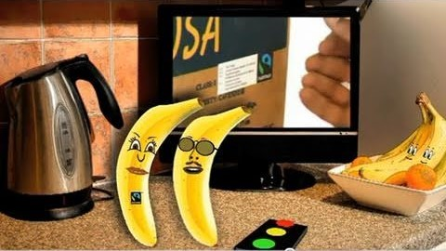
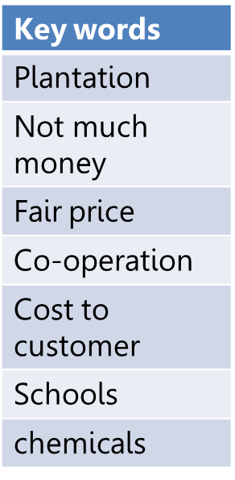
Task 2 Whilst watching the video – ‘tipping the balance’ make notes and list at least 5 facts about fair trade farming – use the key words to help you

Slide 6

Task 3 – what do you think the fairtrade logo looks like? Describe your ideas and say why you think the logo looks like this

Slide 7
Task 4 –fill in the blanks
Choose the correct words from the options given to complete the following sentences.
Million Ghana Clean Water Fair Hope Logo School
If a product has the Fairtrade _______________ on it, it means that farmers get a _______________ price for what they sell, plus a bit extra.
This ‘bit extra’ is called the Fairtrade Premium, and farmers can spend it on things like _______________ _______________, _______________ for their children, medicines or whatever they decide.
In _______________, Africa, farmers have used their Fairtrade premium for schools and clinics.
When interviewed, farmers in Ghana who are part of the Fairtrade scheme said that Fairtrade had given them _______________.
Over seven _______________ people in LEDC countries around the world are getting a better deal.

Slide 8
Task 4 –fill in the blanks
If a product has the Fairtrade ____Logo___________ on it, it means that farmers get a _________Fair______ price for what they sell, plus a bit extra.
This ‘bit extra’ is called the Fairtrade Premium, and farmers can spend it on things like _______Clean________ _______Water________, ______School_________ for their children, medicines or whatever they decide.
In _______Ghana________, Africa, farmers have used their Fairtrade premium for schools and clinics.
When interviewed, farmers in Ghana who are part of the Fairtrade scheme said that Fairtrade had given them _______Hope________.
Over seven _____Million__________ people in LEDC countries around the world are getting a better deal.

Slide 9


Do you agree with the statement ‘Fairtrade makes a difference’? Write down you ideas in your book.

