Slide 1

Year 8 Food Lesson 1

Slide 2






Task 1: An easy one to get you started:
Match the food issue with the logo
Rob wants to be sure the farm his eggs came from hens which were free to roam around
Alan wants to be sure he knows exactly where his meat came from
Sam wants to be sure the farm his animal came from had high welfare standards
Chris wants to be sure he doesn’t eat foods which were produced with the use of chemicals
Megan wants to be sure the producers of her food were given a fair wage
Mary wants to ensure she buys foods with few food miles.

Slide 3
Task 1: An easy one to get you started:
Match the food issue with the logo
Rob wants to be sure the farm his eggs came from hens which were free to roam around
Sam wants to be sure the farm his animal came from had high welfare standards
Chris wants to be sure he doesn’t eat foods which were produced with the use of chemicals
Mary wants to ensure she buys foods with few food miles.
Alan wants to be sure he knows exactly where his meat came from
Megan wants to be sure the producers of her food were given a fair wage

Slide 4

Task 2-
Have you ever seen these logos on food.
On the same piece of paper can you now list any foods you have seen the logo on

Slide 5


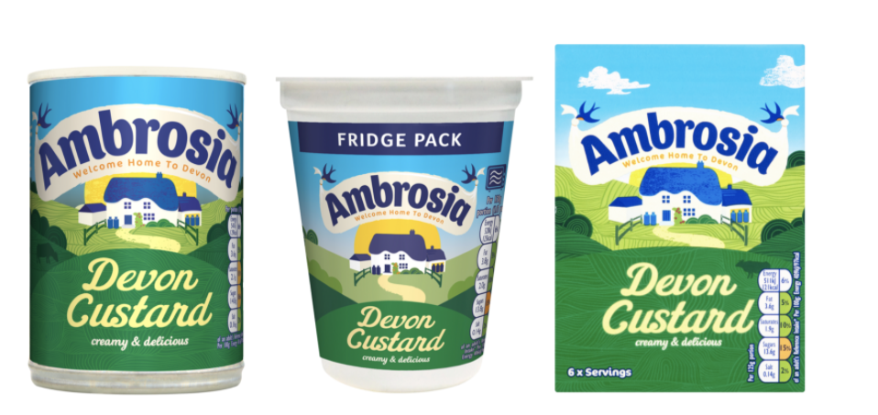
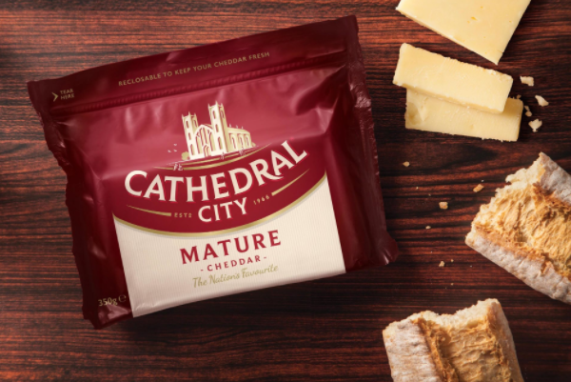

Slide 6
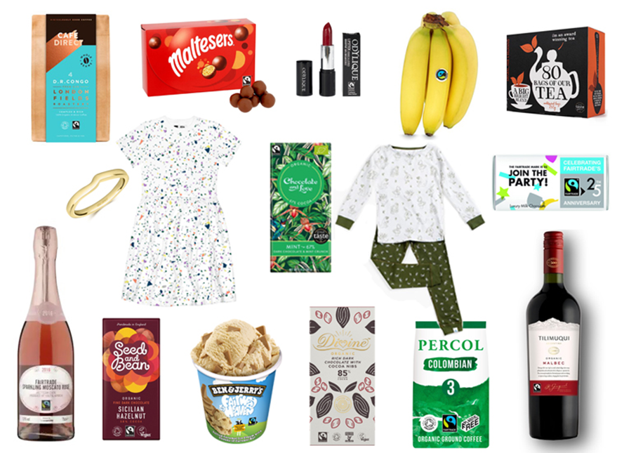

Fairtrade

Slide 7

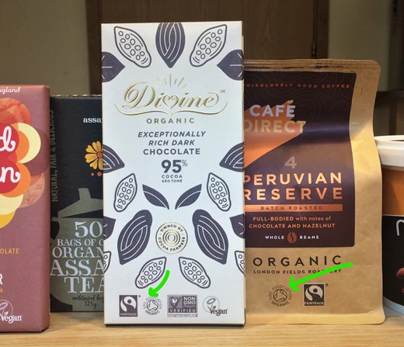

Slide 8
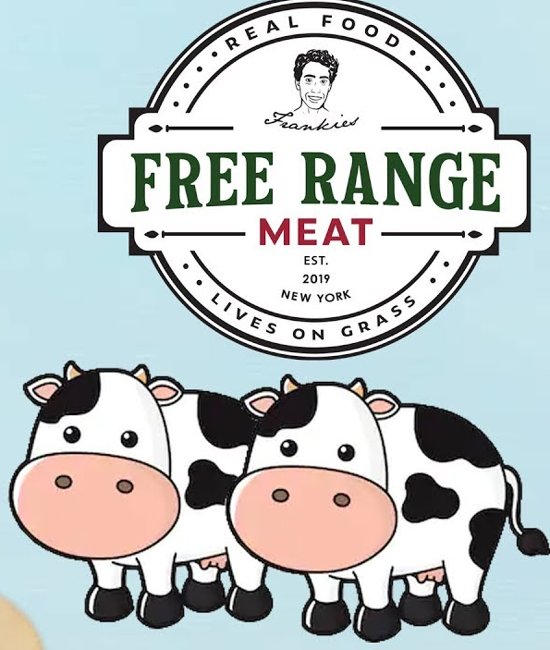
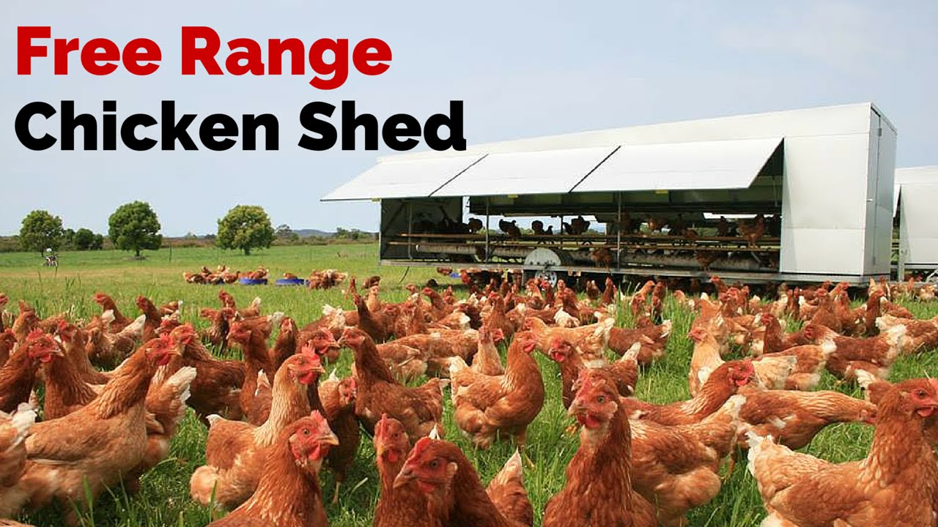
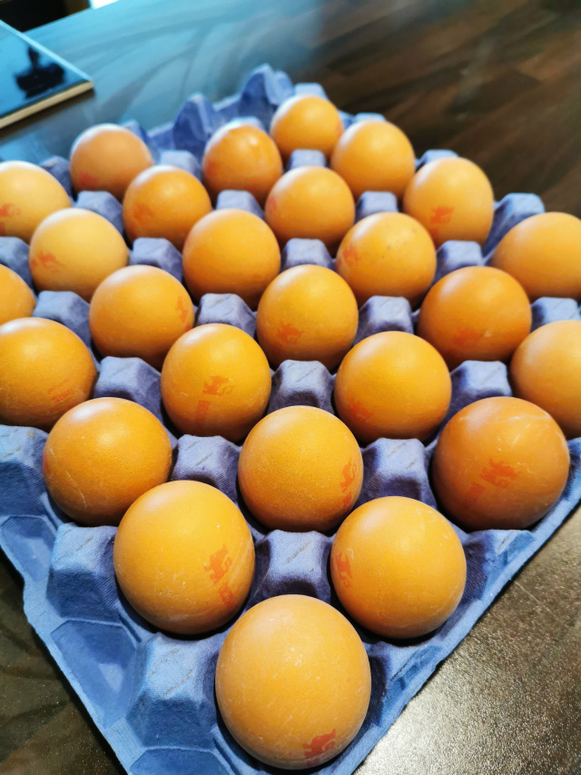



Slide 9


Lion Quality

Slide 10
Task 3
You are now going to watch 2 short video’s.
After each one you are going to write down 3 facts from that video.

Slide 11
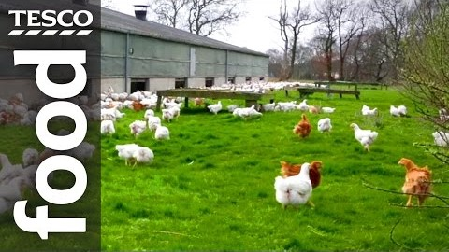
1. Free range
https://www.youtube.com/watch?v=dG26MoT-boU

Slide 12
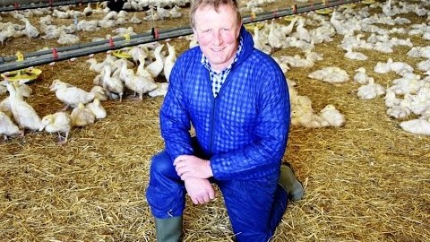
2. Red Tractor
https://www.youtube.com/watch?v=O6cRgXVI4H0

Slide 13
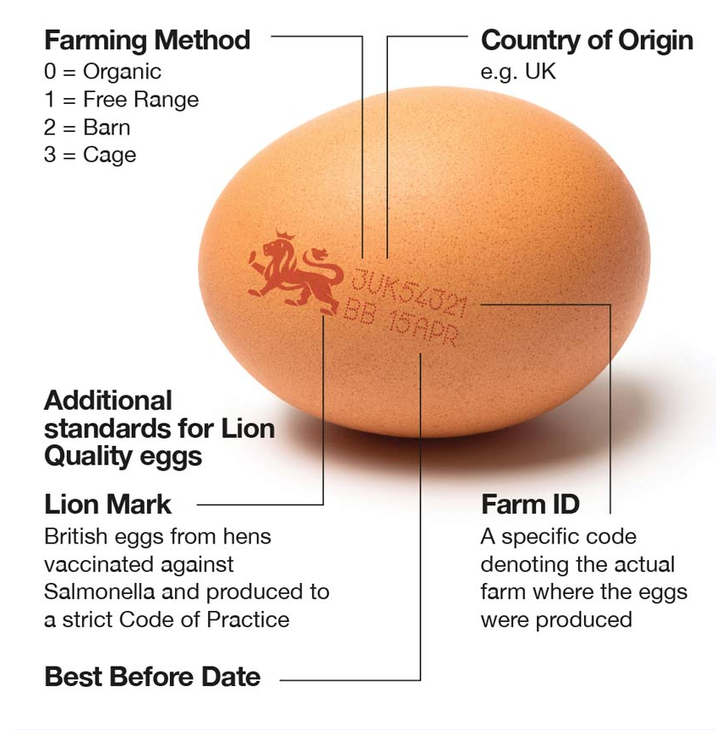
Task 4: a) draw an egg in the centre of your page b) on the egg write
3UK54321
BB 15 APR c) now using the diagram, explain what the letters mean

Slide 14

Task 5 – Design time
On the next page you will see a range of products that are fair trade.
Your job is to produce an advert for the radio which sells the product and explains fair trade at the same time.
You will need to write the script for the advert – its should last approx. 30 seconds.
You might want to add an advert that could go in a magazine too
You could also do it as a cartoon strip/ storyboard

Slide 15





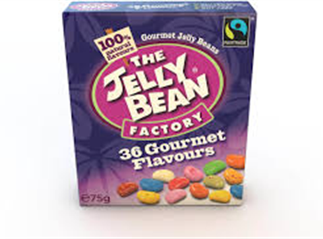

Slide 16
Extra Info
The Fairtrade premium is a sum of money paid on top of the agreed Fairtrade price for investment in social, environmental or economic development projects, decided upon democratically by producers within the farmers’ organisation or by workers on a plantation.
The premium is fixed by the FLO Standards Unit in the same way as the minimum price and remains the same, even if the producer is paid more than the minimum price for the product.
The premium fund is typically invested in education and healthcare, farm improvements to increase yield and quality, or processing facilities to increase income.
Key words
Fair Trade
Fair Trade Premium
Wages
Workers
Consumers
Profit
Co-operatives

Slide 17


Draw Your Brain
Draw your brain - fill it with everything you have learnt (knowledge and skills) during last lesson.

