Slide 1
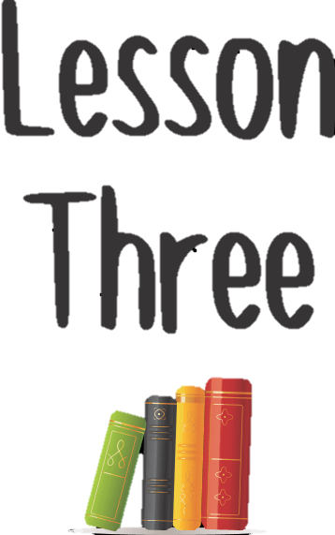

Slide 2



Name these logo’s.

Slide 3
Todays date In your book.
Title
Vegetarianism

Slide 4

Task 1
Produce a list or mind map in your book about everything you know about vegetarians.
Are there different sorts?
What do they eat?
What do they not eat?

Slide 5
Task 2
After class discussion
Write down definition for the following types of vegetarians
Demi vegetarian
Lacto ovo vegetarian
Vegan
Think about what they eat and don’t eat

Slide 6
Demi Vegetarian
a person who eats poultry and fish, but no red meat
Lacto Ovo Vegetarian
a vegetarian whose diet includes dairy produce and eggs
Vegan
Someone who is vegan never eats meat or any animal products such as milk, butter, or cheese.

Slide 7
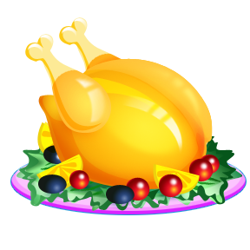
TASK 3
Draw circles around the pictures of the foods that you think lacto ovo vegetarians can eat and drink.
Then in another colour draw around the foods that a vegan would eat and drink
And finally in another colour draw around the foods that a demi vegetarian would eat and drink.

Slide 8

Task 4 – Vegetarian research
CREATE A FACT SHEET ON VEGETARIANISM
You can include some images
You must include at least 10 facts from a range of sources
You must include information on:
Vegans
Demi vegetarians
Lacto ovo vegetarians
What they eat/ what they don’t eat
Reasons for being vegetarian
EXTENSION: Discuss how vegetarians nutritional needs are different to meat eater

Slide 9
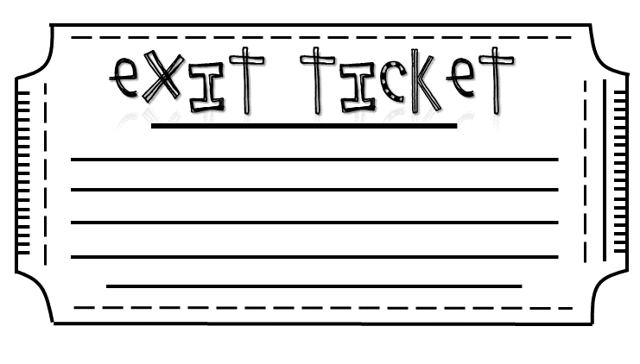
Do you think you could become a vegan? Explain your answer

