Slide 1
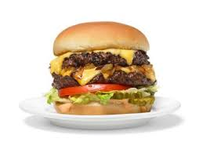
Build A Burger
Week 1

Slide 2
The first hamburger was sold in America in the 1890s. No one can agree on who created it, though many lay claim to the title. Burgers are a popular quick service meal, with consumers wanting high quality burgers made with fresh ingredients, sourced from quality assured farms, available all year round.

Slide 3
Build a Burger
For this project, you will be designing a gourmet burger
We will be looking at a number of food related issues as we build your burger
You will be making your burger at home, either digitally, or in the kitchen

Slide 4
Food Provenance

Slide 5
Food provenance
Food provenance means knowing all about where your food comes from and how it has been grown or reared, harvested, caught or slaughtered and finally prepared. The above poster outlines traditional foods produced around the country, some of which have protected status.
When buying the beef and lamb for your burgers, take a moment to think about where the meat has come from. Are there any logos on the packaging? If so, what do they mean?
In order that you can make an informed choice next time you go shopping, find out more about the following quality assurance schemes:

Slide 6



Slide 7
Posh nosh!

Slide 8
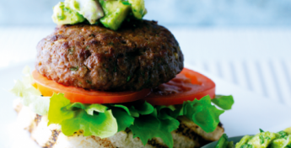
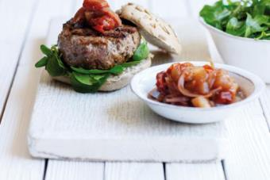
The challenge
You will need to create a premium or luxury burger.

Slide 9
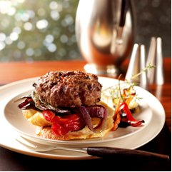
What makes a premium product?
In pairs, write down three things that make a premium product.
Did you include?
High quality ingredients.
Food provenance and quality assurance – knowing where your food comes from.
A variety of burger ingredients, breads, toppings and sides.
Good quality control – well made, shaped and cooked to perfection!

Slide 10
Food provenance
Quality assurance schemes are used by the red meat industry to assure consumers that the meat they buy is traceable, safe to eat and produced responsibly.

Slide 11
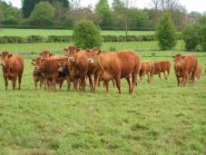
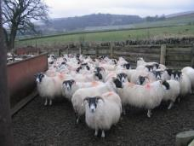
Food provenance
Task:
Research The Red Tractor and Quality Standard Beef & Lamb assurance schemes.
Why do you think that manufacturers of premium products might choose to use meat produced following these assurance schemes?

Slide 12
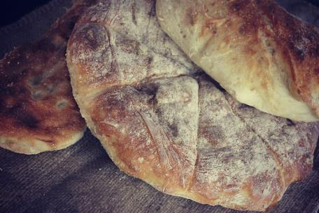
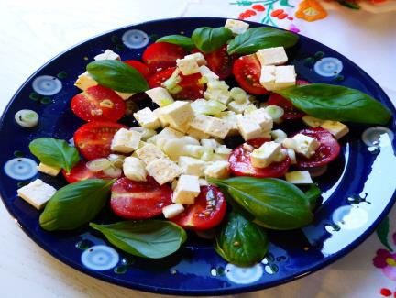

Inspiration

Slide 13
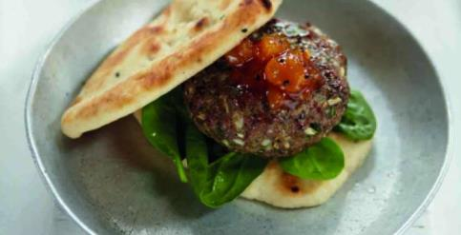
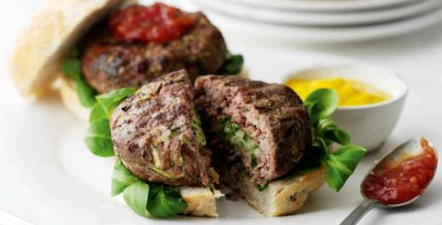
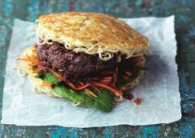
Inspiration

Slide 14
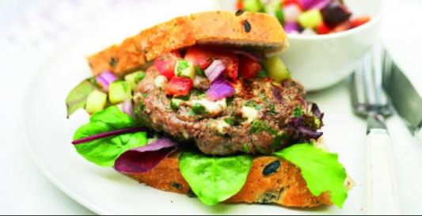
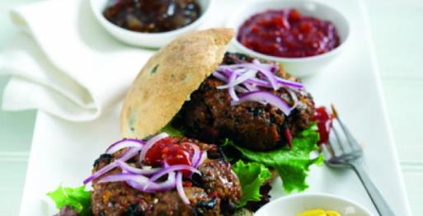
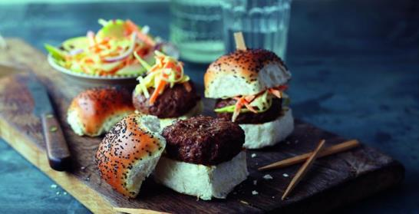
Inspiration

Slide 15
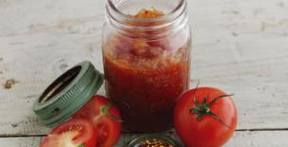
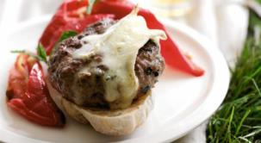
What’s on the side?
Breads, toppings and sides all make a premium product really special.
What will you serve with your burger?
Explore the different types of sides that could be added to your premium burger.
Think about appearance, textures and flavours!

Slide 16
Food and Nutrition: Build a Burger
Burger Design
Date:
______________________________________________________________________________________________________________________________________________________________________________________________________________________________________________________

