Slide 1
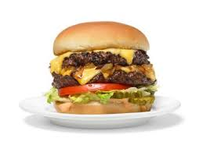
Build A Burger
Week 2

Slide 2
Recipe modification

Slide 3
Recipe modification challenge
Task 1
Review the Gourmet Burger recipe below. You must create 3 recipes to improve the nutritional content:
  total Fat content
  amount of Fibre
  amount of Vitamin C
Extra Challenge
Explain the importance of reducing fat intake or increasing fibre in the diet or the function of Vitamin C in the body.
Success Criteria
Ingredients
Burger ingredients
250g beef mince
20g onion
1 x 5ml spoon (1tsp) fresh garlic
50g hard cheese, e.g. Cheddar
1 x 15ml spoon (1tbsp) green pesto from a jar
Bread and toppings ingredients per burger
1 white bun
1 pineapple ring
1 x 15ml spoon (1tbsp) mayonnaise
Allergens
Milk, Cashew nuts, Egg, Wheat, Soya
One chilli…
Swapping one or two ingredients for each modification
Two chillis…
Substituting a number of ingredients, with justifications
Three chillis…
Three new recipes,

Slide 4
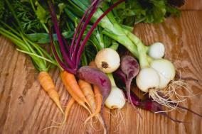

The challenge
Create a burger with fruit and vegetables to add colour, flavour and texture.

Slide 5
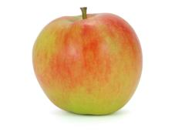
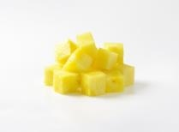
Why add fruit and vegetables?
Adding fruit and vegetables to a burger can provide:
Texture – crisp and crunchy celery
Colour – grated red apple with the skin left on
Flavour – fiery chillies
Aroma – sweet pineapple chunks.

Slide 6
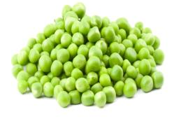
Why add fruit and vegetables?
Fruit and vegetables can also enhance the nutritional content of your burgers:
Fibre
Fibre is found in fruit and vegetables. Fibre can reduce your risk of heart disease, diabetes and some cancers, and also help with weight control. Fibre also helps to maintain a healthy gut.

Slide 7
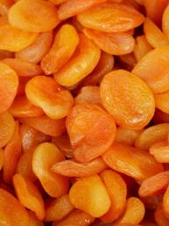
Why add fruit and vegetables?
Vitamins
Fruit and vegetables provide:
Vitamin C, which is important for maintaining healthy body tissues
Vitamin A for the maintenance of normal vision, skin and the immune system.

Slide 8
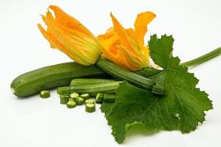
Why add fruit and vegetables?
Minerals
Fruit and vegetables provide:
Folate, which is needed for the formation of healthy red blood cells and for the nervous system
Potassium, which helps maintain a healthy blood pressure and is also involved in the normal functioning of the nervous system
Magnesium, which helps maintain normal bones and teeth.

Slide 9
Fat
Watch the videos to explain the nutritional importance of the following:
Fibre
Vitamin C

Slide 10
Food and Nutrition: Build a Burger
Recipe Modifications
Date:
total Fat content​
amount of Fibre​
amount of Vitamin C
Ingredients
Burger ingredients
250g beef mince
20g onion
1 x 5ml spoon (1tsp) fresh garlic
50g hard cheese, e.g. Cheddar
1 x 15ml spoon (1tbsp) green pesto from a jar
Bread and toppings ingredients per burger
1 white bun
1 pineapple ring
1 x 15ml spoon (1tbsp) mayonnaise
Allergens
Milk, Cashew nuts, Egg, Wheat, Soya
____________________________
____________________________
____________________________
____________________________
____________________________
____________________________
____________________________

