Slide 1
Monsters
Sustainability

Slide 2

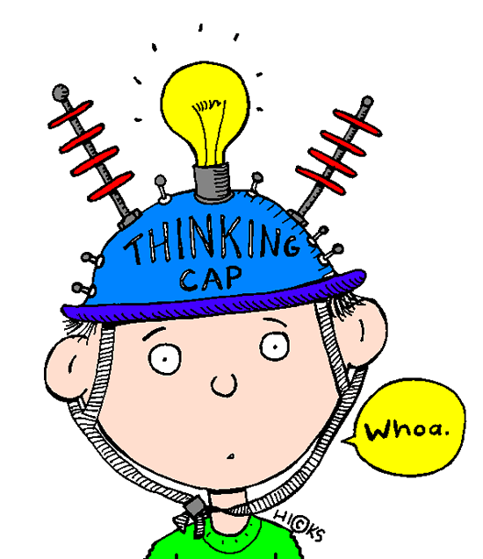
Introduction To Project
Learning Objectives
What is Sustainability?
Understanding how as designers we can be more environmentally responsible
Success Criteria
Identifying the 6 R’s
Explain how we can be more sustainable as designers and consumers
Extension work
Create an information sheet explaining the importance of the 6 R’s

Slide 3
Introduction to the Project
Living a sustainable lifestyle is becoming increasingly important for both consumers and manufacturers. As a result of this, items made from recycled materials are growing in popularity.
A local shop is launching a range of monsters made from recycled materials and have asked you as a group to design and make one each for their collection. As the pieces are made from recycled materials, each will be a one-off piece.

Slide 4
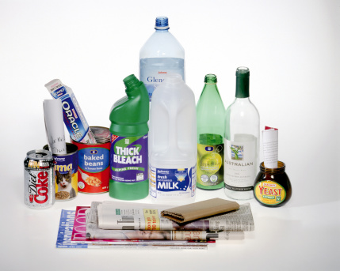
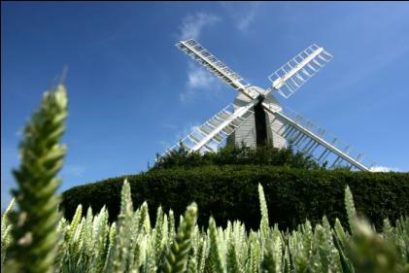

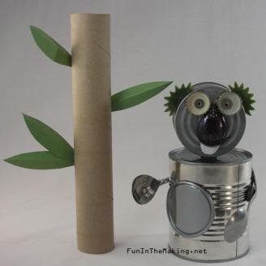
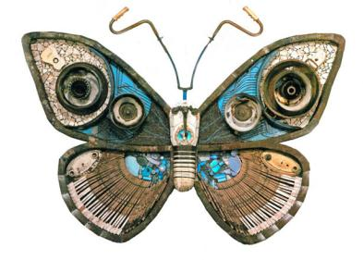



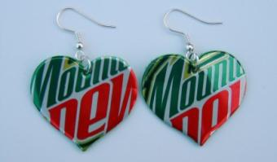
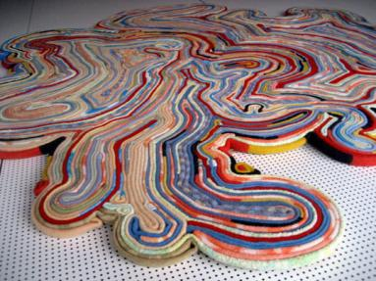
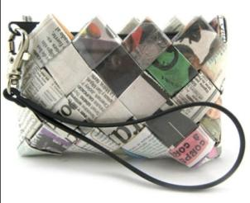
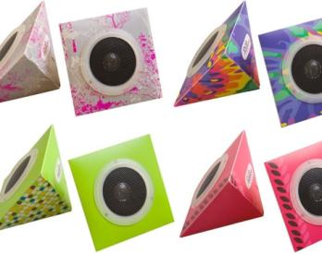
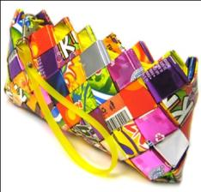
SUSTAINABILITY

Slide 5
The 6 R’s
https://www.youtube.com/watch?v=luE5Aeqjf1Q

Slide 6
Sustainability – The 6 R’s
Refuse
Reuse
Don’t use a material or buy a product if you think you don’t need it or if it’s unsustainable.
Take an existing product that’s become waste, and use the material or parts for another purpose, without reprocessing it.
Reduce
Recycle
Minimize the amount of material and energy you use.
Take an existing product that’s become waste, and reprocess the material to use in a new product.
Repair
Rethink
When a product breaks down or doesn’t function properly, try to fix it.
Ask whether we can sustain our current way of life and the way we design and make.

Slide 7
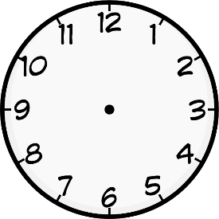
Task:
Create an information sheet explaining the 6 R’s
Your page should be a mixture of text and images
Consider the presentation of your page as well as the content
Success Criteria
One chilli…
I can identify the 6 R’s
Two chillis…
I can explain why the 6 R’s are important as a designer and consumer
Three chillis…
I can suggest ways that I can be more environmentally friendly when designing and buying things
20 minutes

